Slide 1
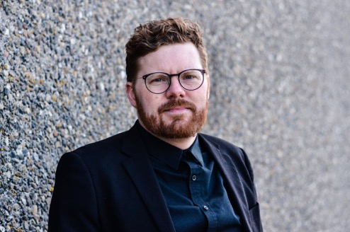


Rasmus Frey
 rasmus@os2.eu
 +45 31 15 45 25
 rasmusfrey
Public Collaboration
Open Source
Notes:
Hi my name is Rasmus Frey – I’m the chief of operations and secretary in OS2 which is a Danish association for public authorities whishing to collaborate using the open source model.

Slide 2

Why should you listen to me?
You will learn how Danish Municipalities buy and use
open source on a practical level
Photo by Math on Unsplash
Notes:
In my talk today will tell you a about how we with OS2 approach procurement of open source in Danish Municipalities.
I will begin by giving you some context on what OS2 is and what the purpose of OS2 is.
Then I will talk about the most important aspects when purchasing open source and to put this in context I will say a bit about the challenges we need to address.

Slide 3

3 + 4 = 98
When 3 municipalities develop a solution and
the next 4 improve it – It benefits all 98*
*There are 98 municipalities in Denmark
Photo by Kelly Sikkema on Unsplash
Notes:
So – OS2 is an association for public authorities. We are founded by 5 municipalities 10 years ago and today nearly all 98 Danish municipalities are members.
OS2 is just one brick in the puzzle when it comes to digitalization in Denmark – But if you ask me an important one - Because our focus is that municipalities and other public authorities don’t reinvent the wheel every time a new shared business need that can be solved using a digital solution is identified.
It makes sense to ensure that we get the most value for tax payers money when digitizing our services and workplaces.

Slide 4

Danish Municipalities Want
Coherent IT-solutions
To build for reuse and change
Data as a value-adding resource
Trust and Security
Multiple Vendors
Notes:
We don’t do this because open source is the solution to all our problems. We do it because the Danish municipalities want to best implementation of technology they can get – and because open source is a great means to achieve certain goals.
For example we want to make sure that it is not complexity that prevent change and development – therefor we want to build for reuse and change.
And it is very important that we don’t create vendor lock-ins. Technology must not be the barrier that prevent changing vendor or involving more than one.
I think we can agree that open source is a great driver to achieve the goals I mentioned and the other goals on the list.

Slide 5
Comply
Contribute
Release
Procure
Notes:
So with open source we have opportunities that we can use to our advantage – but we also put ourself in another position in the regards to procurement and in regards of making the most of the advantages open source give us.
There are things we must be aware of when buying open source development or open source standard software. We no longer buy a piece of software owned by a single company. We buy software maintained by a community or we buy software that we ourself become the maintainer of.
It’s important that we are in a position where we know with what to comply and when to comply.
It’s important that it is clear how we can and how we will contribute. We must make sure that everyone work on the same core code and that people are actually contributing in a meaningful way and add value to the project, the community and our own business.
This all begin with procurement – it’s very important that we get started the right way and know why we want open source and how we get it.

Slide 6

OS2 is here to
ensure a governance framework that enable technical exchange and sharing of knowledge in the Danish public sector.
Photo by Tim Mossholder on Unsplash
Notes:
Which is also why OS2 exist – there is no need for each Danish municipality becoming experts. We can compare OS2 to an OSPO – Essentially we are the Open Source Program Office for Danish municipalities.
The place where we make sure to gather knowledge about open source and where we maintain the governance framework needed for Danish public authorities to be able to Procure – Comply – Contribute and Release within the open source model.

Slide 7

Challenges
Not invented here
Culture – Myths about Open Source
Higher degree of involvement needed - a different kind of involvement
Legal
Non-functional requirements
Photo by Jukan Tateisi on Unsplash
Notes:
So some of the challenges often presented to us may sound banal – But it’s often what the public servant wishing to make a difference is met with.
The procurement process start early and it’s always because there is a need a challenge that must be solved. So before you can even being procuring for open source there must be leadership backing. Most of the challenges we identify are related to just getting to the point where the organisation choose to go with open source.
We as OS2 must make sure that there are as few barriers as possible in the pre-procurement and procurement process. So some of these are:
Not invented here – It’s often a harder sell because of the concept not invented here! It’s easy to reject something saying it’s not the right fit
Culture – Many organisations still have certain biased opinions on open source – I think most of you know what these are.
Involvement – With open source it’s part of the eco-system, part of the sustainability that you are able to contribute. If it’s a project you create, you yourself must define the playbook – If it’s an existing project you must be able to comply with the existing.
Legal – Then there legal - Some will tell you that we can’t buy Open Source or that we can’t release something we have developed ourself as a public authority.
Non-functional requirements – The last challenge is setting the right non-functional requirements. These are important and they must take into account the specifics about open source which I will get back to later.

Slide 8

How we do it in OS2
Our aim is to maintain a low barrier making it easy to buy and use open source in a Danish Municipality.
Photo by Zulian Firmansyah on Unsplash
Notes:
With OS2 we have a central place for knowledge about open source in the Danish public sector – our primary focus is to lower the barriers when it comes to the before mentioned challenges and when it comes to establishing governance and sustainable collaborations around open source projects within the public sector. This of course starts with being able to buy open source software and services.
In the following I will go through some of the important things we do.

Slide 9

Communication
We make sure to tell all the great stories
Photo by Patrick Fore on Unsplash
Notes:
First of all we do a lot of communicating – We need to tell people about open source and make those myths disappear and put a bit of pressure on culture.
I say this because if we don’t – Open source procurement will never happen.

Slide 10

The Open Source note
Photo by Tingey Injury Law Firm on Unsplash
Notes:
Then we make sure we have the needed documentation to get legal on our side in choosing open source.
Kammeradvokaten – The primary attorneys to the Danish state have on OS2s behalf published what we call the open source note. First of all it concludes that what we do is within the law and any legal worker presented to it should at least become aware that there is something they might need to study and then be more open to saying yes.

Slide 11
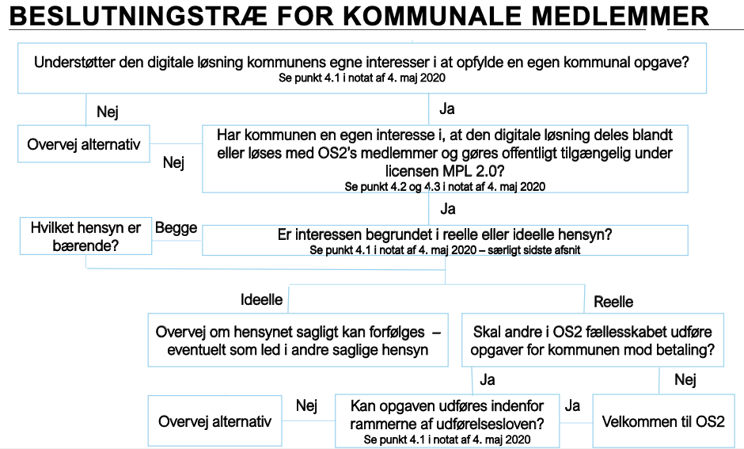
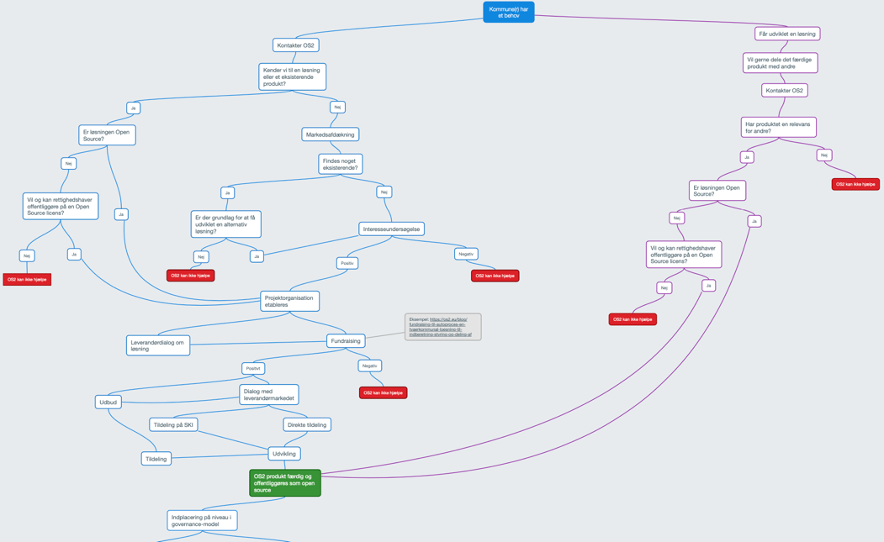
Decision tree
Notes:
A part of the open source note is our decision tree that is used to conclude if the project can legally be solved within the OS2 framework.
It’s a set of simple questions related to Danish law that in most cases will end up with a: Welcome to OS2
If the conclusion is OS2 we have a bigger decision tree to figure what type of project is it and if it is a fit with OS2s purpose and and fit with the OS2 governance model.
If we don’t end up in OS2 it’s because we don’t solve a shared and common problem or the preferred solutions is not open source and can’t be made open source.

Slide 12

Getting help from professionals
A typical Danish municipality don’t have many
technical skilled people on staff.
Photo by Matthew Waring on Unsplash
Notes:
Next step is being able to get help from professionals
In OS2 we have a list of private it-companies that have signed our partner-agreement. Meaning they are willing and able to hand over all results created in the partnership.
It’s an important part of our procurement process that vendors are pre-screened and that we know they will release results as open source and they will comply with OS2s code of conduct.

Slide 13
Non-functional requirements
Digital tool – OS2kravmotor (requirements engine)
Guides you through a simple set of basic questions
Result is a list of recommended non-functional requirements
  From a pool of 79 different requirements
Notes:
Then we have those non-functional requirements – An important part of any procurement but in our case we have some extra ones.
Do you for example require that the vendor contribute back to the project.
How will the vendor comply with the OS license.
What are the vendors process for handling security updates.
How do they handle contributions from other members of the community.
In OS2 we have the project OS2kravmotor – in English the requirements engine.
The solution guide you through a set of questions to determine what kind of project you are about to purchase
Then you are presented with a list of recommended non-functional requirements.
The engine can also be used to procure proprietary software – The requirements database and the questions asked are configurable.
A great tool helping you to not forget and making sure the requirements are formulated in the same way over time.

Slide 14
The quality of an Open Source product is reflected by the community behind it.
Notes:
Next steps are to evaluate the quality of the open source project or set the bar for your own project.
Just because it’s open source it does not mean it’s great or sustainable and long lasting.

Slide 15

Governance report
3 levels with minimum requirements for:
Relevance
Formal requirements
Governance
Strategic context
OS2’s Governance report:
https://github.com/OS2offdig/Governance_Reports
Photo by Max Ostrozhinskiy on Unsplash
Notes:
In OS2 we group projects into three levels based on minimum requirements.
We have a simple checklist with questions forcing you to think about how certain things are addressed or how we want them to be addressed if it’s a new development project.
We call this our governance report.

Slide 16
Board
Program Committees
Secretary / Operations
Other Stakeholders
Products &
Projects
Suppliers / Vendors
Steering committee
Coordination group
Professional groups
The users
Notes:
Another thing we do is establish a formal organisation around each product or project placed in OS2. It’s an important part because the working groups within each product-community are the drivers.
OS2 and the secretary function is only there to support them in procurement and afterwards in collaborating and using the open source solution.
The community is the most important part of the open source project – without it nothing happens so we see this as critical to investing in open source and therefor we focus on establishing these sub communities as part of the procurement and around each of the projects placed in OS2.

Slide 17
It’s a success when we have
a common goal / a shared purpose
a good framework
  OS license
  Guides / Templates
  Code of conduct
  Governance
  Principles (community, code, it-architecture)
  Toolbox
a plan for own participation and contributions to the community
Notes:
So – It’s a success when we have a need that we share with someone else.
We also need a good framework that help us achieve our goals and make it easy to do it the open source way.
It’s also a good idea to consider how we want to participate and contribute to the community or how we would like others to do.
Then there’s everything else and we are set for open source in the public sector!
It’s actually not that hard and not that different from buying any other form of software.

Slide 18
Questions ?
Also hit me on rasmus@os2.eu
Or find me on LinkedIn as Rasmus Frey
Notes:
Time for questions.

