Slide 1
23
May
2022
Open Source Software Procurement
Digital Europe Programme
Patrice-Emmanuel Schmitz Legal support

Slide 2
OSS fits public procurement
Why?
Transparency: open source software is available along with its source code.
Interoperability: whether implemented in open source software, open standards ensure interoperability, the ability of systems from different vendors to function fully with each other without technical or legal obstacles.
Independence: transparency and interoperability allow current and future vendors to work with, adapt and maintain the software, eliminating the dependence of purchasers or third party support and service providers on the vendors of the original version of the software.
Flexibility: open source software allows systems to be adapted and extended as user needs evolve. It does this without requiring that the user go back to the original vendor - new suppliers can be selected on a competitive basis.
Sustainability
lower costs over the longer term
reduces the users' reliance on the original vendors (or “locking”)

Slide 3
EIF (2017)
Recommendations
Decisions?
Procurement (Recommendation 3):
Ensure a level playing field for open source software and demonstrate active and fair consideration of using open source software, taking into account the total cost of ownership of the solution.
Sharing and Reuse (Recommendation 6):
Reuse and share solutions, and cooperate in the development of joint solutions when implementing European public services.
COMMISSION DECISION of 8.12.2021 on the open source licensing and reuse of Commission software
C(2021) 8759
The Commission services may choose to make Commission software available for reuse…
Such software shall be licensed under an open source licence
The open source licence granted by the Commission shall be the EUPL (with possible exceptions due to third party obligations or copyleft provisions)

Slide 4
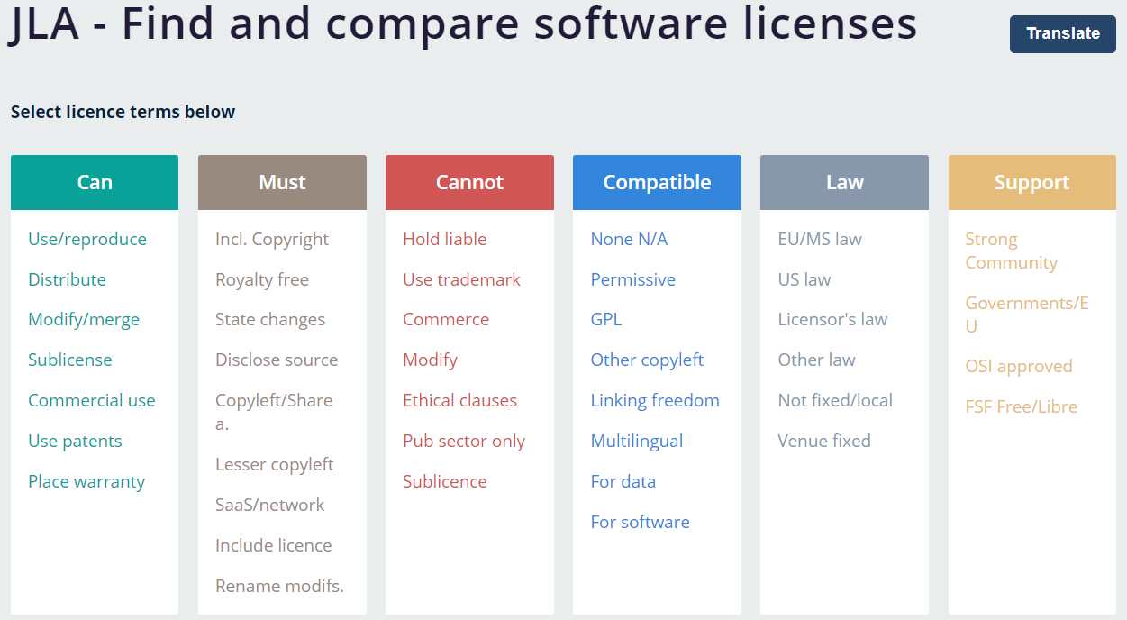
Joinup tools
Joinup licensing assistant
Joinup proposes a new solution: the JLA, a unique tool allowing everyone to compare and select open licences based on their content.
Joinup licensing compability checker
The objective of this functionality is to determine how far and on which licences a work using/combining data or software components licensed under different licences can be distributed and under which licence(s).

Slide 5
Off-the-shelf or custom-built?
Historically (2006) packaged software in European software spending is only 19%. Much more is spent on custom- built software (52%) and internal software development (29%).
In the public sector, a lot of software is custom-built, or developed in-house. Public sector information system is not a domain with a large private-sector market.
About 10% of local public authorities in the EU had or were in a position to release software they owned (custom-built or developed in-house) as open source.
Joint software procurement still has to be promoted.

Slide 6
Off-the-shelf?
Fonctionnalité | Logiciel
Gestion des mots de passe | KeePass
Compression | 7-zip
Suite bureautique | LibreOffice
Éditeur de texte | Notepad++
Lecture et modification de fichiers PDF | Sumatra PDFMuPDF
Système d'information géographique | QGIS
Publication (PAO) | Scribus
Dessin (matriciel) | Gimp
Dessin (vectoriel) | InkScape
Courrielleur | Thunderbird
Client de messagerie instantanée | Jitsi
Microblog | Mastodon
Client FTP | Filezilla
Navigateur web | Firefox ESR
Moteur de recherche | Qwant
Grapheur d'idées | Freeplane
Gestion de projet | RedmineProjectLibre ProjeQtOr [archive]
Wiki | MediaWiki
Lecteur multimédia | VLC
Régie vidéo enregistrement et/ou streaming | Open Broadcaster Software
Capture d'écran photo | Greenshot
Montage vidéo | OpenShot Video EditorAvidemux
Webconférence à usage pédagogique | BigBlueButtonJitsi
Datavisualisation | Apache Superset
Visualisation d'arborescence | Archifiltre
Éditeur HTML | BlueGriffon
Antivirus (orienté serveur) | ClamAV
Créateur menus pour DVD | DVD Styler [archive]
Forum | Discourse
Schémas | Draw.io Desktop [archive]
Sondage pour dates | Framadate
Synchronisation et sauvegarde de fichiers | FreeFileSync
Édition d'OpenStreetMap | JOSM
Scan de documents | NAPS2 [archive]
Modification de fichiers pdf | PDFSam Basic
Messagerie instantanée | RocketChat [archive]
Case study on France
The « socle interministériel de logiciels libres (SILL) » is a catalogue of Open Source software
As from 2013 (updated in 2021), the SILL includes 227 software. For 165 software, the SILL is a « recommandation ».
For 49 software, the SILL reports a simple mention (« observation »).
The CRPA limits procurement licences:
Permissives: MIT, BSD or APACHE
Reciprocal: EUPL, CeCILL, GPL, LGPL, MPL, EPL

Slide 7
Custom-built software
Procurement must be based on:
Definition of IT architecture (the European Interoperability Framework provides a high- level structure for many aspects of an IT architecture).
Functional and technical definition of requirements (no vendor- or brand- based terms)
Definitions of required open standards when applicable
Complete and “long term” costs estimation:
Isolated migration costs when imposed by the old system
Development and implementation costs
Operational and maintenance costs
Exit costs

Slide 8
The case of “free downloading”
Convenient for Study, test and evaluation purpose.
Do not miss other evaluation steps:
Functional (comparisons)
Legal (impact of licensing – EUPL compatibility ?)
Evaluation of language, repositories, support, maturity, reliability
Sustainability for long term support - by the service provider (minimum turnover, capital) and by the size and quality of the developer’s community
Downloading software free of charge | Purchasing software
Large emphasis on market research | Large emphasis on specification
Knowledge to search for the appropriate software to acquire (download) is required by the agency | Bidders provide some of the knowledge, though preparing the tender specifications may also require considerable knowledge
Services must be tendered separately | Software and services can be included in the same tender

Slide 9
Perspectives
It may be too late for trying to replace all proprietary « best sellers » (such as Windows/Office on PCs) or dominant proprietary services (GAFAM).
There are successful Open Source wins (LINUX on servers, Internet, Drupal, etc. ).
Open Source becomes the norm for public sector assets sharing and reuse.
Going beyond « recommendations » concerning Open Source in procurement or mandating a portfolio of Open Source Solutions is difficult.
Alternatives:
Regulating the « reality » (equal treatment and transparency in procurement, open competition, use of open standards, personal data protection, Digital Services Act)
Investing on next generation open standards + legal interoperability tools (data algorithms, blockchain, New computing tech., EU common licensing/sharing tools)
Use joint procurement for developing new common public sector tools (i.e. health)

Slide 10
Questions?

Slide 12
@Joinup_eu
Joinup Community
Contact us
joinup.ec.europa.eu

Slide 13
The views expressed in this presentation are purely those of the author and may not, in any circumstances, be interpreted as stating an official position of the European Commission. The European Commission does not guarantee the accuracy of the information included in this document, nor does it accept any responsibility for any use thereof.
© European Union 2020
Unless otherwise noted the reuse of this presentation is authorised under the CC BY 4.0 license. For any use or reproduction of elements that are not owned by the EU, permission may need to be sought directly from the respective right holders.
Notes:
Update/add/delete parts of the copy right notice where appropriate.
More information: https://myintracomm.ec.europa.eu/corp/intellectual-property/Documents/2019_Reuse-guidelines%28CC-BY%29.pdf

