Slide 1
Linked Open Data
Principles,
Technologies and Examples
PwC firms help organisations and individuals create the value they’re looking for. We’re a network of firms in 158 countries with close to 180,000 people who are committed to delivering quality in assurance, tax and advisory services. Tell us what matters to you and find out more by visiting us at www.pwc.com.
PwC refers to the PwC network and/or one or more of its member firms, each of which is a separate legal entity. Please see www.pwc.com/structure for further details.

Slide 2
Learning objectives
By the end of the course, participants should have a clear understanding of:
What linked open data is;
What is the difference between linked and open data;
How to publish linked data;
The economic and social aspects of linked data;
How linked data technologies can be applied to improve the availability, understandability and usability of EU data.

Slide 3
Content
This training consists of 3 modules:
1. Introduction to linked data
2. Introduction to RDF & SPARQL
3. Workshop on publishing open linked EU data

Slide 4
Learning Module 1:
Introduction to Linked Data

Slide 5
Introduction to linked data
This module contains ...
An introduction to the linked data principles;
The expected benefits of linked data;
An introduction to linked data technologies;
An outline of the 5-star scheme for publishing linked data;
An overview of linked data initiatives in Europe.
Find more on: training.opendatasupport.eu

Slide 6
What is linked data?
Evolution from a document-based Web to a Web of interlinked data.

Slide 7
The Web is evolving from a “Web of linked documents” into a “Web of linked data”
  The Web started as a collection of documents published online – accessible at a Web location identified by a URL.
  These documents often contain data about real-world resources which is mainly human-readable and cannot be understood by machines.
  The Web of Data is about enabling the access to this data, by making it available in machine-readable formats and connecting it using Uniform Resource Identifiers (URIs), thus enabling people and machines to collect the data, and put it together to do all kinds of things with it (permitted by the licence).
Machine-readable data (or metadata) is data in a format that can be interpreted by a computer.
2 types of machine-readable data exist:
  human-readable data that is marked up so that it can also be understood by computers, e.g. microformats, RDFa;
  data formats intended principally for computers, e.g. RDF, XML and JSON.
See also:
http://www.ted.com/talks/tim_berners_lee_on_the_next_web.html
http://linkeddatabook.com/editions/1.0/

Slide 8
Defining linked data
Providing data as a service
See also:
http://www.youtube.com/watch?v=4x_xzT5eF5Q
http://www.w3.org/DesignIssues/LinkedData.html http://www.youtube.com/watch?v=uju4wT9uBIA
“Linked data is a set of design principles for sharing machine-readable data on the Web for use by public administrations, business and citizens.”
EC ISA Case Study: How Linked Data is transforming eGovernment
The four design principles of Linked Data (by Tim Berners Lee):
Use Uniform Resource Identifiers (URIs) as names for things.
Use HTTP URIs so that people can look up those names.
When someone looks up a URI, provide useful information, using the standards (RDF, SPARQL).
Include links to other URIs so that they can discover more things.

Slide 9
The value proposition of linked (open) government data
  Flexible data integration: facilitates data integration and enables the interconnection of previously disparate government datasets.
  Efficiency gains in data integration– the network effect: the addition of each new dataset increases the value of those datasets that are already published!
  Ease of navigation: makes browsing through complex data easier via URIs.
  Increase in data quality:
    The use of URIs leads to improved data management and quality.
    The increased (re)use triggers a growing demand to improve data quality. Through crowd-sourcing and self-service mechanisms, errors are progressively corrected.
See also:
ISA Study on Business Models for LOGD https://joinup.ec.europa.eu/community/semic/document/study-business-models-linked-open-government-data-bm4logd

Slide 10
The value proposition of linked (open) government data
  Increase in data usability by providing data as a service:
    Resolvable URIs
    Data is available in different formats, not limited to RDF, e.g. XML, CSV, text, JSON…
  Compatible with existing standards and technologies: a linked data infrastructure can provide access to homogenised, linked, and enriched data using standard Web-based interfaces (such as HTTP and SPARQL) and Web-based languages (such as XHTML, RDF+XML), on top of either:
    Existing relational/spatial database systems, by applying database-to-RDF conversions; or
    Existing XML/file-based data.

Slide 11
The value proposition of linked (open) government data
  Ease of model updates: RDF data models and vocabularies can be extended, adapted and updated more easily. Changes can be reflected on the data with lower costs and effort (compared to traditional relational databases).
  Cost reduction: The reuse of LOGD in e-Government applications leads to considerable cost reductions, when it comes to service integration, data use, reuse, and exchange.
  New services: The availability of LOGD gives rise to new, integrated, services offered by the public and/or private sector.
See also:
ISA Study on Business Models for LOGD https://joinup.ec.europa.eu/community/semic/document/study-business-models-linked-open-government-data-bm4logd

Slide 12
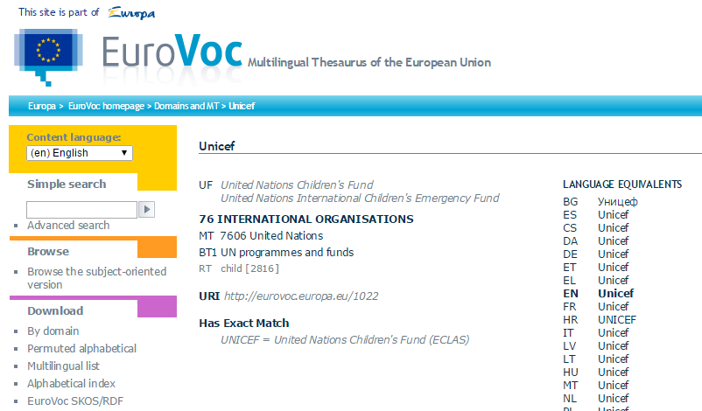
The four principles of linked data in practice
Use Uniform Resource Identifiers (URIs) as names for things.
Use HTTP URIs so that people can look up those names.
  E.g. for an organisation: UNICEF in EuroVoc.
    http://eurovoc.europa.eu/1022
Notes:
UPDATE: Slide has been completely updated

Slide 13
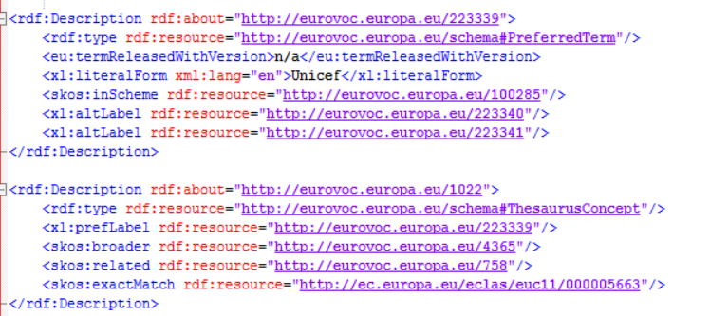
The four principles in practice
When someone looks up a URI, provide useful information, using the standards (RDF, SPARQL).
Include links to other URIs so that people/machines can discover more things.
Notes:
UPDATE: additional slide

Slide 14
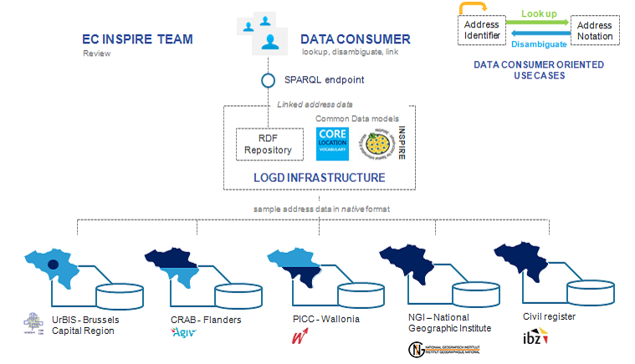
Linked data can help you publish structured data and integrate data from different sources
Example: Core Location Pilot ‘Interconnecting Belgian National and Regional Address data’
See also:
https://joinup.ec.europa.eu/community/semic/og_page/logd
Building a common view on address data in Belgium
Notes:
Updated title.

Slide 15
Enablers of Linked Open Government Data
Forward-looking strategies. Alignment with modern techniques as a way to maintain reputation as leaders in the domain.
Open licensing and free access: an advantage contributing to the popularity of LOGD.
Ease of data model updates to include new data or connect data from different sources.
Enthusiasm from ‘champions’.
Emerging best practice guidance: dissemination of best practices to create common approaches and reduce the risk in implementation.
See also:
ISA Study on Business Models for LOGD https://joinup.ec.europa.eu/community/semic/document/study-business-models-linked-open-government-data-bm4logd
Notes:
New slide

Slide 16

Linked data vs. open data
“Open data is data that can be freely used, reused and redistributed by anyone – subject only, at most, to the requirement to attribute and share-alike.”
- OpenDefinition.org
Open data
Data can be published and be publicly available under an open licence without linking to other data sources.
Linked data
Data can be linked to URIs from other data sources, using open standards such as RDF without being publicly available under an open licence.
See also:
Cobden et al., A research agenda for Linked Closed Data
http://ceur-ws.org/Vol-782/CobdenEtAl_COLD2011.pdf

Slide 17
Linked data foundations
URIs for naming things, RDF for describing data and SPARQL for querying linked data.

Slide 18


Uniform Resource Identifier (URI)
“A Uniform Resource Identifier (URI) is a compact sequence of characters that identifies an abstract or physical resource.”
– ISA’s 10 Rules for Persistent URIs
  A country, e.g. Belgium
    http://publications.europa.eu/resource/authority/country/BEL
  An organisation, e.g. the Publications Office
    http://publications.europa.eu/resource/authority/corporate-body/PUBL
  A dataset, e.g. Countries Named Authority List
    http://publications.europa.eu/resource/authority/country/
BE
See also:
http://www.slideshare.net/OpenDataSupport/design-and-manage-persitent-uris
Notes:
UPDATE: update of examples

Slide 19
RDF & SPARQL
The Resource Description Framework (RDF ) is a syntax for representing data and resources in the Web
RDF breaks every piece of information down in triples:
Subject – a resource, which may be identified with a URI.
Predicate – a URI-identified reused specification of the relationship.
Object – a resource or literal to which the subject is related.
SPARQL is a standardised language for querying RDF data.
http://example.org/place/Brussels is the capital of “Belgium”.
OR
http://example.org/place/Brussels is the capital of http://example.org/place/Belgium.
Subject
Predicate
Object
See also:
http://www.slideshare.net/OpenDataSupport/introduction-to-rdf-sparql

Slide 20
How to publish linked data?
Paving the way towards 5-star linked data

Slide 21
5 star-schema of Linked Open Data
★ | Make your stuff available on the Web (whatever format) under an open license.
★★ | Make it available as structured data (e.g., Excel instead of image scan of a table).
★★★ | Use non-proprietary formats (e.g., CSV instead of Excel).
★★★★ | Use URIs to denote things, so that people can point at your stuff.
★★★★★ | Link your data to other data to provide context.

Slide 22
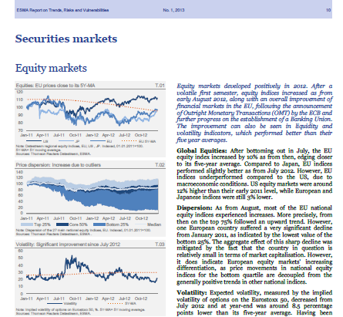


★ Make your stuff available on the Web under an open licence
Trends, risks and vulnerabilities in securities markets

Slide 23
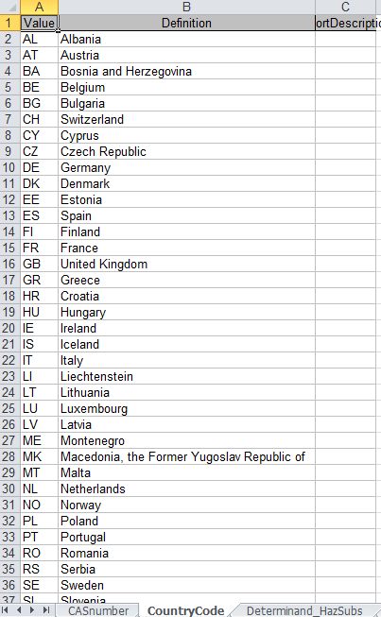
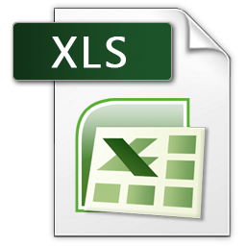
★ ★ Make it available as structured data
Waterbase - Emissions to water:
CountryCode

Slide 24
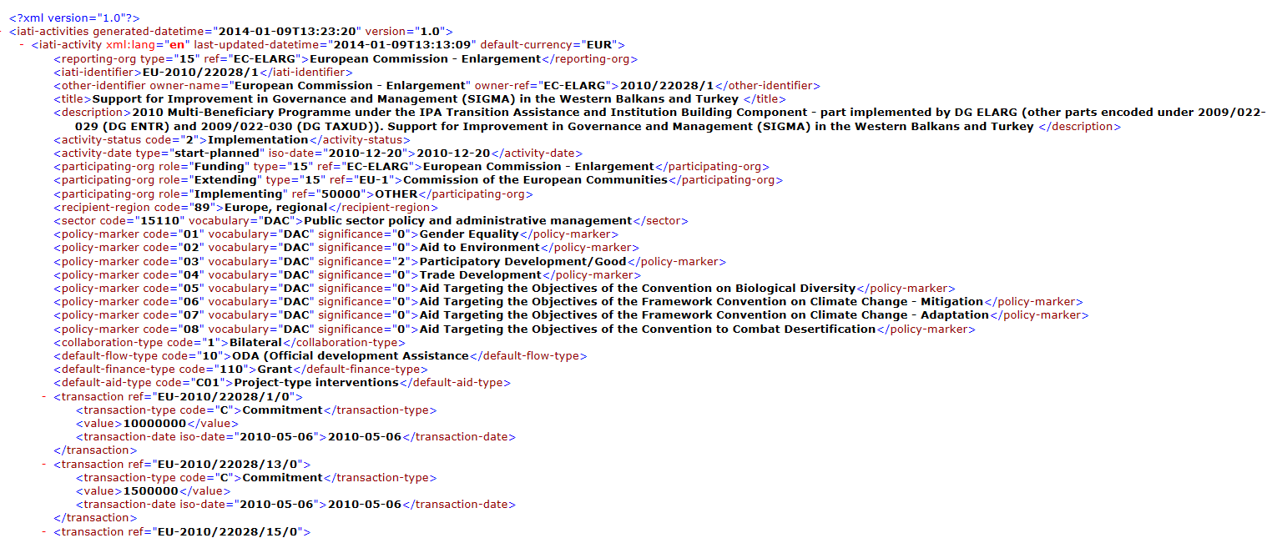
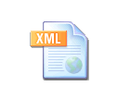
★ ★ ★ Use non-proprietary formats
Proprietary: Excel, Word, PDF...
Non-proprietary: XML, CSV, RDF, JSON, ODF...
DG Enlargement - Regional programmes:

Slide 25
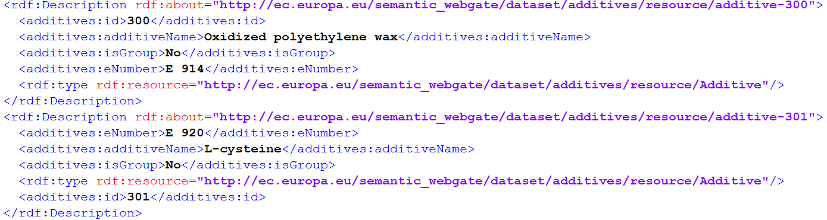
★ ★ ★ ★ Use URIs to denote things
Food Additives - http://open-data.europa.eu/en/data/dataset/1gXgb0Yj73R4ttDChQ5Wyg
See also:
http://www.slideshare.net/OpenDataSupport/design-and-manage-persitent-uris

Slide 26
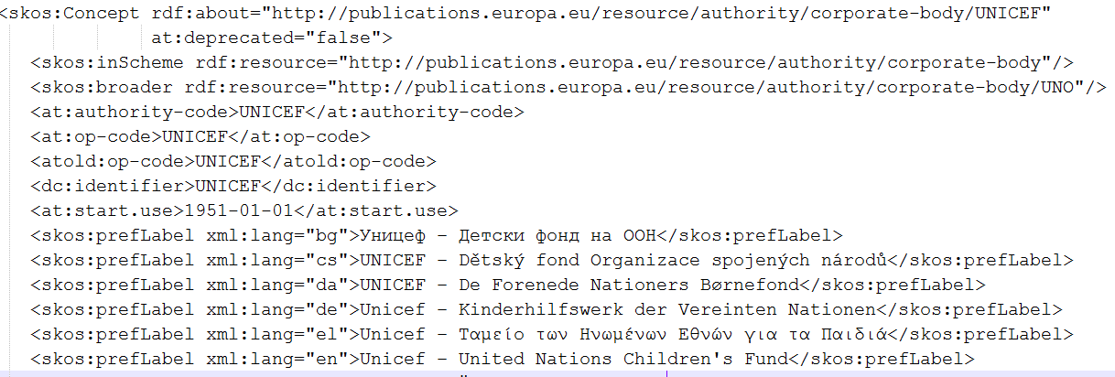
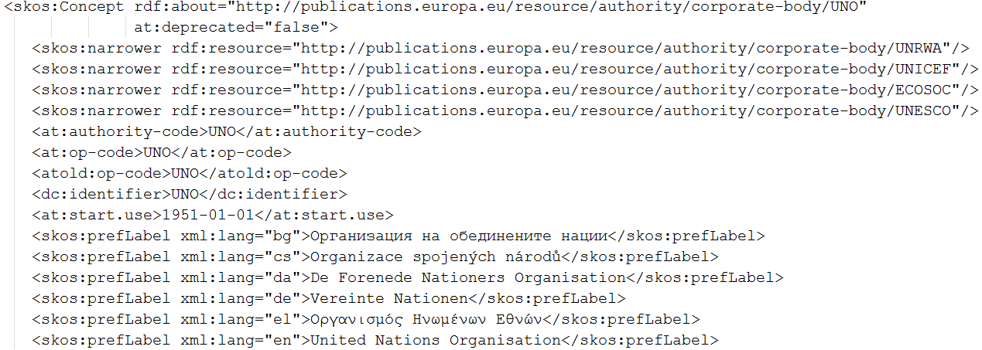
★ ★ ★ ★ ★ Link your data to other data to provide context
Corporate bodies Named Authority Lists - http://open-data.europa.eu/en/data/dataset/corporate-body

Slide 27
LOGD roadblocks
Necessary investments.
Lack of necessary competencies.
Perceived lack of tools.
Lack of service level guarantees.
Missing, restrictive, or incompatible licences.
Surfeit of standard vocabularies.
The inertia of the status quo – change is accomplished slowly.
See also:
ISA Study on Business Models for LOGD https://joinup.ec.europa.eu/community/semic/document/study-business-models-linked-open-government-data-bm4logd
Notes:
New slide

Slide 28
Linked data initiatives in Europe
Examples on supra-national, national, regional and private initiatives in the area of linked data.

Slide 29
Member State initiatives – some examples
DE – Bibliotheksverbund Bayern
Linked data from 180 academic libraries in Bavaria, Berlin and Brandenburg.
IT – Agenzia per l’Italia digitiale
Three datasets published as linked data: the Index of Public Administration, the SPC contracts for web services and conduction systems and the Classifications for the data in Public Administration.
NL – Building and address register
The Dutch Address and Buildings base register published as linked data.
UK – Ordnance Survey
Three OS Open Data products published as linked data: the 1:50 000 Scale Gazetteer, Code-Point Open and the administrative geography taken from Boundary Line.
UK – Companies House
Publishing basic company details as linked data using a simple URI for each company in their database.
See also:
ISA Study on Business Models for LOGD https://joinup.ec.europa.eu/community/semic/document/study-business-models-linked-open-government-data-bm4logd

Slide 30
EU institutions initiatives – some examples
European Environment Agency SPARQL endpoint:
Tool allowing searching for linked data published by the the European Environment Agency. http://semantic.eea.europa.eu/sparql
EU Open Data Portal SPARQL endpoint:
Tool allowing searching for the metadata stored in the EU Open Data Portal triple store.
https://open-data.europa.eu/en/linked-data
DG SANTE SPARQL endpoint:
Tool for querying linked open data on European Community Health Indicators, the EU Register of Health Claims, etc. http://ec.europa.eu/semantic_webgate/
Europeana SPARQL endpoint:
Tool allowing querying a multi-lingual online collection of millions of digitized items from European museums, libraries, archives and multi-media collections. http://labs.europeana.eu/api/linked-open-data-SPARQL-endpoint

Slide 31
















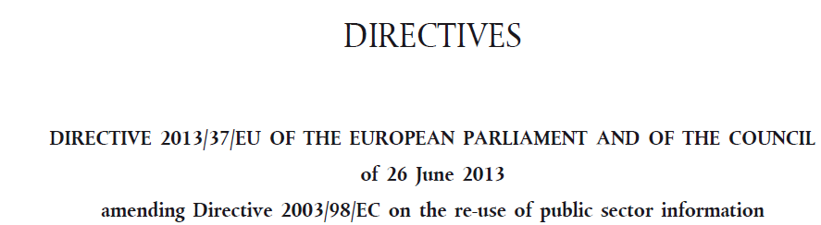

Initiatives funded by the European Commission
Notes:
UPDATE: logos updated

Slide 32
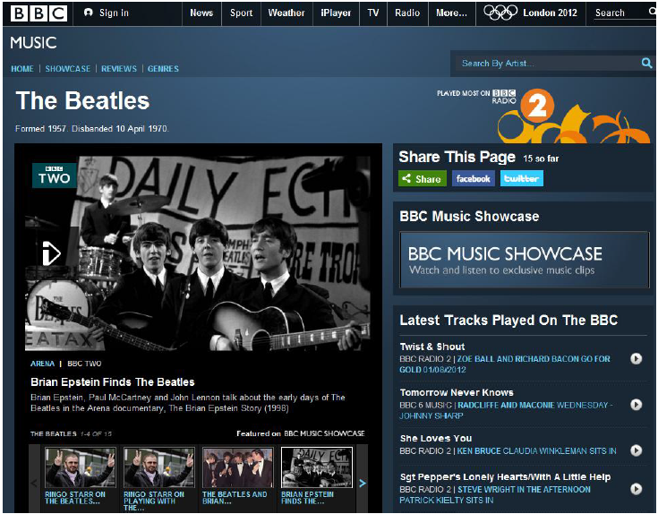
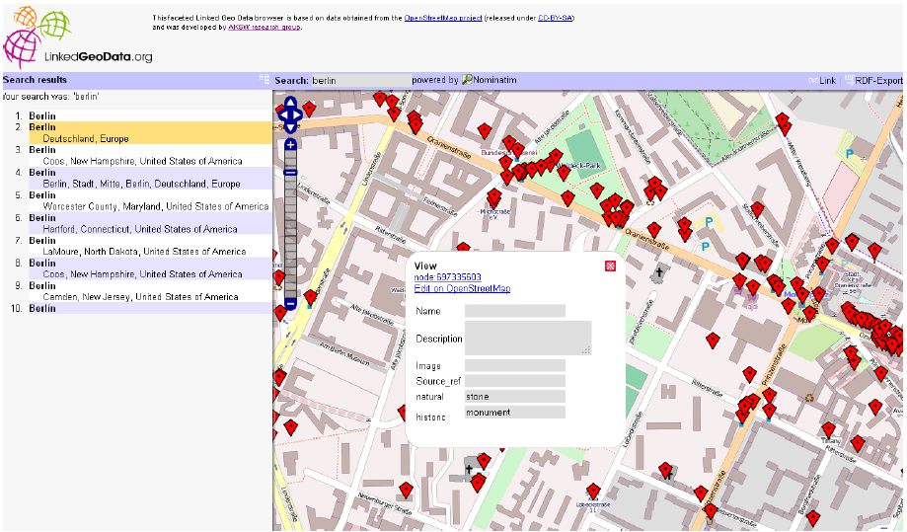
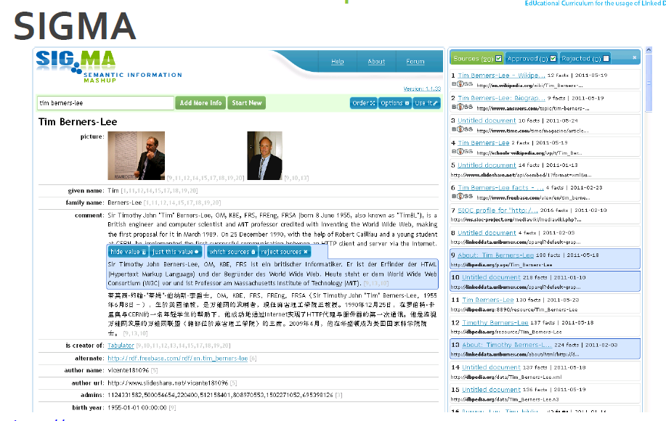
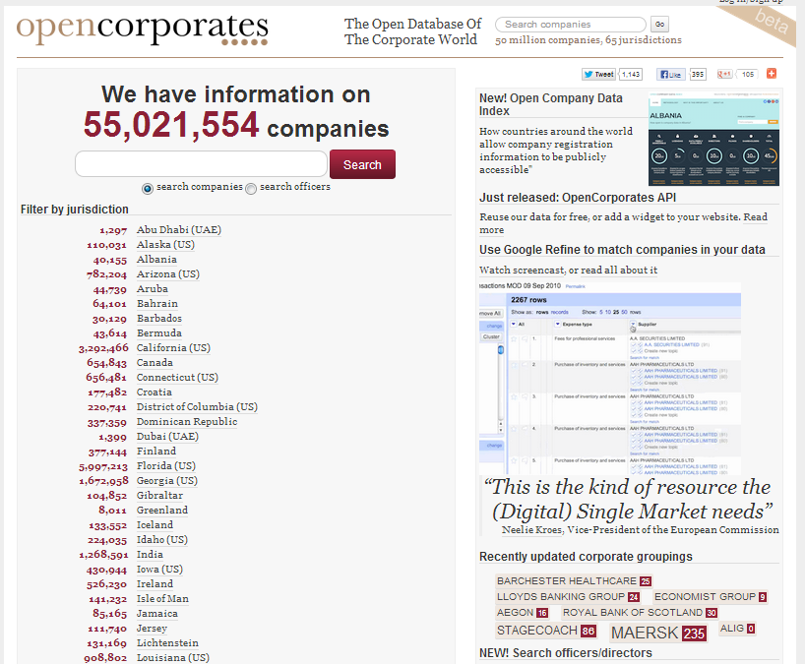
Non-governmental applications

Slide 33
Conclusions
  Linked data is a set of design principles for sharing machine-readable data on the Web.
URIs, RDF and SPARQL form the foundational layer for Linked data.
Linked data offers a number of advantages such as:
    Data integration with small impact on legacy systems;
    Enables for semantic interoperability;
    Easier browsing through complex data;
    Increased data quality;

Slide 34
Conclusions cont’d
Linked data offers a number of advantages such as:
    Enables easy updates, adaptations and extensions of data models;
    Cost reduction from the reuse of LOGD in e-Government applications;
    Enables creativity and innovation through context and knowledge-creation.

Slide 35
Learning Module 2:
Introduction to RDF & SPARQL

Slide 36
Introduction to RDF and SPARQL
This module contains ...
  An introduction to the Resource Description Framework (RDF) for describing your data.
  An introduction to SPARQL on how you can query and manipulate data in RDF.
Find more on: training.opendatasupport.eu

Slide 37
Learning objectives
By the end of this training module you should have a clear understanding of:
The Resource Description Framework (RDF);
How to write/read RDF;
How you can describe your data with RDF;
What SPARQL is;
How to understand and write a SPARQL SELECT query.

Slide 38
Resource Description Framework
An introduction on RDF.

Slide 39
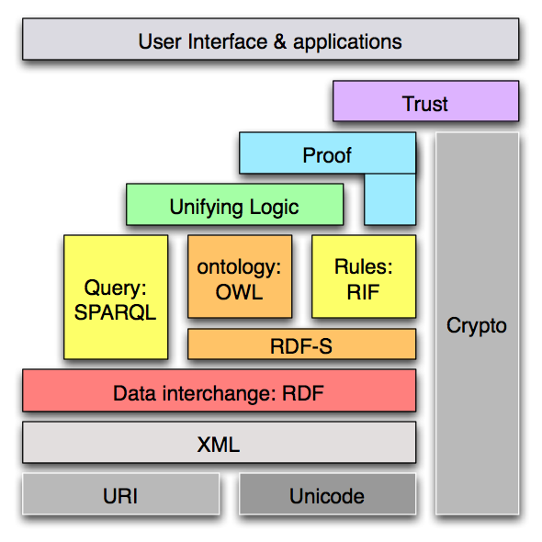
RDF in the stack of Semantic Web technologies
  Resource: Everything that can have a unique identifier (URI), e.g. pages, places, people, organisations, products...
  Description: attributes, features, and relations of the resources
  Framework: model, languages and syntaxes for these descriptions
  Published as a W3C recommendation in 1999.
  RDF was originally introduced as a data model for metadata.
  RDF was generalised to cover knowledge of all kinds.

Slide 40
Example: RDF description of an organisation
Publications Office, 2, rue Mercier, 2985 Luxembourg, LUXEMBOURG
<rdf:RDF
xmlns:rdfs=“http://www.w3.org/2000/01/rdf-schema#”
xmlns:org=“http://www.w3.org/ns/org#”
xmlns:locn=“http://www.w3.org/ns/locn#” >
<org:Organization rdf:about=“http://publications.europa.eu/resource/authority/corporate-body/PUBL”>
<rdfs:label> “Publications Office”< /rdfs:label>
<org:hasSite rdf:resource=“http://example.com/site/1234”/>
</org:Organization>
<locn:Address rdf:about=“http://example.com/site/1234”/>
<locn:fullAddress>”2, rue Mercier, 2985 Luxembourg, LUXEMBOURG”</locn:fullAddress>
</locn:Address>
</rdf:RDF>

Slide 41
RDF structure
Triples, graphs and syntaxes.

Slide 42
What is a triple?
RDF is a general syntax for representing data on the Web.
Every piece of information expressed in RDF is represented as a triple:
Subject – a resource, which may be identified with a URI.
Predicate – a URI-identified reused specification of the relationship.
Object – a resource or literal to which the subject is related.
Example: name of a dataset:
http://publications.europa.eu/resource/authority/file-type/ has a title “File types Name Authority List”.
Subject
Predicate
Object

Slide 43
RDF Syntax
RDF/XML
<rdf:RDF
xmlns:dcat=“http://www.w3.org/TR/vocab-dcat/“
xmlns:dct=“http://purl.org/dc/terms/”
<dcat:Dataset rdf:about=“http://publications.europa.eu/resource/authority/file-type/”>
<dct:title> “File types Name Authority List”< /dct:title>
<dct:publisher rdf:resource=“http://open-data.europa.eu/en/data/publisher/publ”/>
</dcat:Dataset>
<dct:Agent rdf:about=“http://open-data.europa.eu/en/data/publisher/publ”/>
<dct:title>”Publications Office”</dct:title>
</dct:Publisher>
</rdf:RDF>
Graph
Definition of prefixes
Description of data – triples
 | Subject
 | Predicate
 | Object
RDF/XML is currently the only syntax that is standardised by W3C.

Slide 44
RDF Syntax
Turtle
@prefix dcat: <http://www.w3.org/TR/vocab-dcat/> .
@prefix dct: <http://purl.org/dc/terms/.
< http://publications.europa.eu/resource/authority/file-type/>
a <dcat:Dataset> ;
dct:title “File types Name Authority List“;
dct:publisher <http://open-data.europa.eu/en/data/publisher/publ> .
<http://open-data.europa.eu/en/data/publisher/publ>
a <dct:Agent> ;
dct:title “Publications Office” .
Graph
Definition of prefixes
Description of data – triples
 | Subject
 | Predicate
 | Object
Turtle will be standardised in RDF 1.1.
See also:
http://www.w3.org/2009/12/rdf-ws/papers/ws11

Slide 45
RDF Syntax
RDFa
<html>
<head> ... </head>
<body>
...
<div resource=“http://publications.europa.eu/resource/authority/file-type/”
typeof= “http://www.w3.org/ns/dcat#Dataset”>
<p>
<span property=" http://purl.org/dc/terms/title ">File types Name Authority List<span>
Publisher: <span property="http://purl.org/dc/terms/Agent"> Publications Office</span>
</p></div>
</body>
embedding RDF data in HTML
 | Subject
 | Predicate
 | Object
See also:
http://www.w3.org/TR/2012/NOTE-rdfa-primer-20120607/

Slide 46
How to represent data in RDF
Classes, properties and vocabularies

Slide 47
RDF Vocabulary
“A vocabulary is a data model comprising classes, properties and relationships which can be used for describing your data and metadata.”
RDF Vocabularies are sets of terms used to describe things.
A term is either a class or a property.
    Data type properties (attributes of a class)
    Object type properties (relationships between classes)

Slide 48
What are classes, relationships and properties?
  Class. A construct that represents things in the real and/or information world, e.g. a person, an organisation, a concept such as “health” or “freedom”.
  Property. A characteristic of a class in a particular dimension such as the legal name of an organisation or the date and time that an observation was made.
  Relationship. A link between two classes; for the link between a document and the organisation that published it (i.e. organisation publishes document), or the link between a map and the geographic region it depicts (i.e. map depicts geographic region). In RDF relationships are encoded as object type properties.

Slide 49
Examples of classes, relationships and properties: The Core Person Vocabulary in UML
Class
Relationships
Class
Properties
Class
Class
Class
UML: The Unified Modelling Language class diagrams provide the means for expressing the conceptual data model of vocabularies, such as the ISA Core Vocabularies, thus facilitating the understanding of the meaning of the data model.

Slide 50
Introduction to SPARQL
The RDF Query Language

Slide 51
About SPARQL
SPARQL is the standard language to query graph data represented as RDF triples.
SPARQL Protocol and RDF Query Language
  One of the three core standards of the Semantic Web, along with RDF and OWL.
Became a W3C standard January 2008.
SPARQL 1.1 is a W3C Recommendation since March 2013.

Slide 52
Types of SPARQL queries
  SELECT. Return a table of all X, Y, etc. satisfying the following conditions ...
  CONSTRUCT. Find all X, Y, etc. satisfying the following conditions ... and substitute them into the following template in order to generate (possibly new) RDF statements, creating a new graph.
  DESCRIBE. Find all statements in the dataset that provide information about the following resource(s) ... (identified by name or description)
  INSERT. Add triples to the RDF graph.
  DELETE. Delete triples from the RDF graph.
  ASK. Are there any X, Y, etc. satisfying the following conditions ...
See also:
http://www.euclid-project.eu/modules/chapter2
https://joinup.ec.europa.eu/community/ods/document/tm13-introduction-rdf-sparql-en

Slide 53
Structure of a SPARQL Query
PREFIX dct: <http://purl.org/dc/terms/>
PREFIX dcat: <http://www.w3.org/TR/vocab-dcat/>
SELECT ?title
WHERE
{
?x rdf:type dcat:Dataset .
?dataset rdf:title ?title
}
Definition of prefixes
Type of query
Variables, i.e. what to search for
RDF triple patterns, i.e. the conditions that have to be met

Slide 54
SELECT – return the name of a dataset with particular URI
Sample data
<http://.../authority/file-type/> rdf:type dcat:Dataset.
<http://.../authority/file-type/> dct:title “File types Name Authority List“ .
<http://.../authority/file-type/> dct:publisher < http://open-data.europa.eu/en/data/publisher/publ>.
< http://.../publisher/publ> rdf:type dct:Agent .
< http://.../publisher/publ> dct:title “Publications Office” .
Query
PREFIX dcat: <http://www.w3.org/TR/vocab-dcat/>
PREFIX dct: <http://purl.org/dc/terms/>
SELECT ?dataset
WHERE
{
<http://.../authority/file-type/> dct:title ?dataset .
}
Result
dataset
“File types Name Authority List”

Slide 55
SELECT - return the name and publisher of a dataset
Sample data
<http://.../authority/file-type/> rdf:type dcat:Dataset.
<http://.../authority/file-type/> dct:title “File types Name Authority List“ .
<http://.../authority/file-type/> dct:publisher < http://open-data.europa.eu/en/data/publisher/publ>.
< http://.../publisher/publ> rdf:type dct:Agent .
< http://.../publisher/publ> dct:title “Publications Office” .
Query
PREFIX dcat: <http://www.w3.org/TR/vocab-dcat/>
PREFIX dct: <http://purl.org/dc/terms/>
SELECT ?dataset ?publisher
WHERE
{http://.../authority/file-type/ dct:publisher ?publisherURI.
http://.../authority/file-type/ dct:title ?dataset.
?publisherURI dct:title ?publisher . }
Result
dataset | publisher
“File types Name Authority List” | “Publications Office”

Slide 56
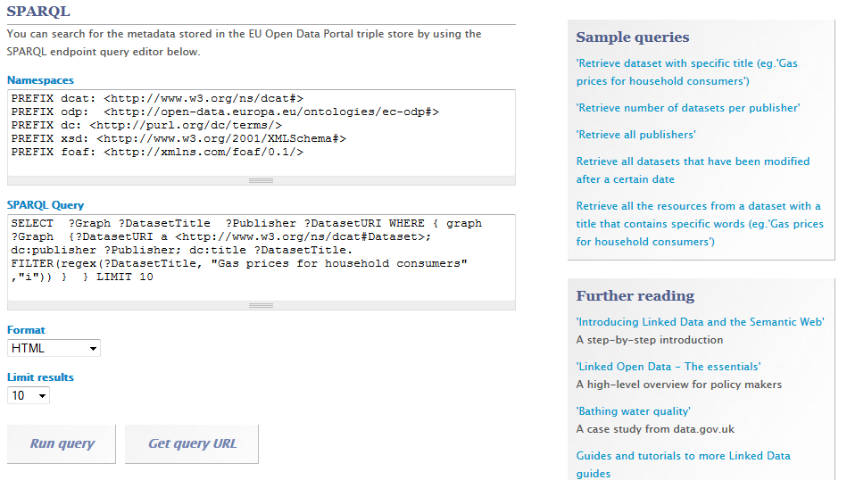
SPARQL Example – EU ODP (1)

Slide 57
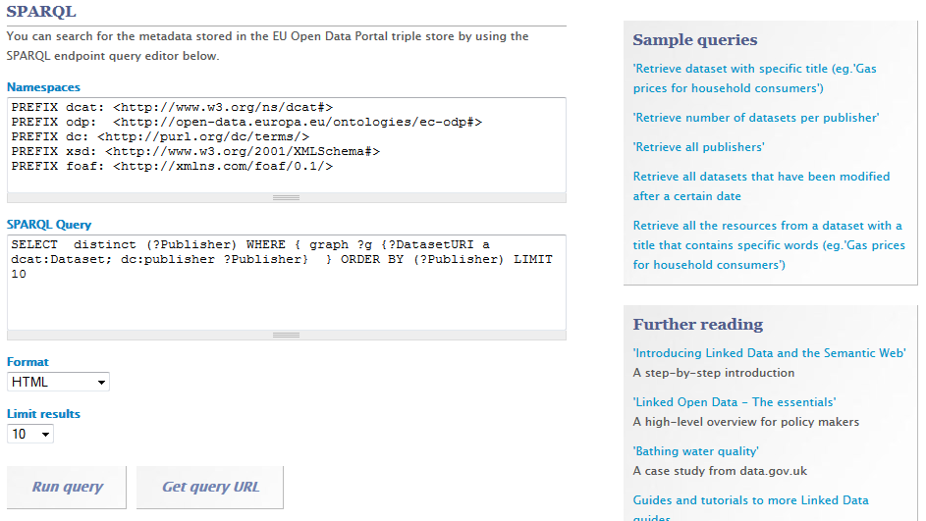
SPARQL Example – EU ODP (2)

Slide 58
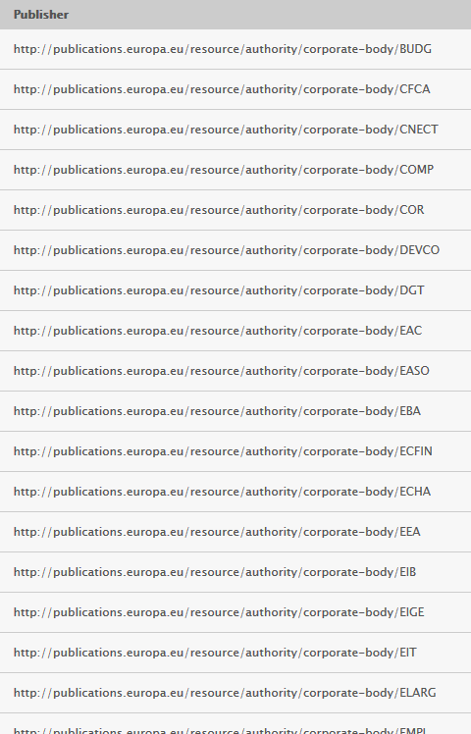
SPARQL Example – EU ODP (2)

Slide 59
Summary
  RDF is a general way to express data intended for publishing on the Web.
RDF data is expressed in triples: subject, predicate, object.
Different syntaxes exist for expressing data in RDF.
  SPARQL is a standardised language to query graph data expressed as RDF.
SPARQL can be used to query and update RDF data.

Slide 60
Learning Module 3:
Workshop for Publishing Open Linked EU Data

Slide 61
Workshop for publishing open linked EU data
This module is about...
Creating an RDF vocabulary for modelling your data.
    How to reuse existing vocabularies to model your data.
    How to create new classes and properties in RDF.
    How and where to publish your RDF vocabulary so that it can be reused by others.
  An example of how tabular data can be published as Linked Open Data using Open Refine.

Slide 62
Learning objectives
By the end of this training module you should have an understanding of:
  What the best practices are for creating an RDF vocabulary for modelling your data.
Where to find RDF vocabularies for reuse.
How you can create your own RDF vocabulary.
How to publish your RDF vocabulary.
  The process and methodology for developing semantic agreements developed by the ISA Programme of the European Commission.

Slide 63
Creating an RDF vocabulary
How to reuse other vocabularies, define your own terms, publish and promote your vocabulary

Slide 64
6 steps for creating an RDF vocabulary
1
Start with a robust Domain Model developed following a structured process and methodology.
Research existing terms and their usage and maximise reuse of those terms.
Where new terms can be seen as specialisations of existing terms, create sub class and sub properties.
Where new terms are required, create them following commonly agreed best practice.
Publish within a highly stable environment designed to be persistent.
Publicise the RDF vocabulary by registering it with relevant services.
2
3
4
5
6
See also:
https://joinup.ec.europa.eu/community/semic/document/cookbook-translating-data-models-rdf-schemas

Slide 65
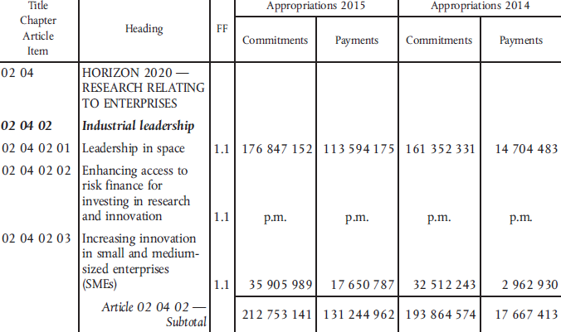
Start with a robust Domain Model
1

Slide 66








Reuse existing terms and vocabularies
2
General purpose vocabularies: DCMI, RDFS
To name things: rdfs:label, foaf:name, skos:prefLabel
To describe people: FOAF, vCard, Core Person Vocabulary
To describe projects: DOAP, ADMS.SW
To describe interoperability assets: ADMS
To describe registered organisations: Registered Organisation Vocabulary
To describe addresses: vCard, Core Location Vocabulary
To describe public services: Core Public Service Vocabulary
To describe datasets: DCAT, DCAT Application Profile, VoID

Slide 67

Well-known vocabularies:
2
See also:
http://www.w3.org/wiki/TaskForces/CommunityProjects/LinkingOpenData/CommonVocabularies
Reuse existing terms and vocabularies
DCAT-AP | Vocabulary for describing datasets in Europe
Core Person Vocabulary | Vocabulary to describe the fundamental characteristics of a person, e.g. the name, the gender, the date of birth...
DOAP | Vocabulary for describing projects
ADMS | Vocabulary for describing interoperability assets.
Dublin Core | Defines general metadata attributes
Registered Organisation Vocabulary | Vocabulary for describing organizations, typically in a national or regional register
Organization Ontology | for describing the structure of organizations
Core Location Vocabulary | Vocabulary capturing the fundamental characteristics of a location.
Core Public Service Vocabulary | Vocabulary capturing the fundamental characteristics of a service offered by public administration
schema.org | Agreed vocabularies for publishing structured data on the Web elaborated by Google, Yahoo and Microsoft

Slide 68
Reuse existing terms and vocabularies
2
Advantages of reuse:
  Reuse greatly aids interoperability of your data
      Use of dcterms:created, for example, the value for which should be a data typed date such as 2013-02-21^^xsd:date, is immediately processable by many machines. If your schema encourages data publishers to use a different term and date format, such as ex:date "21 February 2013" – data published using your schema will require further processing to make it the same as everyone else's.
  Reuse adds credibility to your schema.
      It shows it has been published with care and professionalism, again, this promotes its reuse.
  Reuse is easier and cheaper.
    Reusing classes and properties from well defined and properly hosted vocabularies avoids your having to replicate that effort.

Slide 69
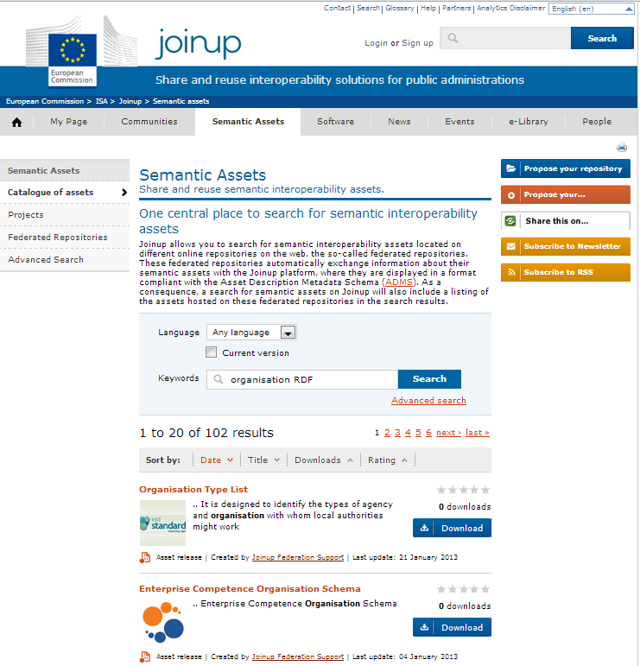
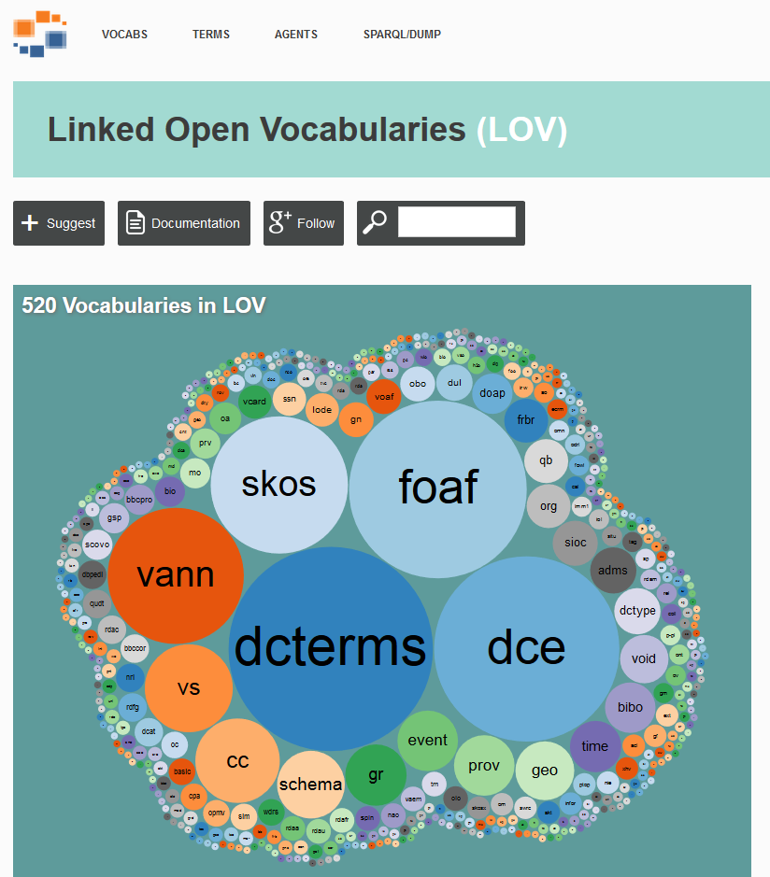
You can find reusable RDF vocabularies on:
2
Reuse existing terms and vocabularies
http://joinup.ec.europa.eu/
http://lov.okfn.org/

Slide 70
Creation of sub-classes and sub-properties
3
  RDF schemas and vocabularies often include terms that are very generic.
  By creating sub-class and sub-property relationships, systems that understand the super property or super class may be able to interpret the data even if the more specific terms are unknown.
  Do not create sub-classes and sub-properties simply to allow you to use your own term for something that already exists.

Slide 71
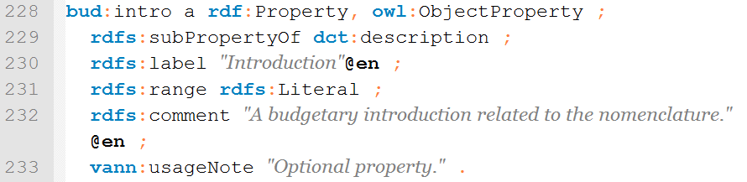
Creation of sub-classes and sub-properties
3
The EU Budget vocabulary defines the introduction property as a sub-property of dct:description.

Slide 72
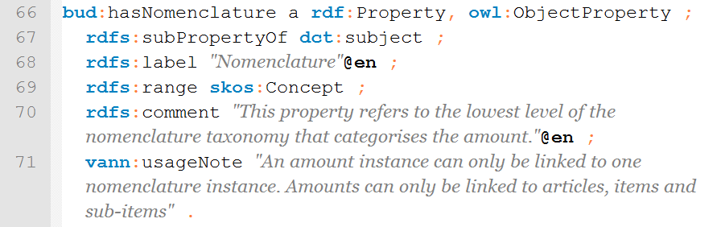
Creation of sub-classes and sub-properties
3
The EU Budget vocabulary defines the has nomenclature property as a sub-property of dct:subject.

Slide 73
Where new terms are required, create them following commonly agreed best practices
4
  Classes begin with a capital letter and are always singular, e.g. skos:Concept.
Properties begin with a lower case letter, e.g. rdfs:label.
Object properties should be verbs, e.g. org:hasSite.
Data type properties should be nouns, e.g. dcterms:description.
  Use camel case if a term has more than one word, e.g. foaf:isPrimaryTopicOf.

Slide 74
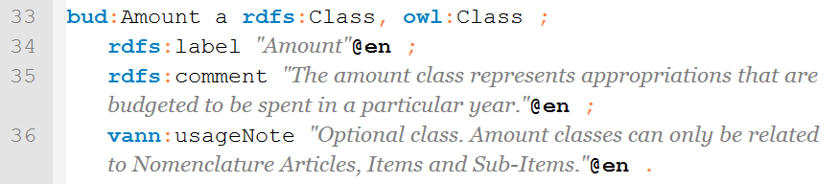
Where new terms are required, create them following commonly agreed best practices
4
If there is no suitable authoritative reusable vocabulary for describing your data, use conventions for describing your own vocabulary:
    RDF Schema (RDFS)
    Web Ontology Language (OWL)
  Example: defining the “Amount” class
See also:
http://www.slideshare.net/OpenDataSupport/model-your-data-metadata

Slide 75
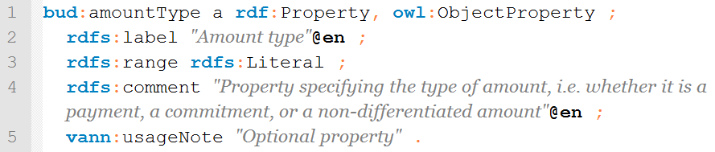
Where new terms are required, create them following commonly agreed best practices
4
If there is no suitable authoritative reusable vocabulary for describing your data, use conventions for describing your own vocabulary:
    RDF Schema (RDFS)
    Web Ontology Language (OWL)
  Example: defining the “amount type” property
See also:
http://www.slideshare.net/OpenDataSupport/model-your-data-metadata

Slide 76
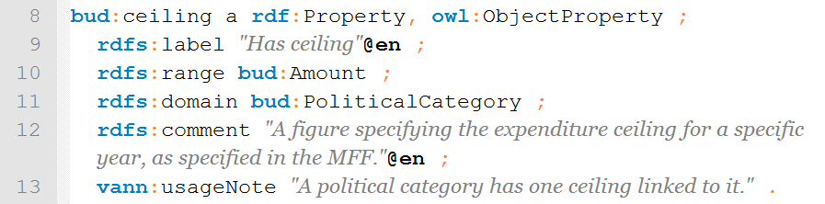
Where new terms are required, create them following commonly agreed best practices
4
When defining new properties, consider to define their domain and range.
A range states that the values of a property are instances of one or more classes.
A domain states on which classes a given property can be used.
See also:
http://www.slideshare.net/OpenDataSupport/model-your-data-metadata

Slide 77
Publish within a highly stable environment designed to be persistent
5
Choose a stable namespace for your RDF vocabulary
    Example: http://data.europa.eu/bud/
  Use good practices on the publication of persistent Uniform Resource Identifiers (URI) sets, both in terms of format, design rules and management.
    Examples:
      http://www.w3.org/ns/adms
      http://purl.org/dc/elements/1.1
See also:
https://joinup.ec.europa.eu/community/semic/document/cookbook-translating-data-models-rdf-schemas
http://www.slideshare.net/OpenDataSupport/design-and-manage-persitent-uris

Slide 78
Publicise the RDF vocabulary by registering it with relevant services
6
Once your RDF vocabulary is published you will want people to know about it. To reach a wider audience, register it on Joinup and Linked Open Vocabularies.

Slide 79
Conclusions
Start with a robust Domain Model developed following a structured process and methodology.
Analyse
Research existing terms and their usage and maximise reuse of those terms.
Where new terms can be seen as specialisations of existing terms, create sub class and sub properties as appropriate.
Model
Where new terms are required, create them following commonly agreed best practice in terms of naming conventions etc
Publish within a highly stable environment designed to be persistent.
Publish
Publicise the RDF vocabulary by registering it with relevant services.

Slide 80
Example
Using Open Refine for RDF to publish tabular data as Linked Data.

Slide 81

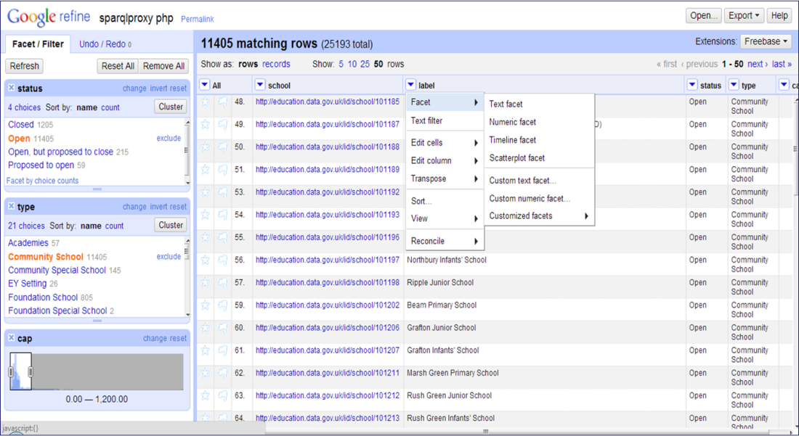
What is Open Refine
“OpenRefine is a powerful tool for working with messy data, cleaning it, transforming it from one format into another, ...”
- openRefine.org
See also:
Open Refine website
http://openrefine.org/

Slide 82
What is Open Refine RDF extension
Open Refine RDF extension allows you to easily import data in different formats such as :
    CSV;
    Excel(.xls and .xlsx);
    JSON;
    XML; and
    RDF/XML.
And then determine the intended structure of an RDF dataset, by drawing a template graph.
See also:
LOD 2 Webinar – Open Refine http://www.youtube.com/watch?v=4Ve93C238gI

Slide 83
Using Open Refine to model and publish open data Getting started
Install Open Refine from: https://github.com/OpenRefine
Install the RDF extension : http://refine.deri.ie/
And then...
        Describe your data in a spreadsheet.
        Create a project and upload it in Open Refine.
        Clean up the data
        Map your data to appropriate RDF classes & properties.
        Export the data in RDF.
1
2
3
4
5

Slide 84
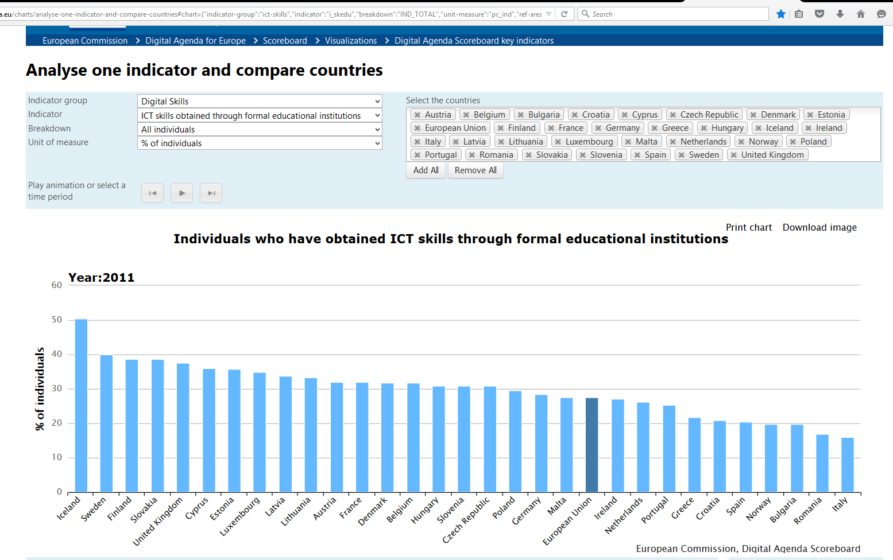
Example situation
Publish statistical data as RDF according to RDF Data Cube Vocabulary
Digital Agenda Scoreboard

Slide 85
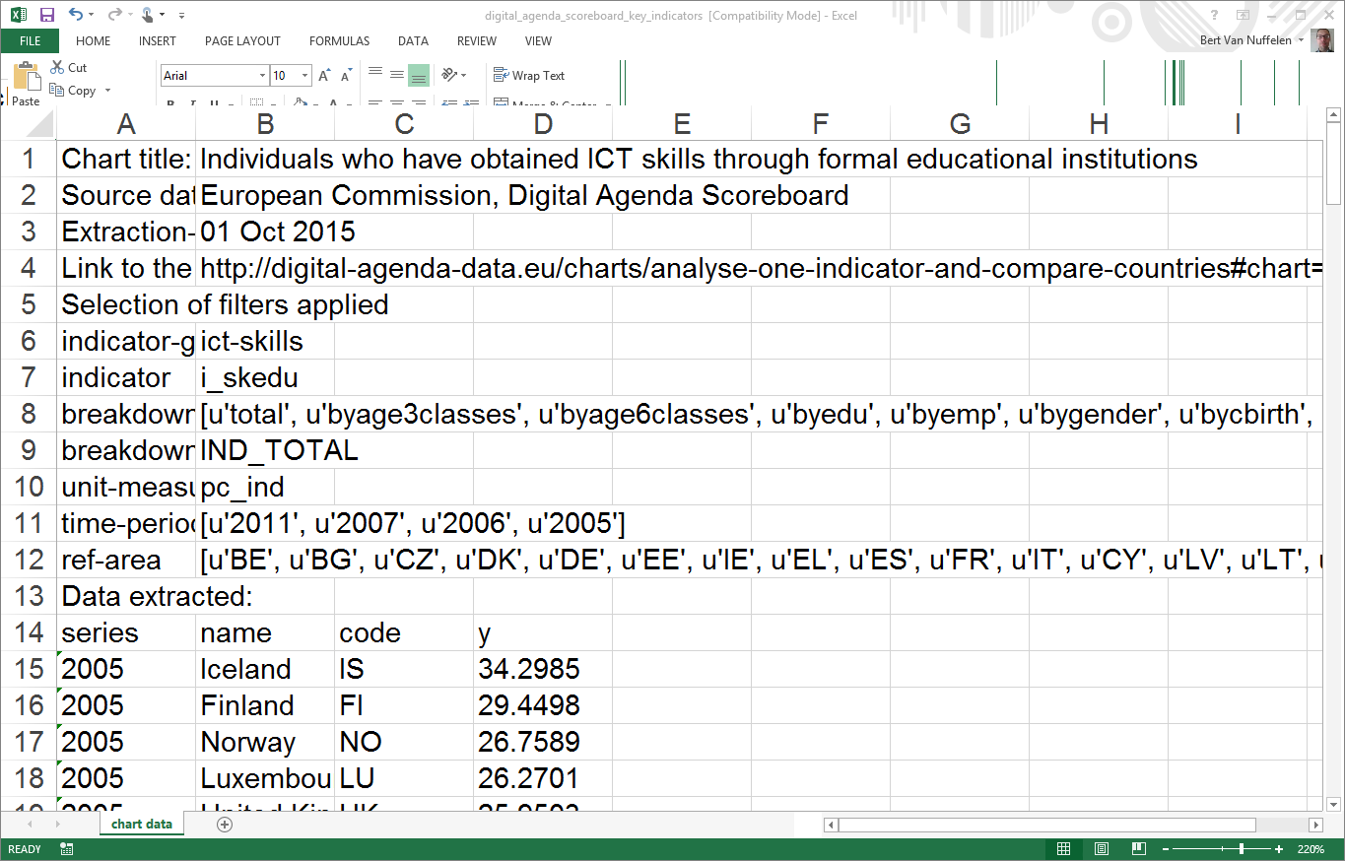
Describe your data in a spreadsheet
1
Download the tabular data

Slide 86
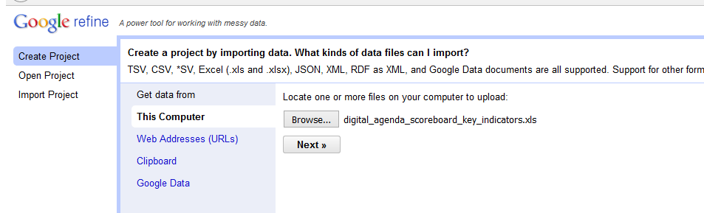
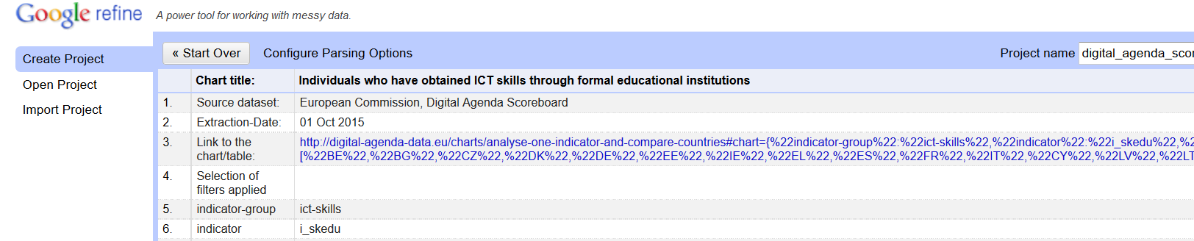
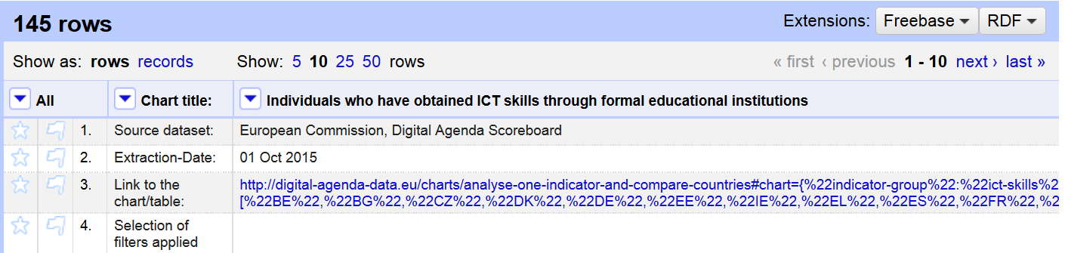
Create a project and upload it in Google Refine
2
Upload the spreadsheet
Select relevant tabs
Create the project

Slide 87
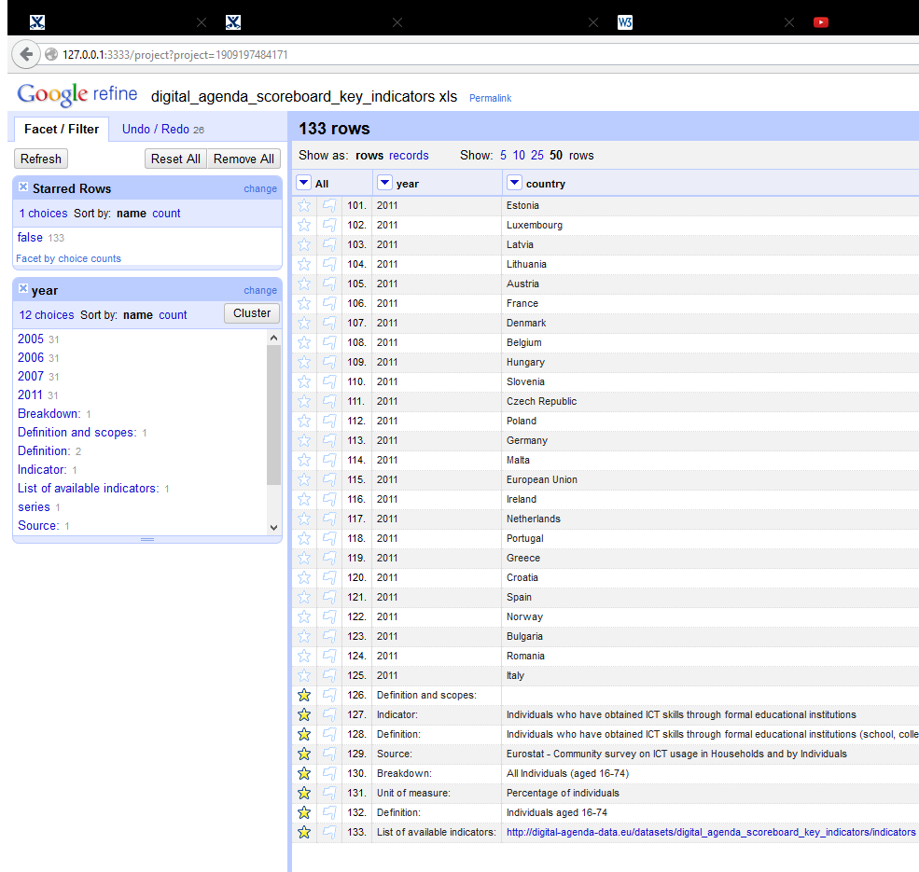
Clean up the data – table harmonisation
3
Star & remove unnessary rows
Rename columns
Use facets to select the data to be published

Slide 88
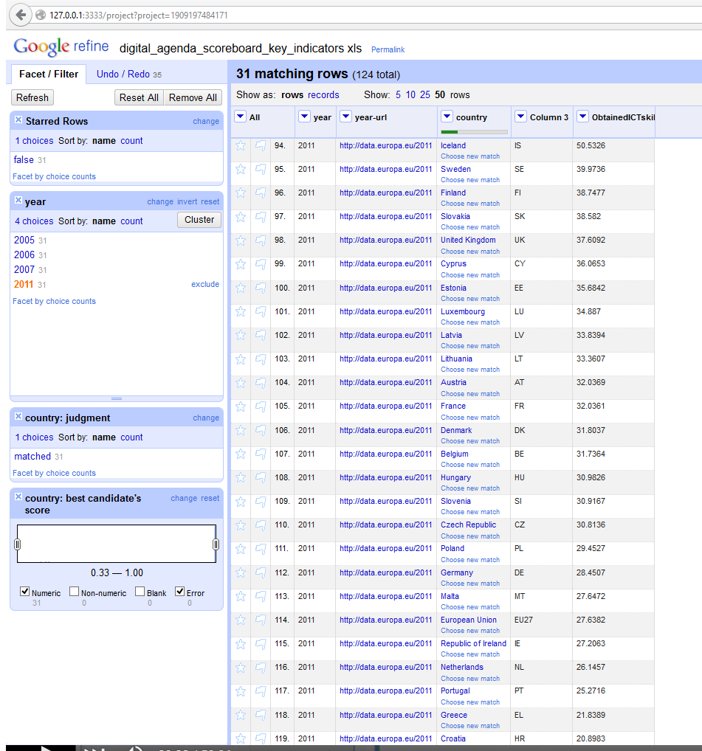
Clean up the data – prepare RDF
3
Create URI representation for the involved object values
  via formula
  via reconsiliation

Slide 89
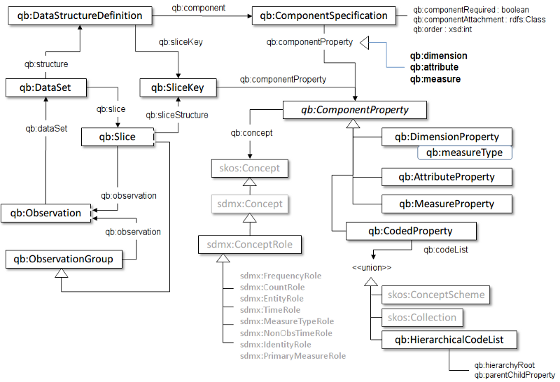
Map your data to appropriate RDF classes & properties (model your data)
4
Understand the target vocabulary: e.g. W3C RDF Data Cube Vocabulary

Slide 90
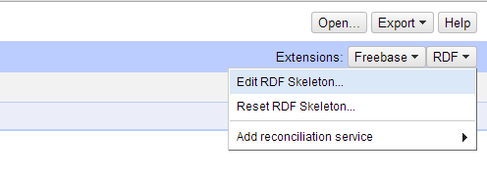
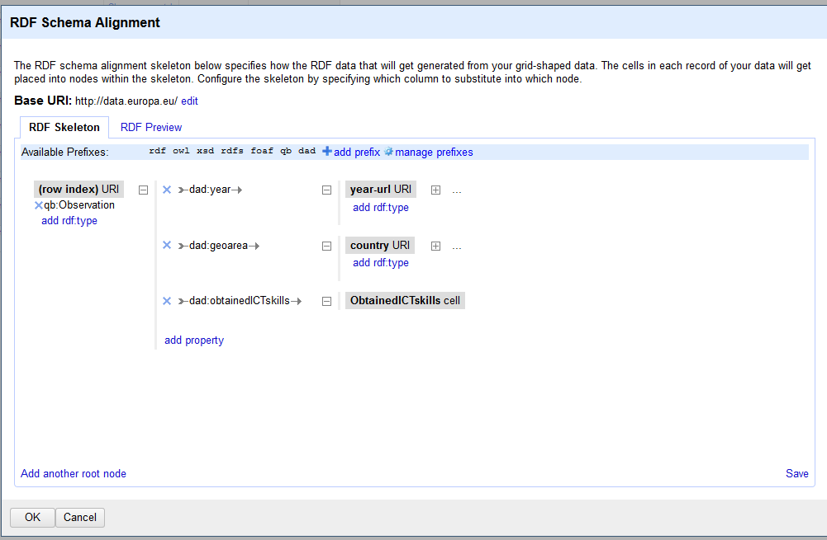
Map your data to appropriate RDF classes & properties (model your data)
4
Define a skeleton to transform your spreadsheet data to RDF

Slide 91
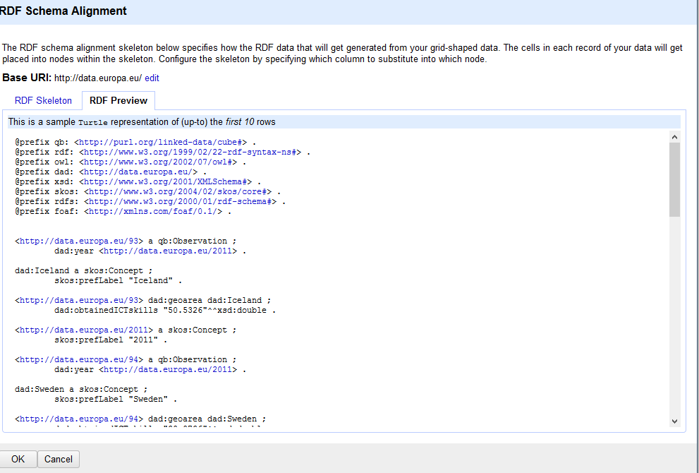
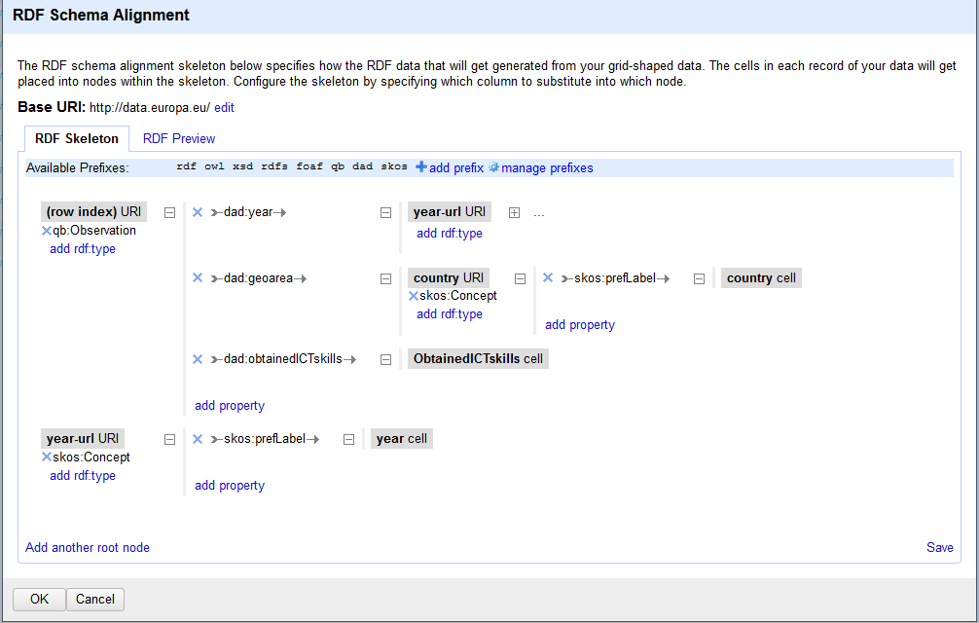
Map your data to appropriate RDF classes & properties (model your data)
4
You can map the data to the ontology using a simple graphical interface to create or edit an existing RDF skeleton.
You can set the base URI for the data.
Graphical interface to edit an RDF skeleton
Graphical interface to copy/paste an existing RDF skeleton

Slide 92
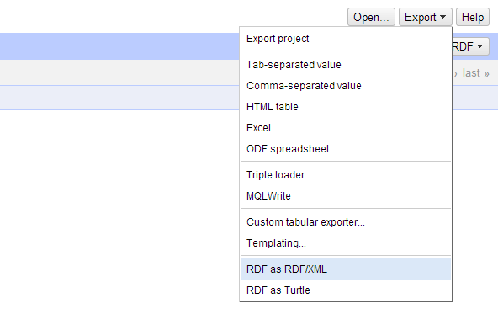
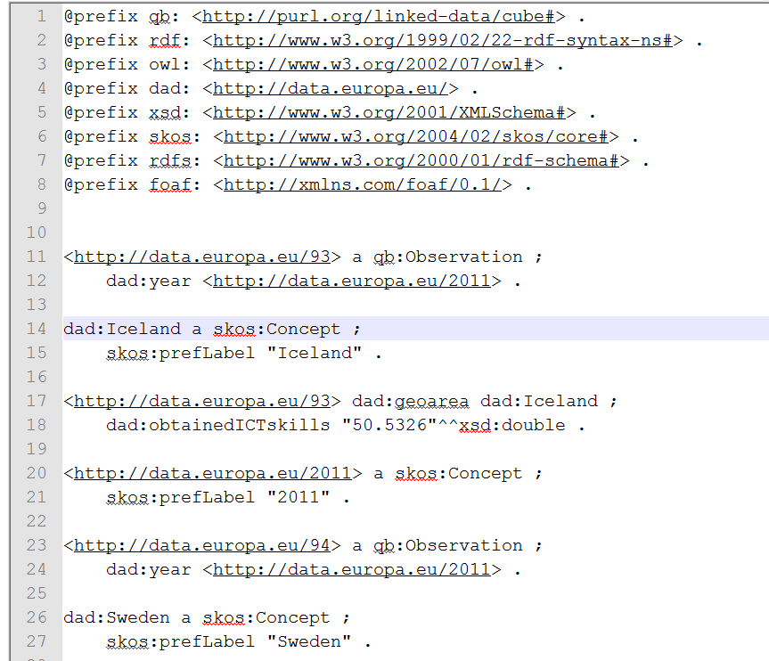
Export your data to RDF/XML or Turtle
5
Export of the data in Turtle

Slide 93
From desk to automated pipeline
desk
flexibility
OpenRefine
Production pipelines
UnifiedViews
Cellar
volume

Slide 94
Ready to test your knowledge?
You may take the online test here!
Notes:
UPDATE: text and link to test

Slide 95
Thank you for your attention!
...and now YOUR questions?

Slide 96
References
  Linked Data Cookbook. W3C. http://www.w3.org/2011/gld/wiki/Linked_Data_Cookbook
  Linking Open Data cloud diagram, by Richard Cyganiak and Anja Jentzsch. http://lod-cloud.net/
  Module 2: Querying Linked Data. EUCLID. http://www.euclid-project.eu/modules/course2
  Open Data – An Introduction. The Open Knowledge Foundation. http://okfn.org/opendata/
  Open Refine: https://github.com/OpenRefine
  RDF Extension: http://refine.deri.ie/
  Resource Description Framework. W3C. http://www.w3.org/RDF/
  Semantic Web Stack. W3C. http://www.w3.org/DesignIssues/diagrams/sweb-stack/2006a.png
  SPARQL Query Language for RDF. W3C. http://www.w3.org/TR/rdf-sparql-query/
  5 ★ Open Data. http://5stardata.info/
  ADMS Brochure. ISA Programme. https://joinup.ec.europa.eu/elibrary/document/adms-brochure
  An organization ontology. W3C. http://www.w3.org/TR/vocab-org/ W3C.
  Case study on how Linked Data is transforming eGovernment. ISA Programme. https://joinup.ec.europa.eu/community/semic/document/case-study-how-linked-data-transforming-egovernment
  Common Vocabularies / Ontologies / Micromodels. W3C. http://www.w3.org/wiki/TaskForces/CommunityProjects/LinkingOpenData/CommonVocabularies
  Cookbook for translating Data Models to RDF Schemas. ISA Programme. https://joinup.ec.europa.eu/community/semic/document/cookbook-translating-data-models-rdf-schemas
  D7.1.3 - Study on persistent URIs, with identification of best practices and recommendations on the topic for the MSs and the EC. ISA Programme. https://joinup.ec.europa.eu/sites/default/files/D7.1.3%20-%20Study%20on%20persistent%20URIs.pdf
  EUCLID. Course 1: Introduction and Application Scenarios. http://www.euclid-project.eu/modules/course1
  Linked Data. Tim Berners-Lee. http://www.w3.org/DesignIssues/LinkedData.html

Slide 97
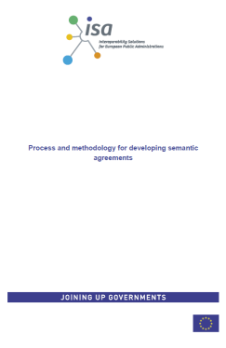
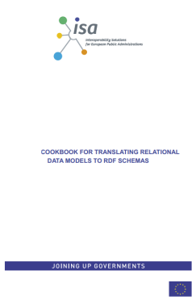
Further reading
EC ISA, Process and methodology for developing semantic agreements, https://joinup.ec.europa.eu/community/core_vocabularies/document/process-and-methodology-developing-semantic-agreements
EC ISA, Cookbook for translating Data Models to RDF Schemas https://joinup.ec.europa.eu/community/semic/document/cookbook-translating-data-models-rdf-schemas

Slide 98

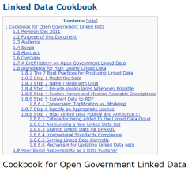
Further reading
EUCLID - Course 1: Introduction and Application Scenarios
http://www.euclid-project.eu/modules/course1
EUCLID - Course 2: Querying Linked Data
http://www.euclid-project.eu/modules/course2
Learning SPARQL. Bob DuCharme.
http://www.learningsparql.com/
Linked Data Cookbook, W3C Government Linked Data Working Group
http://www.w3.org/2011/gld/wiki/Linked_Data_Cookbook

Slide 99




Further reading
Linked Data: Evolving the Web into a Global Data Space. Tom Heath and Christian Bizer.
http://linkeddatabook.com/editions/1.0/
Linked Open Data: The Essentials. Florian Bauer, Martin Kaltenböck.
http://www.semantic-web.at/LOD-TheEssentials.pdf
Linked Open Government Data. Li Ding Qualcomm, Vassilios Peristeras and Michael Hausenblas.
http://ieeexplore.ieee.org/stamp/stamp.jsp?tp=&arnumber=6237454
Semantic Web for the working ontologist. Dean Allemang, Jim Hendler.
http://workingontologist.org/

Slide 100





Be part of our team...
Find us on
Join us on
Open Data Support
http://www.slideshare.net/OpenDataSupport
Open Data Support
http://goo.gl/y9ZZI
http://www.opendatasupport.eu
Follow us
Contact us
@OpenDataSupport
    contact@opendatasupport.eu

Slide 101
This presentation has been created by PwC
Authors:
Michiel De Keyzer, Nikolaos Loutas, Jana Makedonska, Brecht Wyns
Presentation metadata
Disclaimers
The views expressed in this presentation are purely those of the authors and may not, in any circumstances, be interpreted as stating an official position of the European Commission.
The European Commission does not guarantee the accuracy of the information included in this presentation, nor does it accept any responsibility for any use thereof.
Reference herein to any specific products, specifications, process, or service by trade name, trademark, manufacturer, or otherwise, does not necessarily constitute or imply its endorsement, recommendation, or favouring by the European Commission.
All care has been taken by the author to ensure that s/he has obtained, where necessary, permission to use any parts of manuscripts including illustrations, maps, and graphs, on which intellectual property rights already exist from the titular holder(s) of such rights or from her/his or their legal representative.
This presentation has been carefully compiled by PwC, but no representation is made or warranty given (either express or implied) as to the completeness or accuracy of the information it contains. PwC is not liable for the information in this presentation or any decision or consequence based on the use of it.. PwC will not be liable for any damages arising from the use of the information contained in this presentation. The information contained in this presentation is of a general nature and is solely for guidance on matters of general interest. This presentation is not a substitute for professional advice on any particular matter. No reader should act on the basis of any matter contained in this publication without considering appropriate professional advice.
Open Data Support is funded by the European Commission under SMART 2012/0107 ‘Lot 2: Provision of services for the Publication, Access and Reuse of Open Public Data across the European Union, through existing open data portals’(Contract No. 30-CE-0530965/00-17).
© 2015 European Commission

