Slide 1
e-SENS Workshop :
Cartography Tool in practise
European Interoperability Architecture
7-8 January 2015

Slide 2
Workshop checkpoint
Cartography Tool sessions
1
Cartography Tool in practice
2
Collecting data for the Cartography Tool
3
Document Interoperability Solutions - use case
The goal of this session is to acquaint the workshop attendees with the Cartography Tool's functionalities and learn how to use it in practice

Slide 3
Session contents
01
Introduction
02
Main views
Functionalities
03
Demo
04
Scenario-based exercise
05

Slide 4
Overview
01
02
03
04
05
Introduction
Cartography Tool key points and added value
  Its user interface is the EIRA allowing inspection of its views and building blocks
  Allows actual queries on existing solutions mapped to the EIRA’s building blocks that can combine criteria from different views
  Complements existing documentation using a common, ISA-backed language that enhances visibility, consistence and potential reuse
  All Cartography Tool use cases come down to
    Collecting and importing data
    Searching the imported data
This session will present and demo
  The main views of the Cartography Tool and their functionalities
  Examples of using of the Cartography Tool based on various scenarios

Slide 5
Session contents
01
Introduction
02
Main views
Functionalities
03
Demo
04
Scenario-based exercise
05

Slide 6
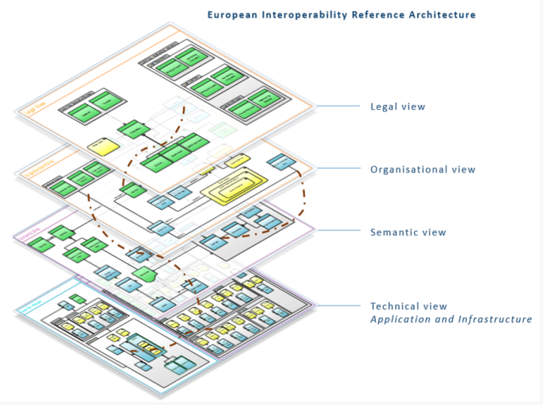
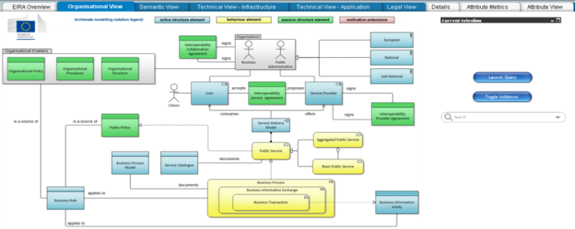
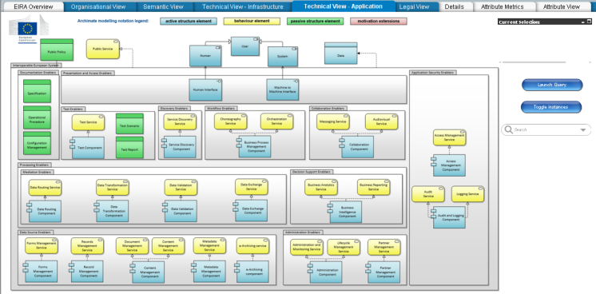
Main views (1/2)
01
02
03
04
05
Main views
EIRA overview
Zoomed EIRA views
  Illustrates the different EIRA views
  Legal
  Organisational
  Semantic
  Technical (Application and Infrastructure)

Slide 7
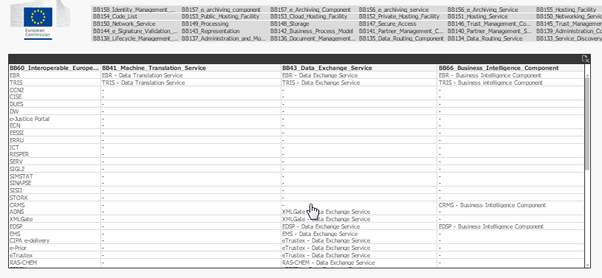
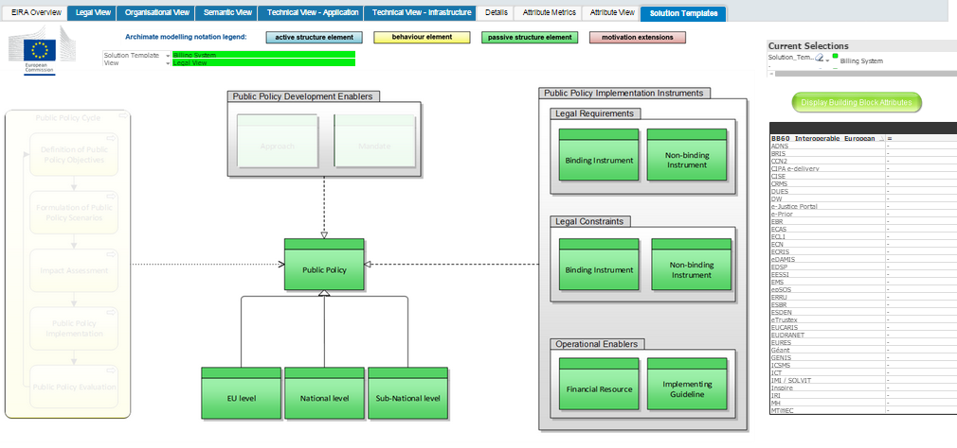
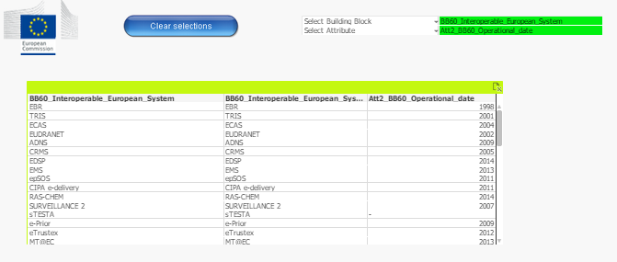
Main views (2/2)
01
02
03
04
05
Main views
Output view
Solution template view
  Results from launched queries
  Sub-sets of the EIRA building blocks
Attribute view
  Retrieve additional data on building blocks

Slide 8
Session contents
01
Introduction
02
Main views
Functionalities
03
Demo
04
Scenario-based exercise
05

Slide 9
Summary
01
02
03
04
05
Functionalities
EIRA overview | Active elements to select zoomed views
Zoomed view | Active elements for building a query Hover over Build and launch query Toggle instances Search functionalities
Output view | Update selections Search functionalities and filtering Clear the current selection query Show building blocks’ description Drag and drop
Solution template view | Selection area Active elements for building the selection query Hover over and query builder
Attribute view | Clear current selection Select specific building blocks and their attributes

Slide 10
EIRA overview
01
02
03
04
05
Functionalities
Active elements
  Integrates the different views as active elements
  Clicking a view’s name opens the corresponding zoomed view

Slide 11
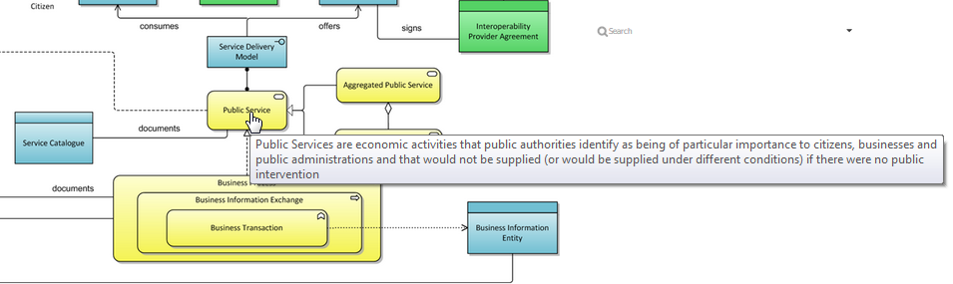
Zoomed view (1/3)
01
02
03
04
05
Functionalities
Hover over
  Definitions displayed when hovering over a building block
Active elements to build a query
  Each zoomed view shows a set of building blocks
  Building blocks can be added to and removed from query by clicking them

Slide 12
Zoomed view (2/3)
01
02
03
04
05
Functionalities
Query builder
  Track the current selection
  Validate the query before launching it
    Fieldnames for the selected building blocks
    Additional rows to filter active selection
  Add or remove elements using dropdown list
    Current selection in green, others in grey
    “Ctrl” to select multiple building blocks
    “Eraser” icon to remove entire sections
  Lookup elements using search box
    Match elements as you type
    Add elements directly to query builder

Slide 13
Zoomed view (3/3)
01
02
03
04
05
Functionalities
Launch query
  Execute query for selected building blocks
  Switch to output view to display the solutions matching the selected criteria
Toggle instances
  Display matching solutions on the building blocks of the current zoomed view itself
  Only advised when filtering is performed as this reduces the number of values

Slide 14
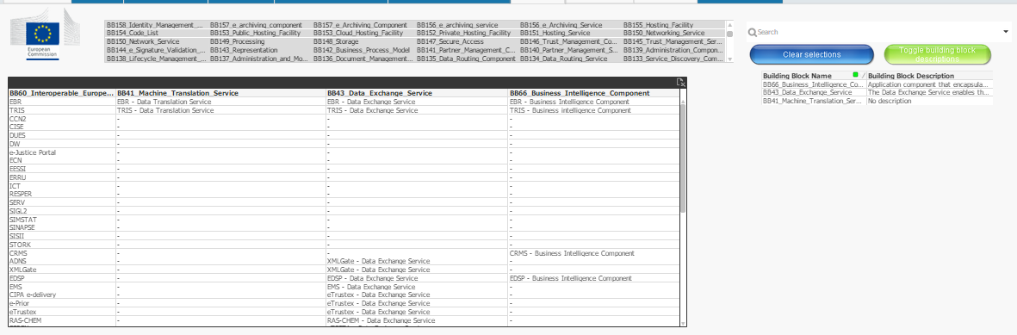
Output view (1/2)
01
02
03
04
05
Functionalities
Update query
  Select the building blocks in the selection menu (“Ctrl” and “Shift” for multiple)
  The query built via the zoomed views’ query builder is re-executed
  “Clear Selection” to remove all current query elements
  “Toggle building block descriptions” to show the selected building blocks’ description in a separate table (same information as the “Hover over” function)

Slide 15
Output view (2/2)
01
02
03
04
05
Functionalities
Drag and drop
  Customise output table by moving columns to a preferred order
Filtering
  Create specific reports filtered according to parameters
  Select specific values in the retrieved data (undo by clicking “eraser”)

Slide 16
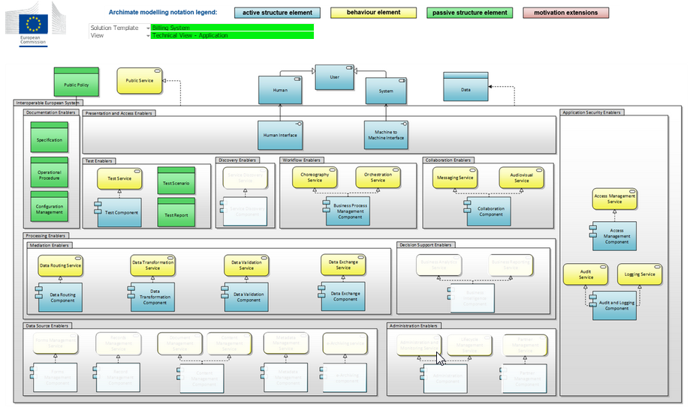
Solution template view
01
02
03
04
05
Functionalities
Selection area
  Select a solution architecture template and its specific zoomed EIRA view
Active elements to build query
  The relevant (not greyed out) building blocks are clickable
  Select exactly one building block
Common functions
  View building block descriptions using “Hover over”
  Build query using Query builder

Slide 17
Session contents
01
Introduction
02
Main views
Functionalities
03
Demo
04
Scenario-based exercise
05

Slide 18
Demo
01
02
03
04
05
Demo
Points to cover
  Walkthrough of the presented views and functionalities on the online Cartography Tool
  Execution of simple searches over existing EU Cartography data to illustrate features

Slide 19
Session contents
01
Introduction
02
Main views
Functionalities
03
Demo
04
Scenario-based exercise
05

Slide 20
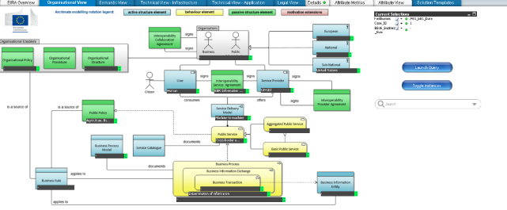
Introduction
01
02
03
04
05
Scenario-based exercise
We now have an overview of the Cartography Tool
  Its core functionalities have been presented
  The online Cartography Tool has been used to run a simple demo
Next step: understand its capabilities using scenarios
  Focus on addressing real life cases rather than specific tool features
  Require combination of information on multiple EIRA views
  Based on the currently collected EU Cartography data
  Scenarios are presented as exercises for all to participate

Slide 21
Scenario 1
01
02
03
04
05
Scenario-based exercise
Marco Revaldi is a Business Analyst working for DG TAXUD on the new eTax system. As part of eTax’s inception phase, Marco wants to see if other DG TAXUD systems that serve similar business needs have a legal basis that may need to be taken into account in the new system’s requirements’ specification.
Scenario 1

Slide 22
Scenario 1 - Key points
01
02
03
04
05
Scenario-based exercise
What are the key points to consider?
1
“… other DG TAXUD systems …”
How do I find the systems provided by a specific DG?
2
“… serve similar business needs …”
How can I find a description of a system’s core business?
3
“… legal basis …”
How can I find a system’s legal basis?

Slide 23
Scenario 1 - Solution
01
02
03
04
05
Scenario-based exercise
Solution steps
1
[Organisational view] Filter “Service Provider” by “DG TAXUD”
Only systems provided by DG TAXUD are displayed
2
[Legal view] Select “Binding Instrument”
Binding legal requirements are displayed
3
[Semantic view] Select “Security and Privacy Policy”
Legal requirements on security and privacy are displayed
4
[Organisational view] Select “Business Process” and “Business Transaction”
Systems’ core business is displayed

Slide 24
Scenario 2
01
02
03
04
05
Scenario-based exercise
Nick Stamos is an Enterprise Architect working for DG TAXUD on the upcoming eTax system. As part of its design, eTax will need to foresee identity management and auditing to check and monitor user access. Nick would like to see if other EC systems have reused such services and get in touch with their contact points to discuss their experience.
Scenario 2

Slide 25
Scenario 2 - Key points
01
02
03
04
05
Scenario-based exercise
What are the key points to consider?
1
“… foresee identity management and auditing …”
How do I find existing services for identity management and auditing?
2
“… other EC systems have reused such services …”
How can I see if these services are reusable and if they have been reused?
3
“… their contact points …”
How can I see who to contact for a given system?

Slide 26
Scenario 2 - Solution
01
02
03
04
05
Scenario-based exercise
Solution steps
1
[Technical application view] Select “Audit Service”
The audit services used by EC solutions are displayed
2
[Technical infrastructure view] Select “Identity Management Service”
The identity management services used are added to the display
3
[Technical views] Select attributes related to service reusability
The reusability status of the selected services is also displayed
4
[Organisational view] Select “Service Provider” and “Unit in DG” attribute
The DG and Unit responsible is displayed for the listed solutions

Slide 27
Scenario 3
01
02
03
04
05
Scenario-based exercise
Nicole Smith is a Project Manager for DGT working on the MT@EC system. As part of a press release, her Head of Unit has requested from her a brief report on the different kind of people that directly or indirectly use MT@EC as well the public services that are directly or indirectly facilitated through MT@EC’s automated translation services.
Scenario 3

Slide 28
Scenario 3 - Key points
01
02
03
04
05
Scenario-based exercise
What are the key points to consider?
1
“… through MT@EC’s automated translation services …”
How do I find which systems are using MT@EC’s translation service?
2
“… the different kind of people that directly or indirectly use MT@EC …”
How do I find who are the users of MT@EC and its linked systems?
3
“… the public services that are directly or indirectly facilitated …”
How do I find the public services supported by these systems?

Slide 29
Scenario 3 - Solution
01
02
03
04
05
Scenario-based exercise
Solution steps
1
[Technical infrastructure view] Filter “Machine Translation service”
The solutions (re)using MT@EC’s translation service are displayed
2
[Technical application view] Select “Human” and “System”
The people and systems using MT@EC and its linked systems are displayed
3
[Organisational view] Select “Public Service”
The public services offered by MT@EC and its linked systems are displayed

Slide 30
Scenario 4
01
02
03
04
05
Scenario-based exercise
Scenario 4
Up to you. Ideas?
Some tips
  Try to select a non-trivial case, ideally combining multiple EIRA views
  Select a case of interest to you, possibly relating to a real life need

Slide 31
Q&A
?

Slide 32
Sources
Cartography Tool link
  https://eia-project.eu/qlikview/
EIA community on JOINUP
  https://joinup.ec.europa.eu/asset/eia/description
Learning material
  https://joinup.ec.europa.eu/site/eia/support_material/EIRA_use_cases.pdf
  https://joinup.ec.europa.eu/site/eia/support_material/EIRA_training_materials.pdf
  https://joinup.ec.europa.eu/site/eia/support_material/EIRA_selected_solution_architecture_template.pdf

