Slide 1

European Interoperability Reference Architecture
(EIRA) overview
Version 0.8.1 beta
07/10/2014
ISA Action 2.1:
European Interoperability Architecture
Specific Contract N. 54
Framework contract N. DI/07171

Slide 2
Document control information
Document Title | European Interoperability Reference Architecture (EIRA) overview
Status | Delivered for acceptance
Project Title | European Interoperability Architecture
Document Author(s) | Max Stahlecker – PwC EU Services
Project Owner | Raul Mario Abril Jimenez
Project Manager | Max Stahlecker
Document Version | v0.01
Sensitivity | Limited
Date | 7 October 2014

Slide 3
Document control information
Document Approver(s) and Reviewer(s)
Name | Role | Action | Date
Raul Mario Abril Jimenez | Project Officer |  | Dd/mm/yyyy
Document History
Revision | Date | Created by | Short description of the change
v0.01 | 07/10/2014 | Max Stahlecker | Initial version

Slide 4
Disclaimer
The information and views set out in this presentation are those of the author(s) and do not necessarily reflect the official opinion of the Commission. The Commission does not guarantee the accuracy of the data included in this presentation. Neither the Commission nor any person acting on the Commission’s behalf may be held responsible for the use which may be made of the information contained therein.
© European Union, 2014
ArchiMate® and TOGAF® are registered trademarks of The Open Group.

Slide 5
Status of this EIRA version
The current version of the EIRA is the version taken over from the previous EIA contractor.
On 12th of June 2014, the ISA coordination group endorsed the current version of the EIRA stating that it is mature enough to go to public consultation and to be used in pilots.
The current EIA contractor published this version as the EIRA release v0.8.1 beta. More information of the versioning of EIRA and Cartography Tool releases can be found in EIA’s deliverable D02.04 – EIRA and Cartography tool releases roadmap.
The EIRA release v0.8.1 is published on Joinup: https://joinup.ec.europa.eu/asset/eia/description

Slide 6
Key take-away messages of the EIRA
The European Interoperability Reference Architecture (EIRA) is an application of Enterprise Architecture with a focus on interoperability in the public sector.
The European Interoperability Reference Architecture is based on the Service Oriented Architecture style and uses the Archimate modelling notation.
EIRA implements the European Interoperability Framework (EIF). There is a full alignment between the EIRA and the EIF.
Each view of the European Interoperability Reference Architecture is defined in terms of the interoperability aspects that are supported.
Views of the European Interoperability Reference Architecture are linked through designated entry and exit building blocks following a layered approach.
The ambition of the EIRA is to provide real value to the European public administration, both at the Member States level as to the European Institutions level. The EIRA is developed in collaboration with the Member States.

Slide 7
Content
1
Introduction & overview
2
EIRA views
3
Questions & Support

Slide 8
Introduction & overview
1

Slide 9

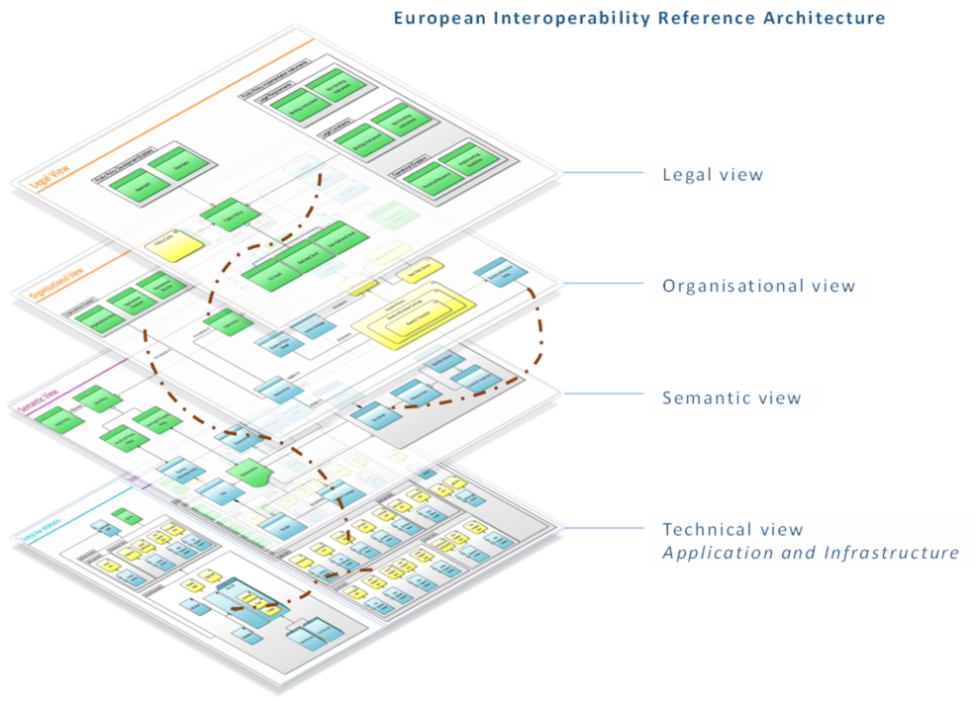
EIRA
An overview
1
2
3
EIRA
European Interoperability Reference Architecture
  A four-view reference architecture for delivering digital public services (across borders and sectors).
  It defines the required capabilities for promoting interoperability as a set of Architecture Building Blocks (ABBs).
Current version of the EIRA release is version v0.8.1 beta
On 12th of June 2014, the ISA coordination group endorsed the current versions of the EIRA and Cartography Tool stating that they are mature enough to go to public consultation and to be used in pilots.

Slide 10
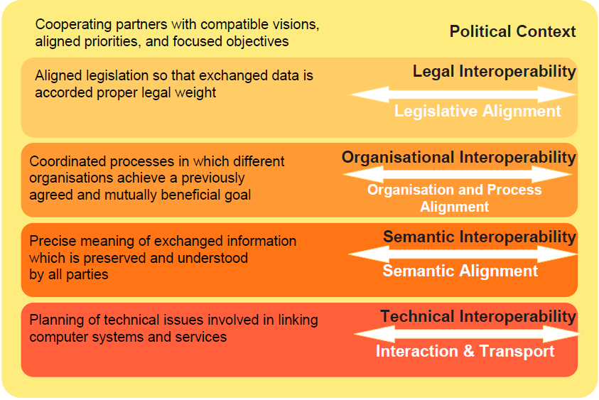
EIRA
From the EIF to the EIA
1
2
3
European Interoperability Framework
European Interoperability Architecture
European Interoperability Reference Architecture
Political context
Legal View
Organisational View
Semantic View
Technical View – Application
Technical View – Infrastructure

Slide 11


EIRA
Positioning canvas
1
2
3
Enterprise Architecture
Interoperability Architecture
Solution Architecture
-
How to go from
State A to State B
How to buy, build
or reuse solutions
EIRA
Cart
Best practices
Best practices
Detail level
How to support interoperability
Best practices
Best practices
+
+
Abstraction level
-

Slide 12





EIRA
Notation used in the EIRA
1
2
3
Building block colours
An active structure element is defined as an entity that is capable of performing behaviour.
A behaviour element is defined as a unit of activity performed by one or more active structure elements.
A passive structure element is defined as an object on which behaviour is performed.
Relationships between building blocks
Composed of
Access
Aggregated of
Specialisation
Used by
Associated with
Realises
Triggers
Assigns

Slide 13
EIRA views
2

Slide 14
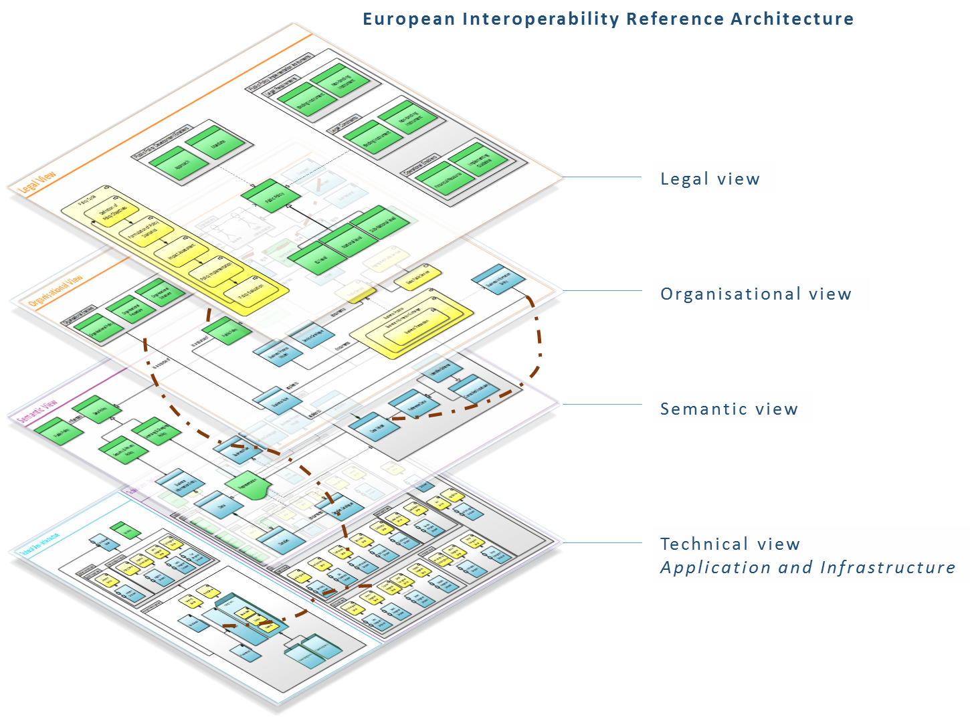
EIRA
Overview
1
2
3

Slide 15
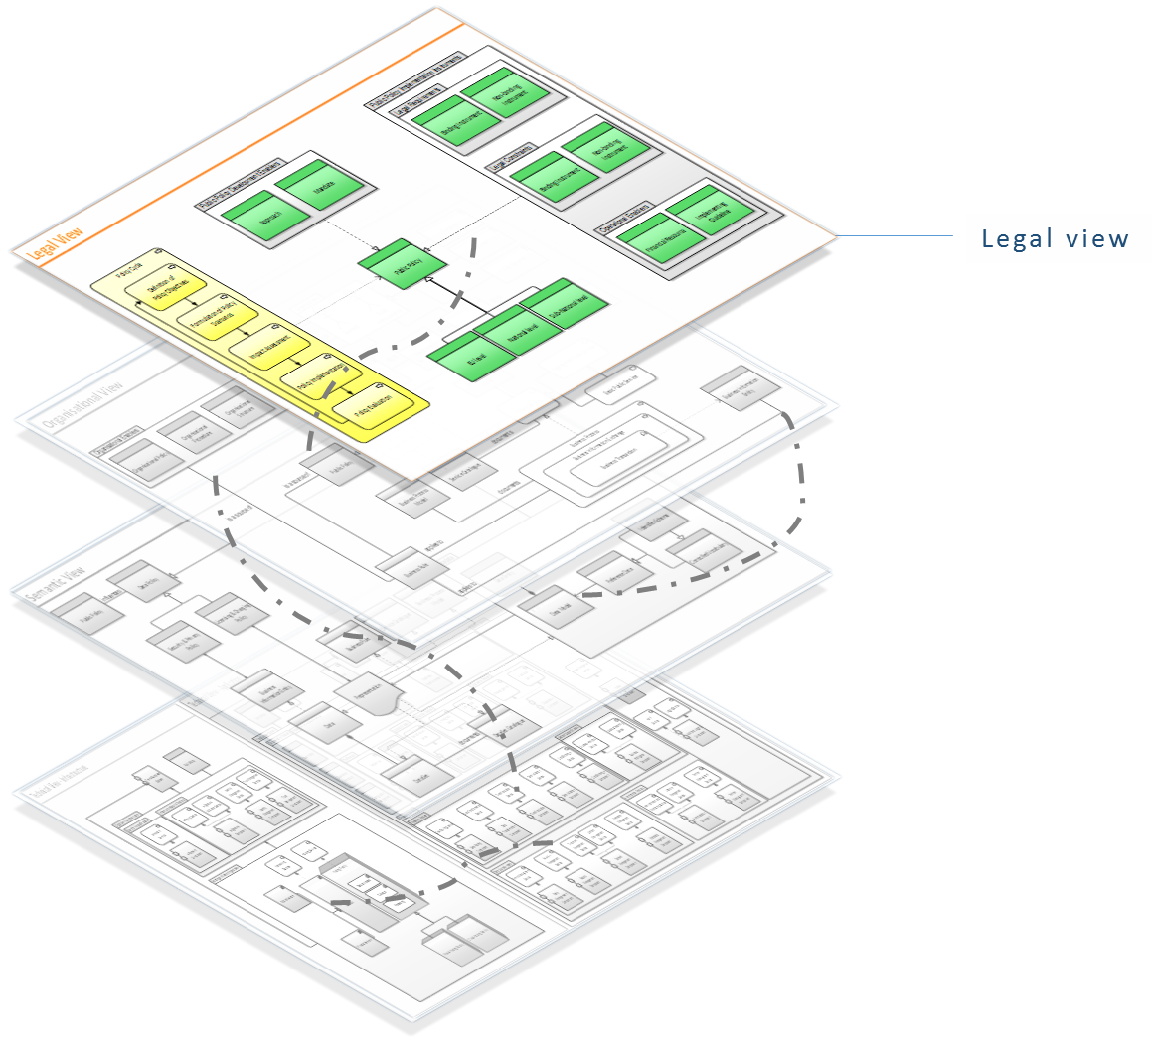
Legal view
Entry & exit points
1
2
3
The Legal view models the most salient public policy development enablers and implementation instruments that shall be considered in order to support legal interoperability in the public policy cycle.
Entry points | /
Exit points | ‘Public Policy’ to ‘Organisational view’, ‘Semantic view’, ‘Technical view – Application’, and ‘Technical view – Infrastructure’

Slide 16
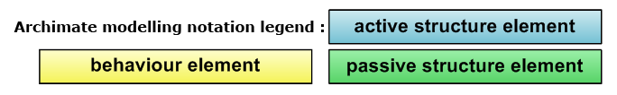
Legal view

Slide 17
Legal view
Narrative
1
2
3
A [Public Policy], at [EU level, National level or Sub-National level], is the outcome of a specific public policy cycle, that aims at addressing the needs of a / a group of stakeholders. The public policy cycle consists of the following subsequent steps: [Definition of Public Policy Objectives], [Formulation of Public Policy Scenarios], [Impact Assessment], [Public Policy Implementation], [Public Policy Evaluation].
The public policy is developed taking into account public policy development enablers, which include a specific [Approach] (centralised/decentralised) and a [Mandate]. The policy is implemented through policy instruments, which can be [Binding / Non-Binding] [Legal Requirements or Constraints], or operational enablers, in the form of [Financial Resources] and [Implementing Guidelines].

Slide 18
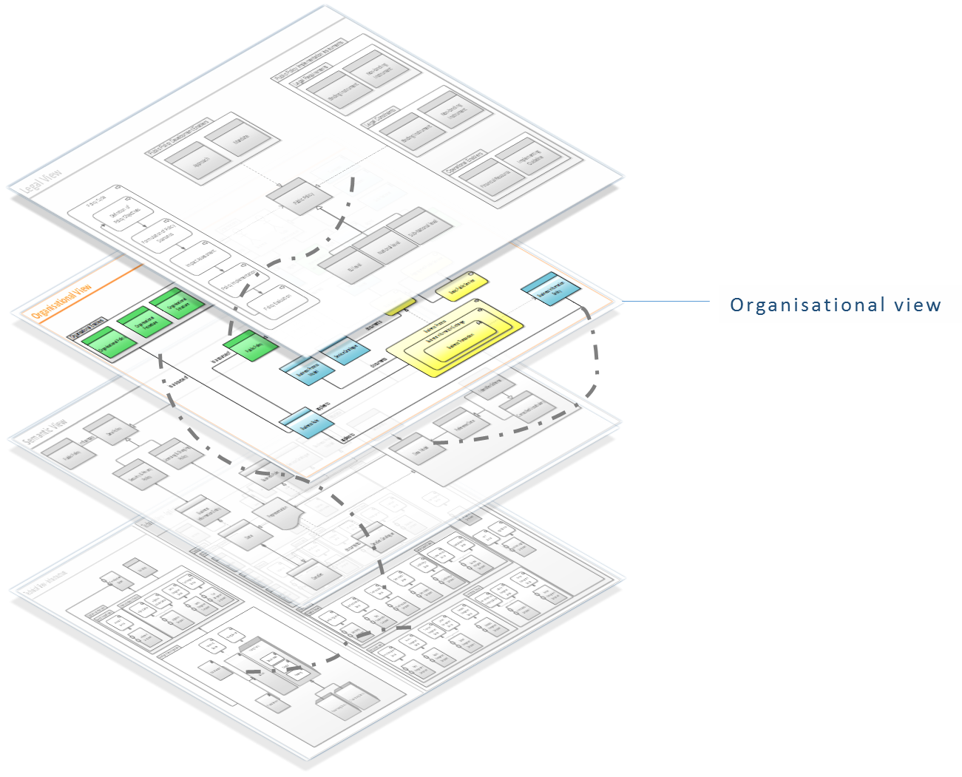
Organisational view
Entry & exit points
1
2
3
The Organisational view models the most salient building blocks that shall be considered in order to support organisational interoperability among providers and users of a public service.
Entry points | ‘Public Policy’ from ‘Legal view’
Exit points | ‘Business Information Entity’ to ‘Semantic view’ ‘Business Rule’ to ‘Semantic view’ ‘Service Catalogue’ to ‘Semantic view’ ‘Business Process Model’ to ‘Semantic view’ ‘Public Service’ to ‘Technical view – Application’

Slide 19
Organisational view

Slide 20
Organisational view
Narrative
1
2
3
[Organisations] on [EU level / National level / Sub-National level] in the role of Service Providers supply [Public Services] of the [Service Catalogue] to [Public Administrations] and/or [Businesses] and/or [Citizens] in the role of users according to a [Service Delivery Model]. Organisations which are collaborating on interoperability projects or assignments, can sign an [Interoperability Collaboration Agreement]. With the aim of delivering the public service, the service provider proposes and the user accepts an [Interoperability Service Agreement]. [Service Providers] can sign an [Interoperability Provider Agreement] to agree on how to deliver a public service to their users.
The delivery of these public services is realised through [Business Processes] following a [Business Process Model]. Business processes contain [Business Information Exchanges], which enclose [Business Transactions] of defined [Business Information Entities].
Business processes and business information entities are subject to [Business Rules] originating from the [Public Policy] and [Organisational Policies] which echo [Organisational Structures] and [Organisational Procedure] of the [Organisations] involved.

Slide 21
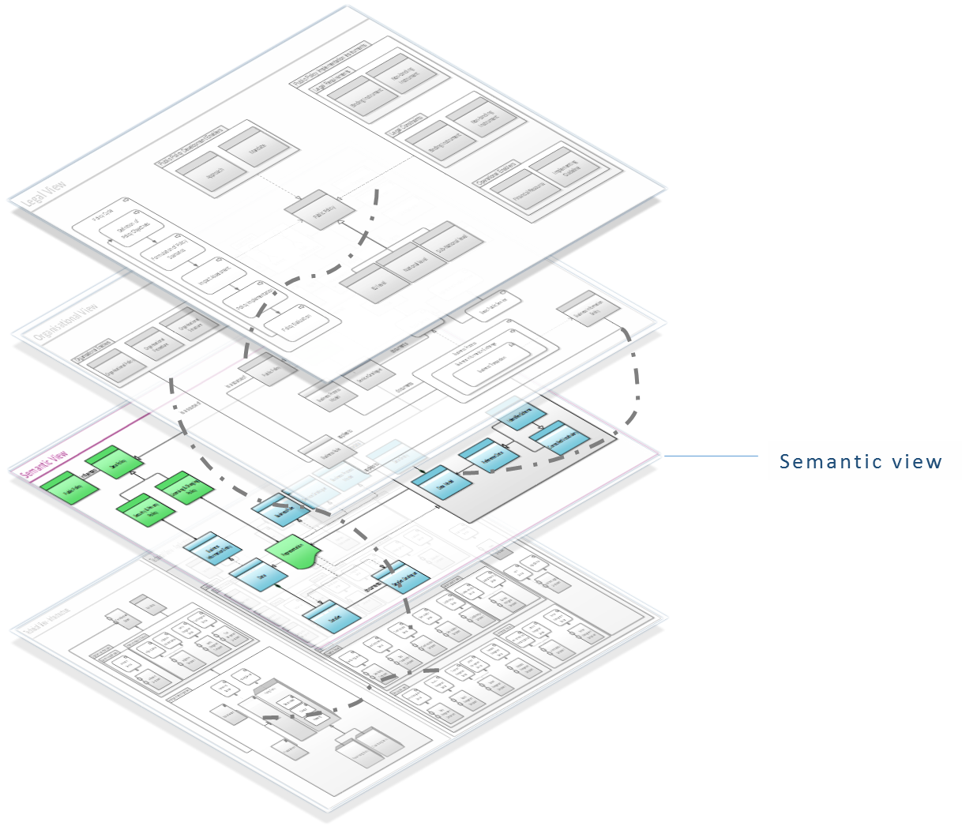
Semantic view
Entry & exit points
1
2
3
The Semantic view models the most salient building blocks that shall be considered in order to support semantic interoperability of business information entities processed by an IES.
Entry points | ‘Public Policy’ from ‘Legal view’ ‘Business Information Entity’ from ‘Organisational view’ ‘Business Rule’ from ‘Organisational view’ ‘Service Catalogue’ from ‘Organisational view’ ‘Business Process Model’ from ‘Organisational view’
Exit points | ‘Data’ to ‘Technical view – Application’

Slide 22
Semantic view

Slide 23
Semantic view
Narrative
1
2
3
[Data], which groups [Data Sets] and is documented in the [Data Set Catalogue], is represented using a specific [Representation] format. [Business Rule], [Service Catalogue] and [Business Process Model] are also subject to a representation.
[Metadata], composed of [Data Models] and [Reference Data], provide the structure for a [Representation]. The reference data include [Identifier Schemas], [Controlled Vocabularies], and/or [Code Lists].
Data is classified according to a [Security & Privacy Policy]. A [Licensing & Charging Policy] can be [applied / not applied], which can depend on the specific representation of data. [Metadata] are managed through a specific [Metadata Management Policy].

Slide 24
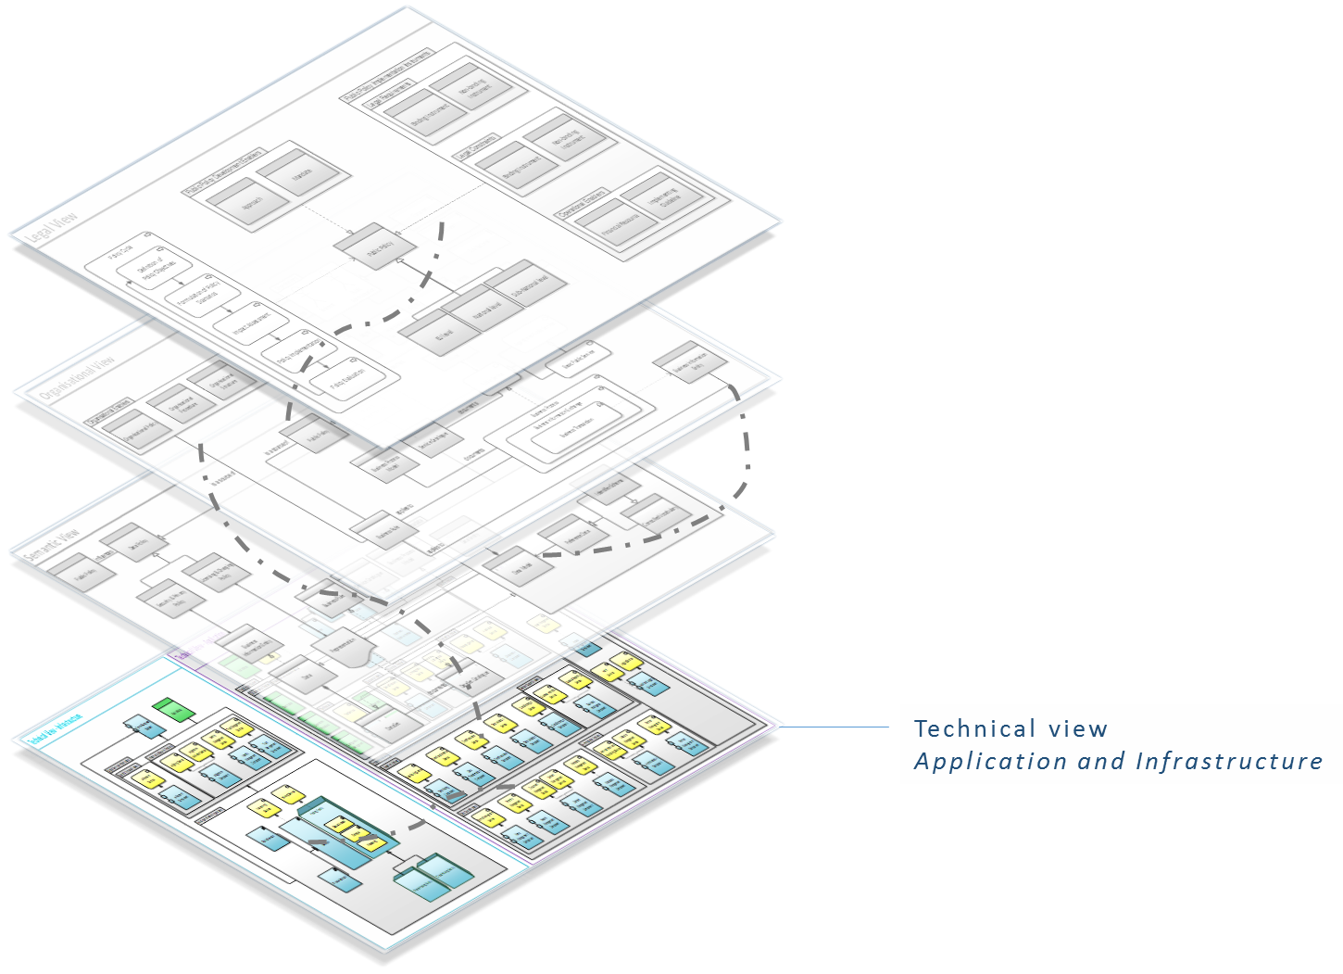
Technical view – Application
Entry & exit points
1
2
3
The Technical view - Application models the most salient policy-specific application building blocks that need to be considered in order to support technical interoperability when building an Interoperable European System (IES). An IES can support one or several policies.
Entry points | ‘Public Policy’ from ‘Legal view’ ‘Public Service’ from ‘Organisational view’ ‘Data’ from ‘Semantic view’
Exit points | ‘Interoperable European System’ to ‘Technical view – Infrastructure’

Slide 25
Technical view – Application

Slide 26
Technical view – Application
Narrative
1
2
3
[Interoperable European Systems (IESs)] implement [Public Services] and are supporting one or multiple [Public Policies]. They can be accessed by [Users], which can be [Humans] or [Systems], through [Presentation and Access Enablers]. The IES is documented through [Documentation Enablers] and is tested through the use of [Test Enablers].
An IES provides access to data through [Data Source Enablers]. Information can be exchanged, cross-border and cross-sector, with the support of [Mediation Enablers], or can be processed to make informed decisions with the help of [Decision Support Enablers].
IESs can execute complex business processes through [Workflow Enablers] and can support interaction among humans through [Collaboration Enablers]. The information related to the services provided by an IES can be discovered by users or systems through the [Discovery Enablers].
Access control and data security are managed through the services offered by [Application Security Enablers], involving [Access Management Components] and [Audit and Logging Components].
The administration and operational management of an IES system is performed through [Administration Enablers].

Slide 27
Technical view – Infrastructure
Entry & exit points
1
2
3
The Technical view - Infrastructure models the most salient infrastructure services that shall be considered in order to support technical interoperability when building an IES.
Infrastructure building blocks are any type of building blocks providing cross-policy services or functionalities.
Entry points | ‘Interoperable European System’ from ‘Technical view – Application’
Exit points | /

Slide 28
Technical view – Infrastructure

Slide 29
Technical view – Infrastructure
Narrative
1
2
3
The [Interoperable European Systems] and its application components make use of cross-sectorial [Digital Services Infrastructures], such as [Infrastructure Security Enablers], [e-Payment Services], and [Machine Translation Services]. The Interoperable European Systems and the digital services infrastructures are deployed and operated through [Hosting and Networking Services Infrastructures], provided by a [Public / Private Hosting Facility], and make use of a [Public / Private Network] to exchange data.

Slide 30
Context view
1
2
3

Slide 31
EIRA
Entry/exit points overview
1
2
3
The number indicated in the cells of the table represents the number of entry building block(s), belonging to the “origin” view, that are included in the “destination” view;
The sum of the numbers in a row indicates the number of exit building blocks in the corresponding “origin” view.
 |  | DESTINATION
 |  | Legal view | Organisational view | Semantic view | Technical view - Application | Technical view - Infrastructure
ORIGIN | Legal view |  | 1 | 1 | 1 | 1
 | Organisational view | - |  | 4 | 1 | -
 | Semantic view | - | - |  | 1 | -
 | Technical view - Application | - | - | - |  | 1
 | Technical view – Infrastructure | - | - | - | -

Slide 32
Questions & Support
3

Slide 33


Questions & Support
Contact information & links
1
2
3
Contact us
Max Stahlecker Lead Architect
+ 32 2 710 4537
eia@be.pwc.com
For more information
EIRA
European Interoperability Reference Architecture
Cartography tool
European Interoperability Cartography
EIA Joinup community | https://joinup.ec.europa.eu/asset/eia/description
EIA project collaborative space | https://webgate.ec.europa.eu/CITnet/confluence/display/EIA/EIA+Home
ISA website | http://ec.europa.eu/isa/index_en.htm
ISA FAQ | http://ec.europa.eu/isa/faq/faq_en.htm

