Slide 1
ISA Action 1.3: Catalogue of Services
Webinar: test implementations and pilots of the tools

Slide 2
How to enter the Virtual Meeting Room?
See https://joinup.ec.europa.eu/asset/cpsv-ap/event/webinar-test-implementations-and-pilots-tools/
Web connection: http://ec-wacs.adobeconnect.com/cpsv_tools/
Audio connection:
Go to http://ec-wacs.adobeconnect.com/cpsv_tools/
Click 'Enter as a guest', fill in your name and click 'Enter meeting'.
Click 'ok' to agree with the Web Conferencing Disclaimer
Answer 'Start' to the question: Would you like audio conferencing with this meeting?
Choose to connect with microphone and headset OR enter your telephone number and have the system call you OR dial your Local or International Access Number:
Belgium: +3228081363 France: +33182880967 Germany: +498922061600 Luxembourg: +35220880608 United Kingdom: +442033189433
Dial the Conference Room Number: *1323004#

Slide 3
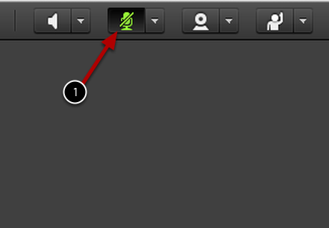
Practical arrangements
Please:
Mute your mic when not speaking
To mute your microphone click the Microphone Icon. When muted, the icon will remain green with a slash.
Raise your hand to request the floor (and help making the speaker aware of who is raising hands)
Use the chat box for sharing links and making comments
Voting: use the chatbox (+1 / -1 / abstain)

Slide 4
Agenda
https://joinup.ec.europa.eu/asset/cpsv-ap/event/webinar-test-implementations-and-pilots-tools

Slide 5
Goals of this webinar
Inform about the current development of the test implementations
Get stakeholder feedback on the current results
Discuss possible pilots and get engagement

Slide 6
Overall context and goals of this task (10’)

Slide 7
What has happened?
Identification and technical analysis of the existing tools used for creating, managing… exchanging public service descriptions
Interview with the technical counterpart of the participating PSCs
Assessment of the reusability of existing solutions
Gap analysis
Description of reusable tools

Slide 8
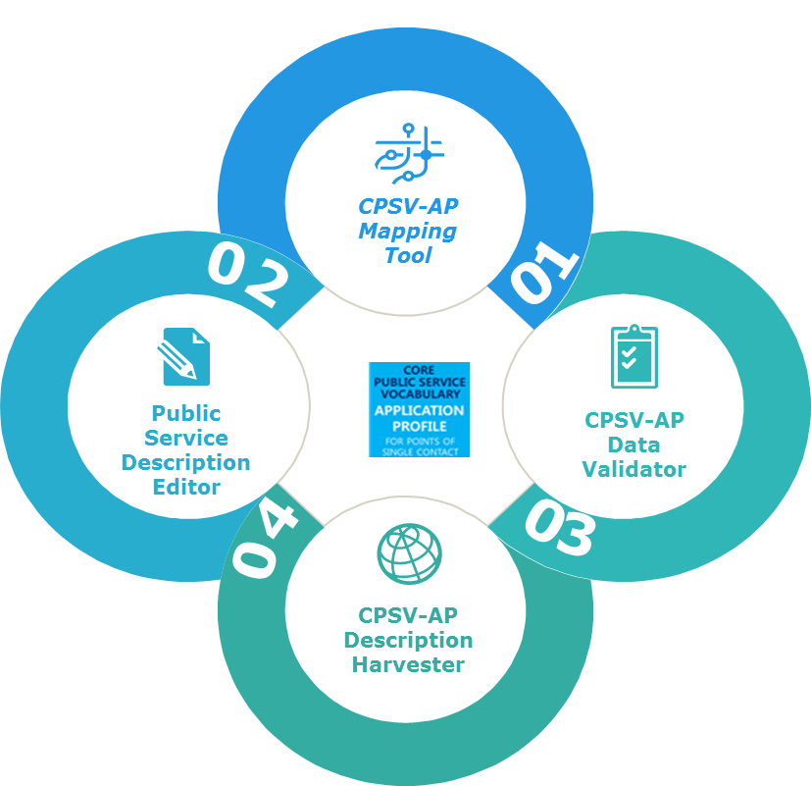
What has happened?
Stakeholder needs
Features
Technical architecture
User Interface design
Use cases

Slide 9
What are the goals?
Selection and feedback on requirements
Deployment / testing with stakeholders + technical support
Feedback on intermediary versions through meetings
Development of the pilot implementations

Slide 10
Creating tools to help public authorities
I want to easily reuse and exchange information on public services.
Portal
for
citizens or businesses
I want to make CPSV-AP compliant descriptions
Public Service
description editor
I want to validate my data against the CPSV-AP
CPSV-AP
Validator
Gather data
I want to map my data model to the CPSV-AP
CPSV-AP
Mapping tool
I want to harvest CPSV-AP compliant descriptions
Exchange data
between public
administrations
CPSV-AP
Harvester

Slide 11
How could the tools work in a European/national context?
Common vocabulary - Standards
CPSV-AP Mapping Tool
CPSV-AP Data Validator
Portal
Public Service Description Editor
Public Service Description Harvester
Notes:
Public administrations offer and public the information. The portal would go through a list of selected existing portals, collecting the description of public services offered. On this purpose, different processes of transformation and harmonisation of information are needed.
First, as the information on the different portals will be structured according to a different data model, a common vocabulary standard, like the CPSV-AP, is needed in order to harmonise this and for being able to integrate the information. This will also enable the searchability and discoverability of the information on public services, as the user only needs to understand one way of how the descriptions of public services are being.
An editor is needed to create/update the information in the source systems.
A mapping tool is needed to map the different MSs data models to the CPSV-AP. The source systems therefore do not need to adapt their system and the way the information is being structured in the source. They only need to be able to map to CPSV-AP and export the information from their system accordingly.
Harvesting and validation is needed to get the information from one place to another

Slide 12
Public Service Description Editor (20’)

Slide 13
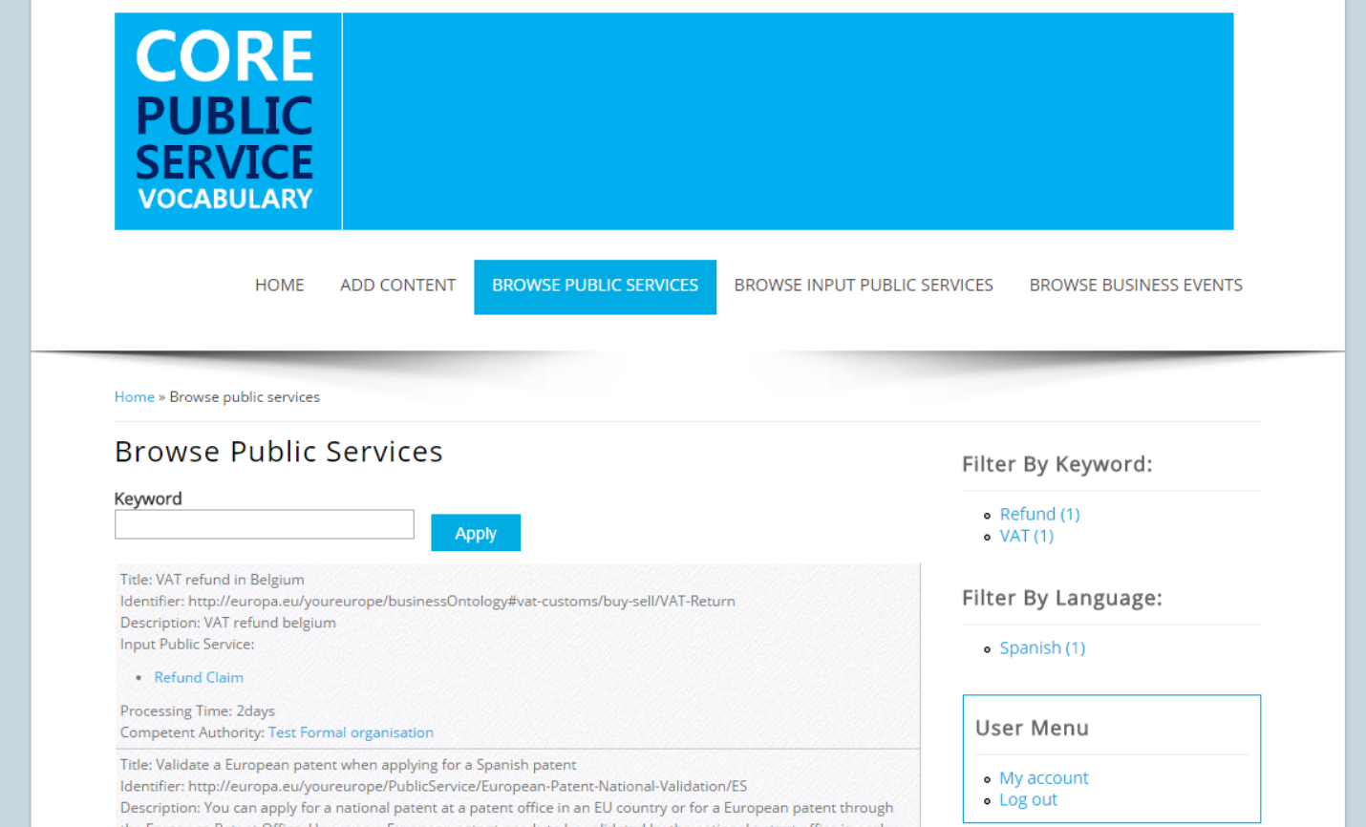
Public Service Description Editor Demonstration of the tool
http://52.50.205.146:8890/cpsv-ap_editor/
http://52.50.205.146/drupal-auth
Graph: http://drupal.cpsv-ap.eu

Slide 14
Public Service Description Editor Use Cases
Use cases
Create/Edit/Remove a public service description
Export public service description
Search a public service description
Visualise the saved information

Slide 15
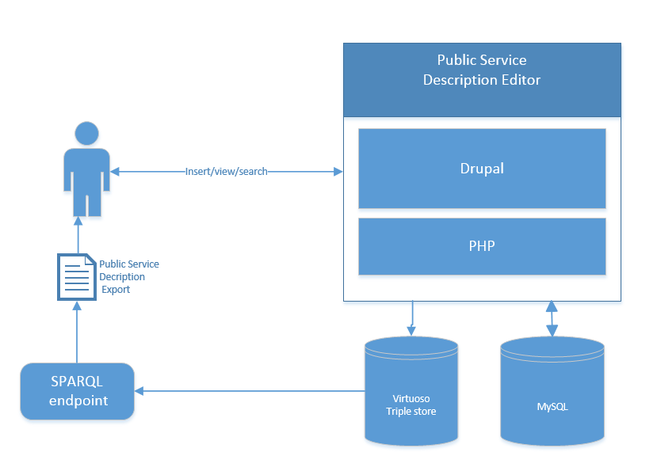
Public Service Description Editor Technical architecture, components & deployment

Slide 16
Public Service Description Editor Ideas & Suggestions
Do we want anonymous users to be able to browse the public service descriptions?
Do we want to add the “country”-field for the public services to make filtering easier.
Possible layout changes?
→ Open a discussion on Joinup to propose changes

Slide 17
https://github.com/catalogue-of-services-isa/cpsv-ap_editor
Public Service Description Editor Adaptability
Download code on GitHub
Add classes, properties and RDF mappings
Adapts XSL-transformation file
Add non-existing classes
Add non-existing properties

Slide 18
Public Service Description Editor Next steps
Implement all classes and reflect changes of the revised CPSV-AP
Evaluate the proposed changes and implement them
Use the test implementations in the organized pilots

Slide 19
CPSV-AP Validator (20’)

Slide 20
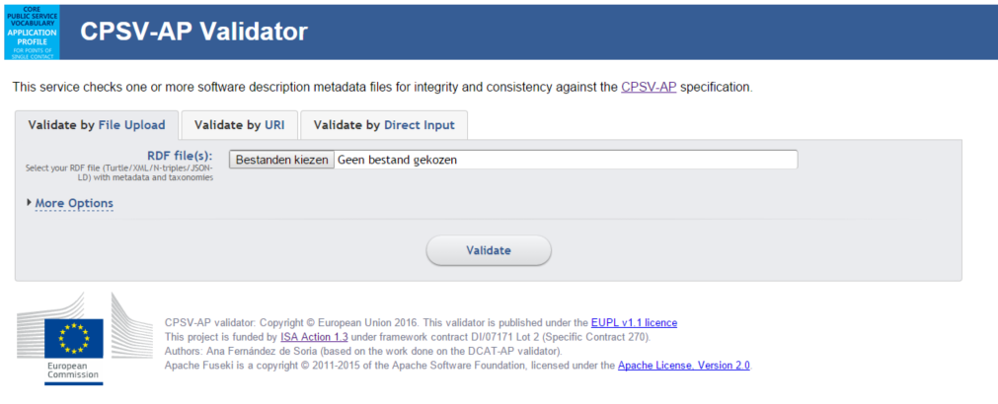
CPSV-AP Validator Demonstration of the tool
http://52.50.205.146:3030/cpsv-ap_validator.html

Slide 21
CPSV-AP Validator Use cases
Use case
Validate a public service description

Slide 22
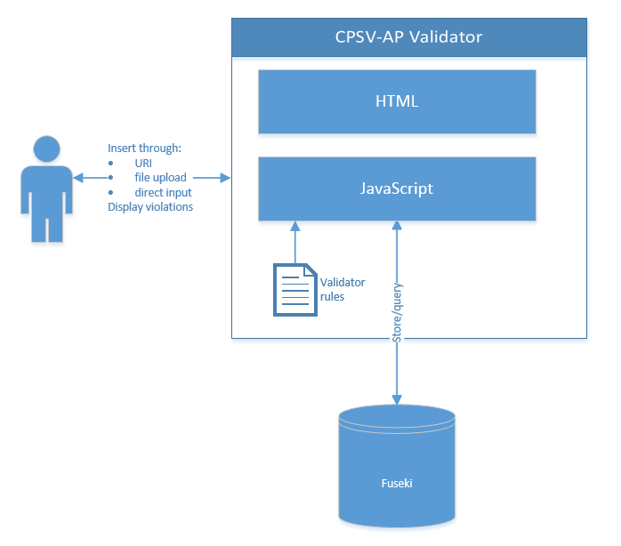
CPSV-AP Validator Technical architecture, components & deployment

Slide 23
CPSV-AP Validator Ideas and suggestions
Do you think it is user-friendly?
Should we restrict the access?
→ Open a discussion on Joinup to propose changes

Slide 24
CPSV-AP Validator Adaptability
https://github.com/catalogue-of-services-isa/cpsv-ap_validator
Download code from GitHub.
Update the rules in the cpsv-ap.rq file.
Update the HTML pages if needed.

Slide 25
Public Service description Editor Next steps
Update the rules with the new CPSV-AP version once the revision is over
Accept additional input formats
Create HTML view of the imported description
Show the errors and/or warnings in the description

Slide 26
CPSV-AP Mapping tool (15’)

Slide 27
CPSV-AP Mapping tool Use cases
Use cases
Add/Edit/Remove metadata manually.
Map a data model.
Visualise saved mappings.

Slide 28
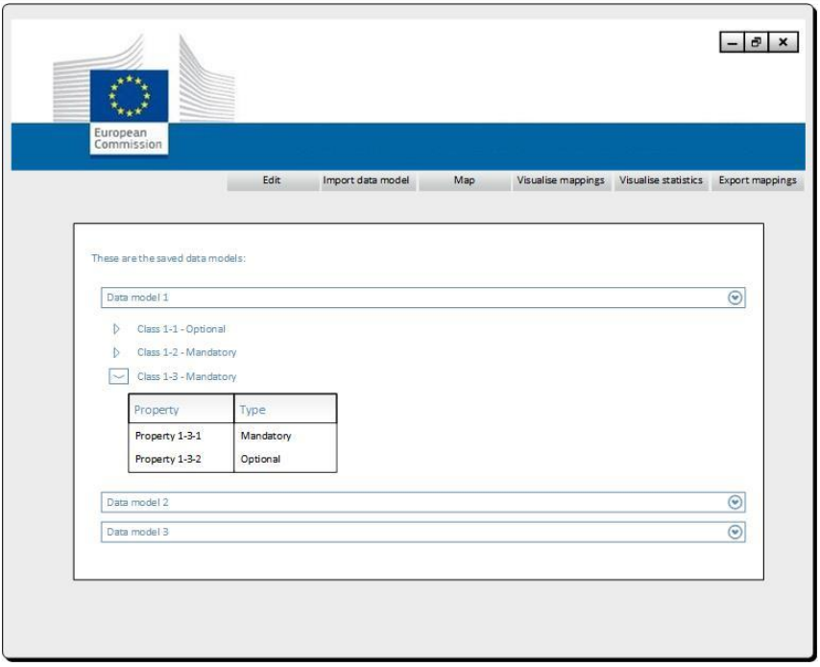
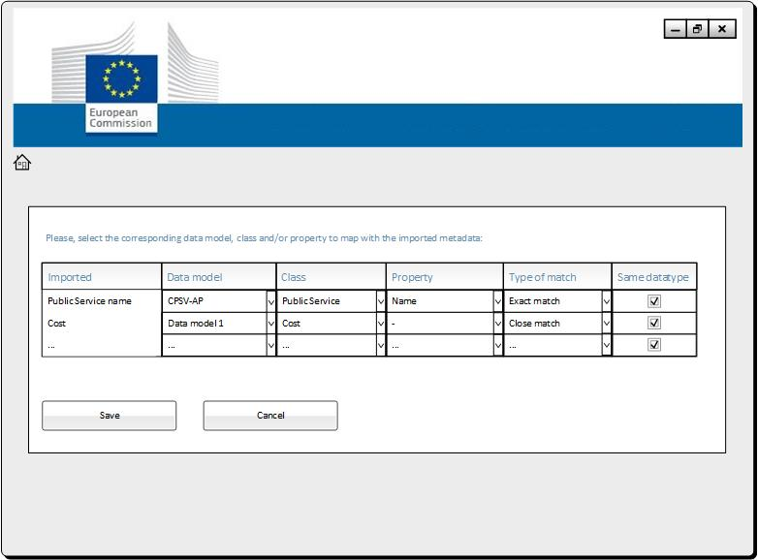
CPSV-AP Mapping tool initial screen designs

Slide 29
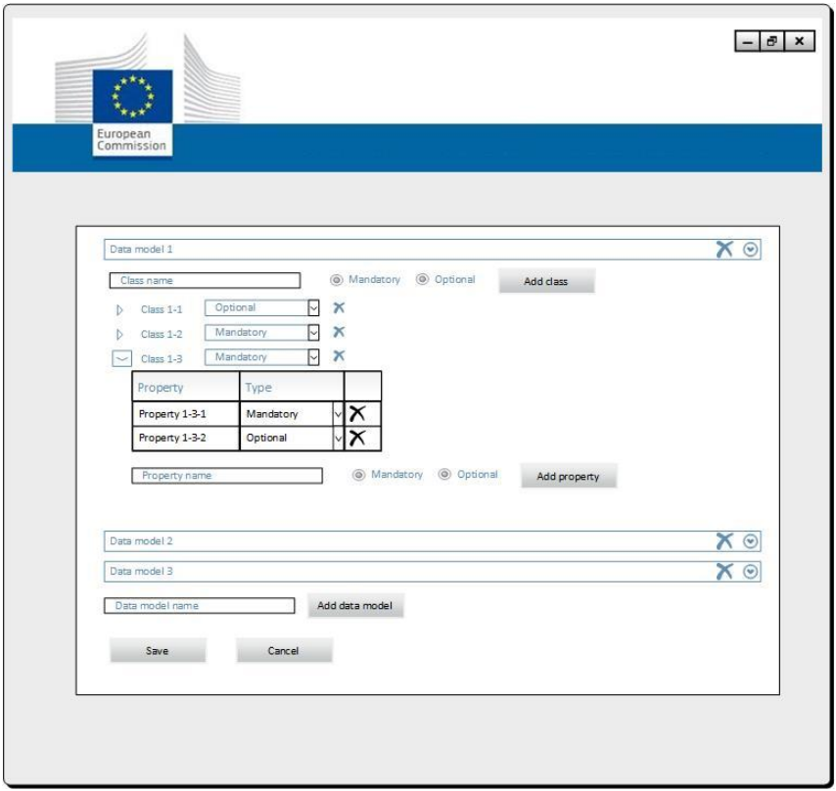
CPSV-AP Mapping tool initial screen designs

Slide 30
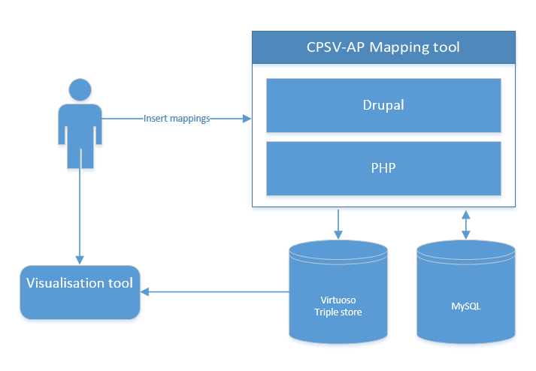
CPSV-AP Mapping tool Technical architecture, components & deployment
Notes:
1. Reutilisation of the Core Data Model Mapping Directory for the visualisation -> http://mapping.semic.eu/visualisation/tree.html

Slide 31
CPSV-AP Mapping tool Plans for development and test implementations
Functional & technical specifications
July 2015
Start development
Begin may 2016
First version
End of may 2016

Slide 32
CPSV-AP Mapping tool Expected goals for the test implementations
Use cases
Add/Edit/Remove metadata manually.
Map a data model.
Visualise saved mappings.

Slide 33
CPSV-AP Description Harvester tool (15’)

Slide 34
CPSV-AP Description Harvester Use cases
Use cases
Configure automatic harvesting.
Harvest information.

Slide 35
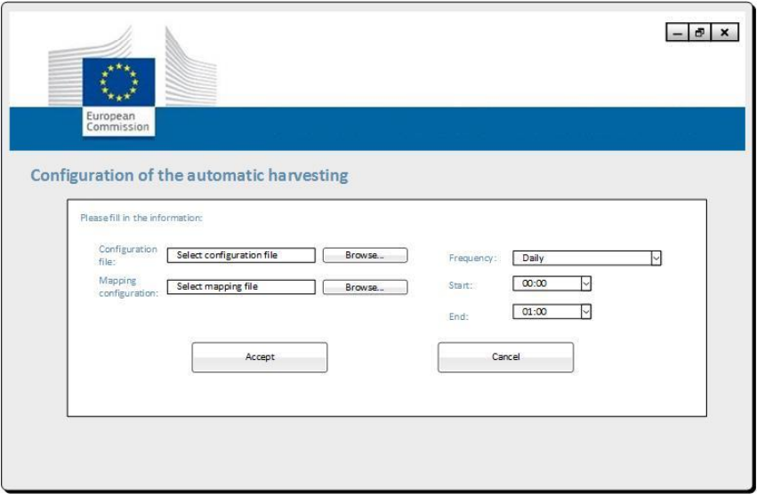
CPSV-AP Description Harvester Initial screen designs

Slide 36
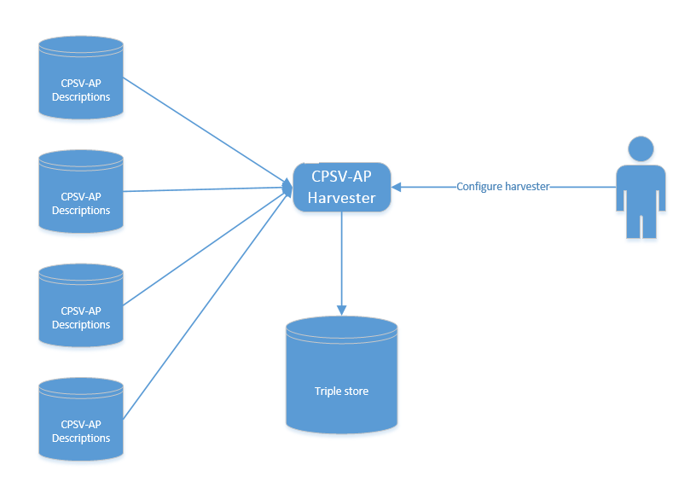
CPSV-AP Description Harvester Technical architecture, components & deployment

Slide 37
CPSV-AP Description Harvester Plans for development and test implementations
Functional & technical specifications
July 2015
Start development
Begin may 2016
First version
End of may 2016

Slide 38
CPSV-AP Description Harvester Expected goals for the test implementations
Use cases
Configure automatic harvesting.
Harvest information.

Slide 39
Piloting for the tools (20’)

Slide 40
Reuse the test implementations in a pilot setting
Reuse the test implementations in a MS or cross-border context
A pilot may reuse one or more tools
Which test implementations could be used for the pilots?
In what form could the test implementations be used
Adapt the test implementations based on the specific needs or setting of the stakeholder
Use the test implementations as they are

Slide 41
Who has shown interest:
Finland
The Netherlands
DG GROW
eSENS
Greece
Belgium
Spain
Latvia
Estonia
Italy
Anyone else
Interested?

Slide 42
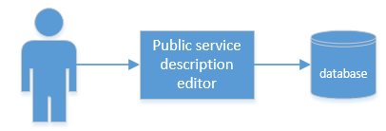
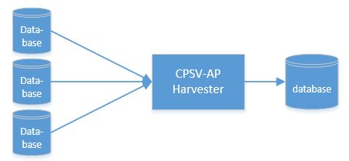
Reuse the test implementations in a pilot setting
Describing public service descriptions
and storing them in a database.
Harvesting CPSV-AP descriptions from multiple databases into one database.
Mapping your data model to CPSV-AP with the mapping tool.
Validating CPSV-AP Descriptions or tailoring the validator for using it in a national context and checking compatibility with the national model.

Slide 43
Piloting of the tools– what’s next?
Confirm engagement and interest for the pilots
How to continue? What are the next steps we are going to take?
Defining the pilot use cases
Planning more focussed calls for the particular pilots
Discuss configuration and implementations of the pilots
What do we expect from you?
Input for defining the pilot use cases;
Attending bilateral meetings for discussing the progress;
Input and feedback for the development of the pilot;
Using the pilot results!

Slide 44
Piloting of the tools – what’s the timing?
Commitment: before end of June;
Defining the pilot use cases: before mid-July
Development of the pilots: between beginning of July and end of October;
Finalised pilots: before end of October

Slide 45
Next steps (5’)

Slide 46
What are the next steps?
Further develop the tools and enhance the current test implementations
Specific meetings with stakeholders involved in pilots
Define and set up the pilots together with the stakeholders
Follow-up meetings with the stakeholders to discuss the pilots

Slide 47
Questions?
?

Slide 48
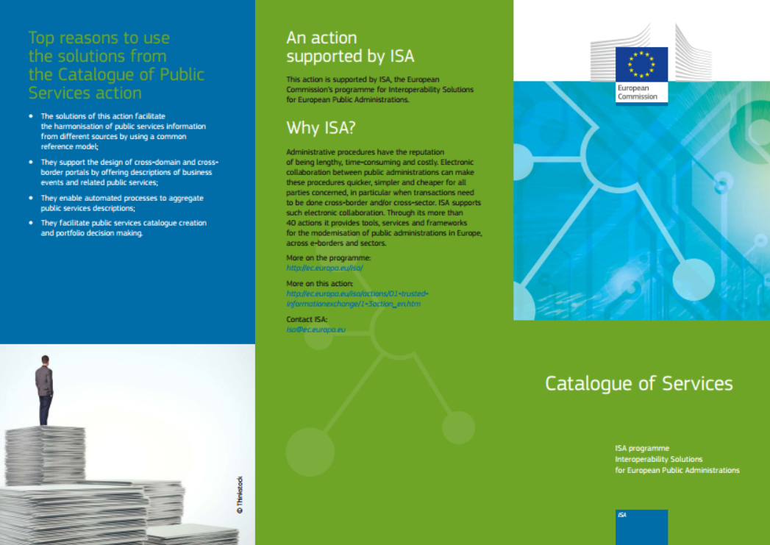
Contact us
Visit our initiatives
Project Officers
Miguel.Alvarez-Rodriguez@ec.europa.eu
Peter.Burian@ec.europa.eu
Contractors
Nikolaos.Loutas@be.pwc.com
Michiel.de.Keyzer@be.pwc.com
https://joinup.ec.europa.eu/node/104244/

