Slide 1
MAGDA²-platform
29 March 2017, Lisbon, Portugal

Slide 2
Outline
Context
MAGDA² problem solver
MAGDA²
Design
Impact and results
Governance
Next Steps
Flanders Region, Belgium

Slide 3
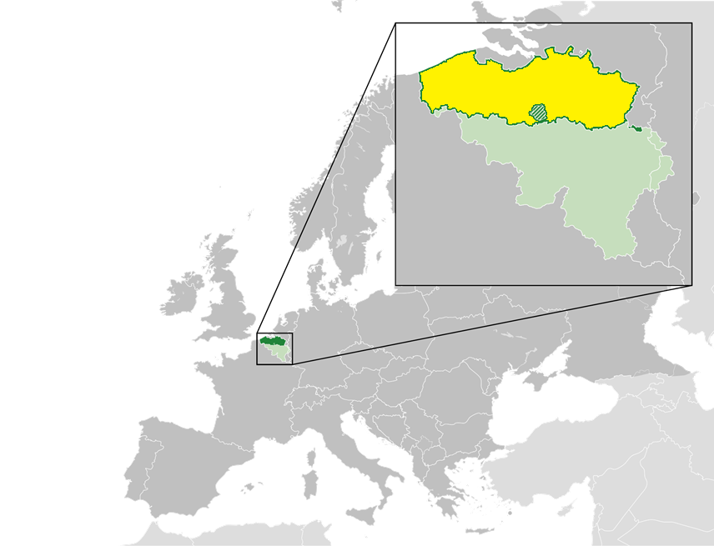
Context
Flanders Information Agency: MAGDA²
308 municipalities
2068 private partners
978 public partners
6,4 M citizens
3 regions
Federal government

Slide 4
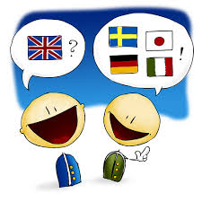
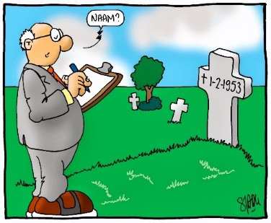
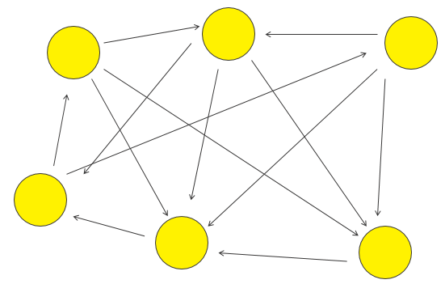
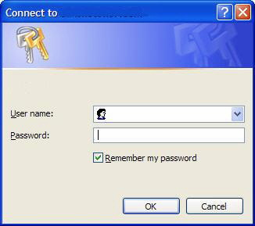
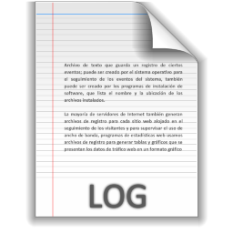
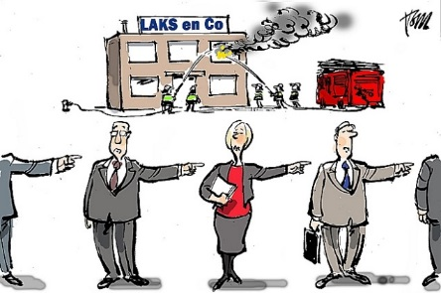
MAGDA²: problem solver
Semantics OSLO²/
Standardisation
Security
Identification
Logging
Authentication
Repsonsabilty
Notes:
Om nog maar niet te spreken over

Slide 5
U
U
U
U
U
U
U
U
U
U
Customers
U
U
U
U
U
U
U
U
U
U
U
U
U
U
MAGDA²
U
U
U
U
U
U
* 7
U
U
U
U
U
U
U
U
U
U
U
U
U
U
U
U
U
U
U
U
U
U
U
U
U
U
U
U
U
U
U
U
U
U
U
U
U
U
U
U
U
U
U
U
U
U
U
U
U
U
U
U
U
U
U
U
U
U
U
U
U
U
U
U
U
U
U
U
U
U
DATA SHARING PLATFORM
National Register
Enterprise regis.
Social Security
Vehicles
Work permits
Refugee Integration
Education info
Diploma
…
Integrator
Int
Integrator
Base Registries

Slide 6
Governance
Coordination Comittee – Customer board
MAGDA² Steering Committe
MAGDA² Team
MAGDA Design/PRODUCT Team
MAGDA Release Team
MAGDA Exploitation Team
Notes:
In gateway: Authenticatie - Authorisatie (dienst, data) - Inschrijvingscontrole (repertorium) - filtering
Logging (wie wat waar wanneer) op elk punt
Reden: unieke en telkens herbruikbare code, eenmaal veranderen overal veranderd, garantie overal hetzelfde.

Slide 7
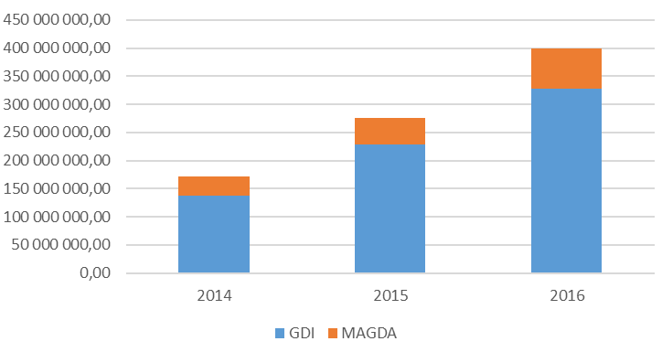
Single point of service delivery “MAGDA²” platform
Once Only
Single Point of Contact
Privacy by Design
> 350 generic services
Notes:
MAGDA² combines and integrates the previous MAGDA platform and the geographical data and services integrator for the Flemish government. This integration and upscaling enables our Agency to become a single point of service delivery for our target audience. As you can see we more than doubled the consumption on our platforms for delivering digital services. A very important aspect in this is of course the privacy regulations and privacy by design.

Slide 8
Interoperability framework
Legal interoperability aligned and digital friendly legislation
Political Context
Political, cultural and structural conditions
Organisational interoperability optimised processes by/for optimised data exchange
Semantic interoperability [OSLO²] meaning, structure and appropriate use of information
Technological interoperability [MAGDA²] technical issues involved in linking computer systems
Notes:
MAGDA² has also an important role in everything interoperabel. Within a given political and cultural context, MAGDA² operates on the level of technological interopariblity and has a basic semantic standard in place. Information Flanders is working very hard – Friday we present in Ghent our ISA²-based extensio.

Slide 9
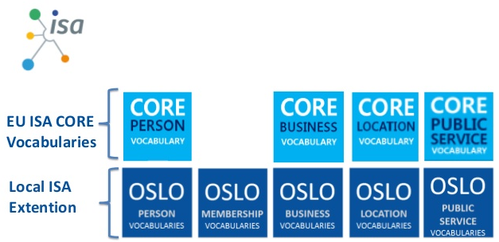
Semantic Interoperability and base registries Open Standards for Linked Organizations (OSLO²)
International (ISO, W3C, …)
EU Framework (ISA, INSPIRE, …)
Flemish context (OSLO)
Belgian Framework (BeStAdd, GT Bâtiments, …)

Slide 10
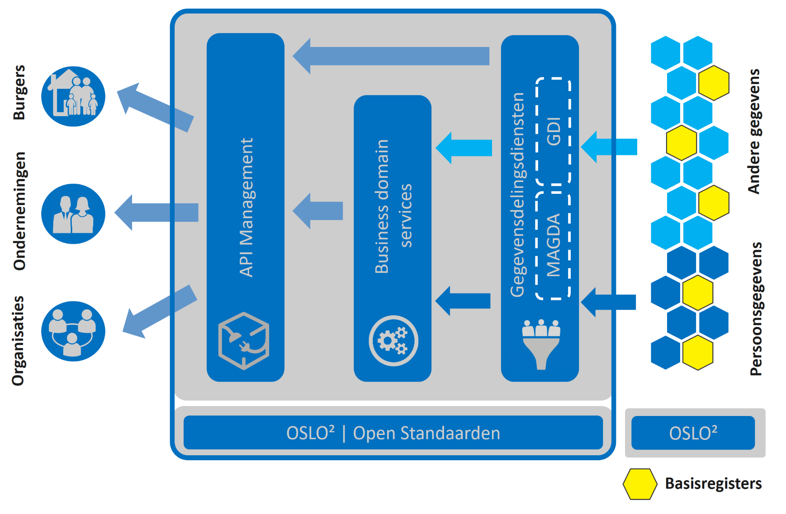
A
MAGDA² | Succeeding by anticipating trends!

Slide 11
Future Roadmap
Sustainability
Scaleability
Business Domain Services

