Slide 1
Catalogue of Services
CPSV Application Profile WG Virtual Meeting 2017-06-09

Slide 2
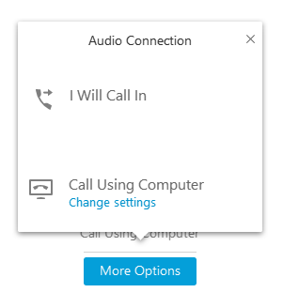
How to use WebEx?
Go to https://pwc-emeamc.webex.com/pwc-emeamc/e.php?AT=SINF&MK=849024646&MJL=1
Fill in your "name - affiliation and country", email and click ‘Join’;
Choose how you would like to connect your audio:
Choose 'Call using computer', configure your audio and microphone, and click 'ok';
Choose ‘I will call in’, choose the call-in user preferred and enter the meeting access code.

Slide 3
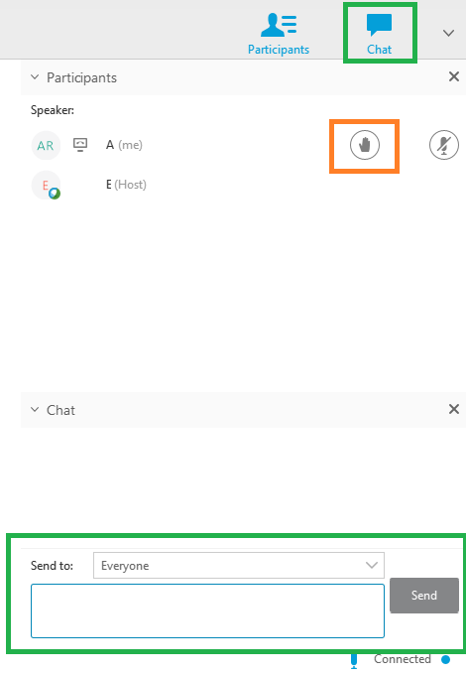
Practical arrangements
Please:
Mute your mic when not speaking
To mute your microphone click the Microphone Icon. When muted, the icon will remain red with a slash.
Raise your hand to request the floor (and help making the speaker aware of who is raising hands)
Use the chat box for sharing links and making comments
Voting: use the chatbox (+1 / -1 / abstain)

Slide 4
CPSV-AP release page
Joinup page where the CPSV-AP specs are published
https://joinup.ec.europa.eu/asset/cpsv-ap/asset_release/all
CPSV-AP Mailing list
Publicly archived mailing list on Joinup
Used for submitting change requests on the draft specification
http://joinup.ec.europa.eu/mailman/archives/cpsv-ap/
Issue tracker
WG Members can log issues on the issue tracker or via the mailing list
WG Members can comment on the issues that are already logged
https://joinup.ec.europa.eu/asset/cpsv-ap/issue/all

Slide 5
Agenda
https://joinup.ec.europa.eu/asset/cpsv-ap/event/cpsv-ap-v20-revision-wg-virtual-meeting-webinar-2

Slide 6
Roles
Chairs
Miguel Álvarez, ISA² Programme – European Commission
Editors
Michiel De Keyzer, PwC
Ana Fernández de Soria, PwC

Slide 7
Submitting issues
Use the mailing list for submitting feedback on the draft specification
Use the following structure:
Name of your organisation and description of its expected use of CPSV-AP
Version to which the issue applies
Description of your issue
Your proposed resolution (if available)

Slide 8
Webinars
Webinar 1:
12th of May
10:00 – 12:00 CET
Webinar 2:
9th of June
10:00 – 12:00 CET
Webinar 3:
September
Public review
June-September

Slide 9
Applied changes and issues to close (35’)

Slide 10
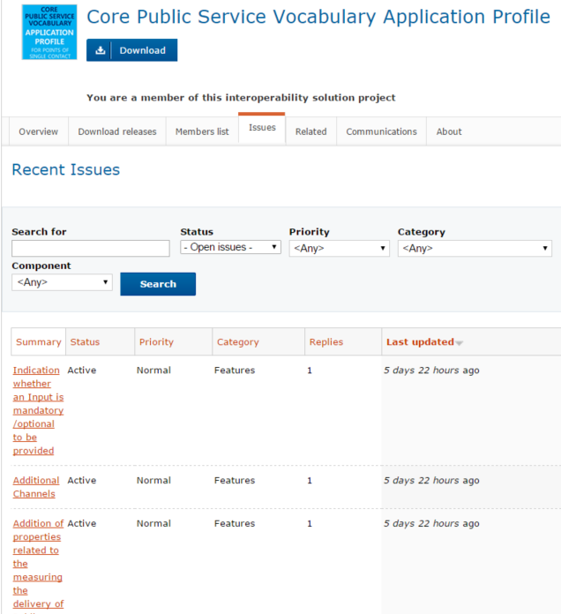
https://joinup.ec.europa.eu/asset/cpsv-ap/issue/all

Slide 11
Future work (10’)

Slide 12
Classification of public services
Current: suggested to group into business or life events.
Proposed: analyse alternative ways of classifying public services, such as:
Type of user;
Type of public service;
Target audience theme;
Sector…
Which others do you see?

Slide 13
Controlled vocabularies
Current | Proposed
Type of business event | Type of evidence
Type of life event | Type of criterion requirement
Type of output | Role of participation
Type of channel | …
For which ones would it be a priority?

Slide 14
Sharing experience between MSs (20’)

Slide 15
Sharing experience
Do you have lessons learnt, experience to share?

Slide 16
Next steps (5’)

Slide 17
Next webinar
Date: September 2017
TO DO between July and August 2017:
Review the specification and provide comments;
Review the issues on Joinup and comment on them;
Review the multilingual labels.
Webinar 1:
12th of May
10:00 – 12:00 CET
Webinar 2:
9th of June
10:00 – 12:00 CET
Webinar 3:
September
Public review
June-September

Slide 18
?

Slide 19
Contact us
Visit our initiatives
Project Officers
Miguel.Alvarez-Rodriguez@ec.europa.eu
Peter.Burian@ec.europa.eu
Contractors
Nikolaos.Loutas@be.pwc.com
Michiel.de.Keyzer@be.pwc.com
https://joinup.ec.europa.eu/node/104244/

