Slide 1
ISA Action 1.3: Catalogue of Services
CPSV Application Profile WG Virtual Meeting 2016-05-24

Slide 2
How to enter the Virtual Meeting Room?
See https://joinup.ec.europa.eu/node/148470/
Web connection: http://ec-wacs.adobeconnect.com/cpsv_webinar1/ Audio connection:
Go to http://ec-wacs.adobeconnect.com/cpsv_webinar1/
Click 'Enter as a guest', fill in your name and click 'Enter meeting'.
Click 'ok' to agree with the Web Conferencing Disclaimer
Answer 'Start' to the question: Would you like audio conferencing with this meeting?
Choose to connect with microphone and headset OR enter your telephone number and have the system call you OR dial your Local or International Access Number:
Belgium: +3228081363 France: +33182880967 Germany: +498922061600 Luxembourg: +35220880608 United Kingdom: +442033189433
Dial the Conference Room Number: *1323004#

Slide 3
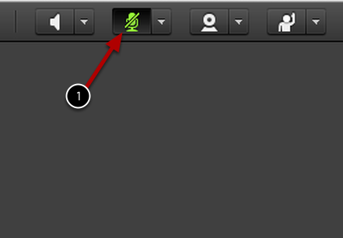
Practical arrangements
Please:
Mute your mic when not speaking
To mute your microphone click the Microphone Icon. When muted, the icon will remain green with a slash.
Raise your hand to request the floor (and help making the speaker aware of who is raising hands)
Use the chat box for sharing links and making comments
Voting: use the chatbox (+1 / -1 / abstain)

Slide 4
CPSV-AP release page
Joinup page where the CPSV-AP specs are published https://joinup.ec.europa.eu/asset/cpsv-ap/asset_release/all
CPSV-AP Mailing list
Publicly archived mailing list on Joinup
Used for submitting change requests on the draft specification http://joinup.ec.europa.eu/mailman/archives/cpsv-ap/
Issue tracker
WG Members can log issues on the issue tracker or via the mailing list
WG Members can comment on the issues that are already logged https://joinup.ec.europa.eu/asset/cpsv-ap/issue/all
Contributor Licence Agreement (CLA)
All WG Members contributing to the specification should sign the CLA https://joinup.ec.europa.eu/node/104627

Slide 5
Roles
Chairs
Thomas D’Haenens, Flemish Information Agency (Belgium)
City of Ghent (Belgium)
Editors
Phil Archer, W3C
Michiel De Keyzer, PwC

Slide 6
Webinars
Webinar 1:
12th of April
10:00 – 12:00 CET
Webinar 2:
3rd of May
10:00 – 12:00 CET
Webinar 3:
24th of May
10:00 – 12:00 CET
Webinar 4: Controlled Vocabularies
June
Webinar 5:
September
Public review
June-September

Slide 7
Agenda
https://joinup.ec.europa.eu/node/150255/

Slide 8
Applied changes to the CPSV-AP (15’)

Slide 9
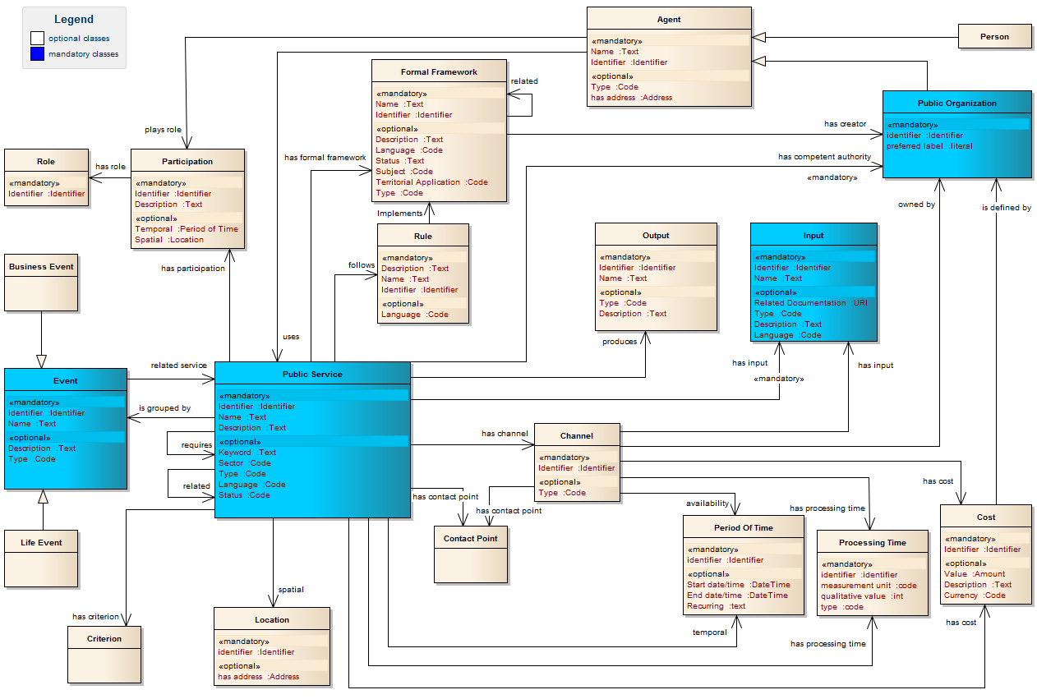
https://joinup.ec.europa.eu/node/151628

Slide 10
Current issues (75’)

Slide 11
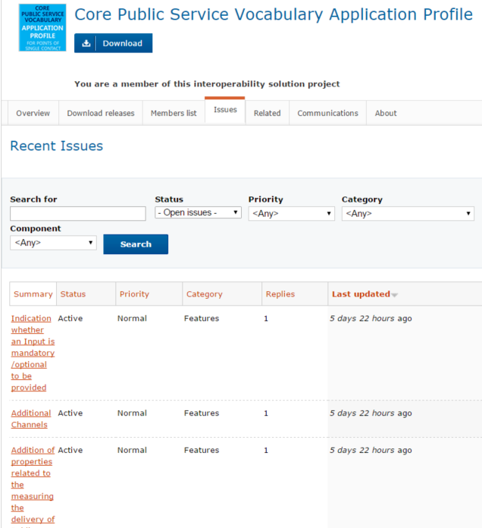
https://joinup.ec.europa.eu/asset/cpsv-ap/issue/all

Slide 12
Next steps (5’)

Slide 13
Next steps
An additional webinar needed before launching the public review?
There will be one webinar specifically to discuss some controlled vocabularies (type of output, life events and business events)
Date & time will be communicated asap
Webinar 1:
12th of April
10:00 – 12:00 CET
Webinar 2:
3rd of May
10:00 – 12:00 CET
Webinar 3:
24th of May
10:00 – 12:00 CET
Webinar 4: Controlled Vocabularies
June
Webinar 5:
September
Public review
June-September

Slide 14
Questions?
?

Slide 15
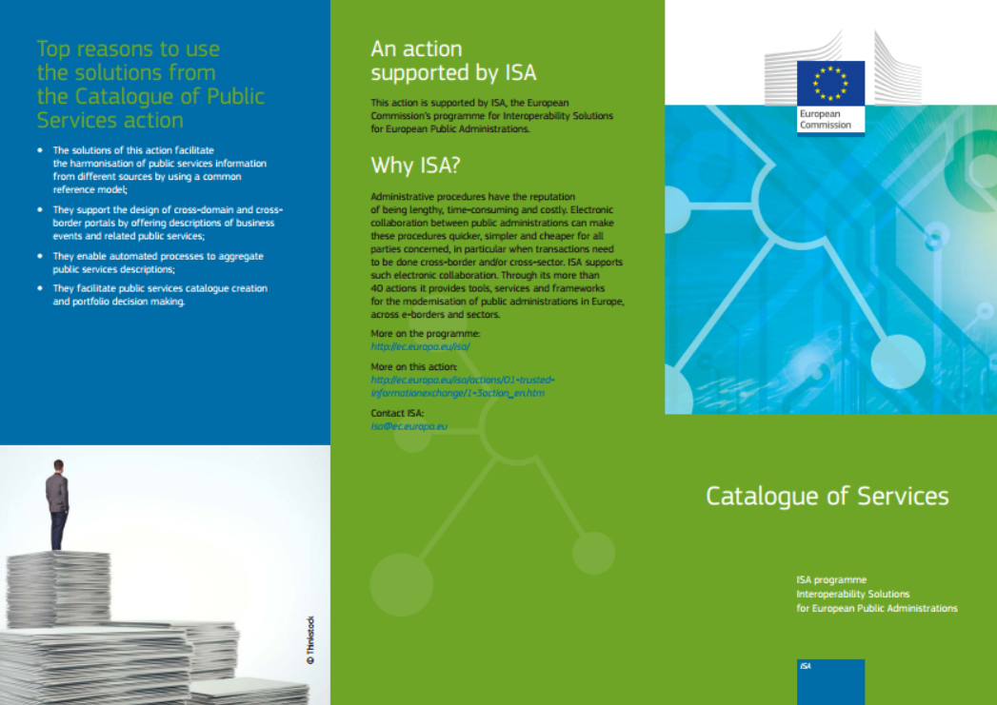
Contact us
Visit our initiatives
Project Officers
Miguel.Alvarez-Rodriguez@ec.europa.eu
Peter.Burian@ec.europa.eu
Contractors
Nikolaos.Loutas@be.pwc.com
Michiel.de.Keyzer@be.pwc.com
https://joinup.ec.europa.eu/node/104244/

