Slide 1
Ref2Link
Overview
LEGAL SERVICE

Slide 2
Agenda
Ref2Link
Features
Use Cases
Benefits
Access and Integrations
Demonstration
Notes:
(Animated slide)
Do you ntice something special in these extracts of EU legal texts?
They are full of references and citation
These can in turn be transformed into WEB links
These WEB links are themselves gateways to EU database when you can collect more information about each reference.
In many situations, these assets are underused

Slide 3
Legal text
Pourvoi formé contre l’ordonnance du Tribunal de l’Union européenne du 16 février 2016 dans l’affaire T-296/15, recours visant l'annulation partielle du règlement d'exécution (UE) 2015/408 de la Commission, du 11 mars 2013, relatif à l'application de l'article 80, paragraphe 7, du règlement (CE) nº 1107/2009 du Parlement européen et du Conseil concernant la mise sur le marché des produits phytopharmaceutiques (…)
elle ne peut pas servir de fondement à une interprétation contra legem du droit national (voir arrêts Impact, C-268/06, EU:C:2008:223, point 100; Dominguez, C-282/10, EU:C:2012:33, point 25, et Association de médiation sociale, C-176/12, EU:C:2014:2, point 39).
Notes:
(Animated slide)
Do you ntice something special in these extracts of EU legal texts?
They are full of references and citation
These can in turn be transformed into WEB links
These WEB links are themselves gateways to EU database when you can collect more information about each reference.
In many situations, these assets are underused

Slide 4
Legal text - Detect
Pourvoi formé contre l’ordonnance du Tribunal de l’Union européenne du 16 février 2016 dans l’affaire T-296/15, recours visant l'annulation partielle du règlement d'exécution (UE) 2015/408 de la Commission, du 11 mars 2013, relatif à l'application de l'article 80, paragraphe 7, du règlement (CE) nº 1107/2009 du Parlement européen et du Conseil concernant la mise sur le marché des produits phytopharmaceutiques (…) elle ne peut pas servir de fondement à une interprétation contra legem du droit national (voir arrêts Impact, C-268/06, EU:C:2008:223, point 100; Dominguez, C-282/10, EU:C:2012:33, point 25, et Association de médiation sociale, C-176/12, EU:C:2014:2, point 39).
Notes:
(Animated slide)
Do you ntice something special in these extracts of EU legal texts?
They are full of references and citation
These can in turn be transformed into WEB links
These WEB links are themselves gateways to EU database when you can collect more information about each reference.
In many situations, these assets are underused

Slide 5
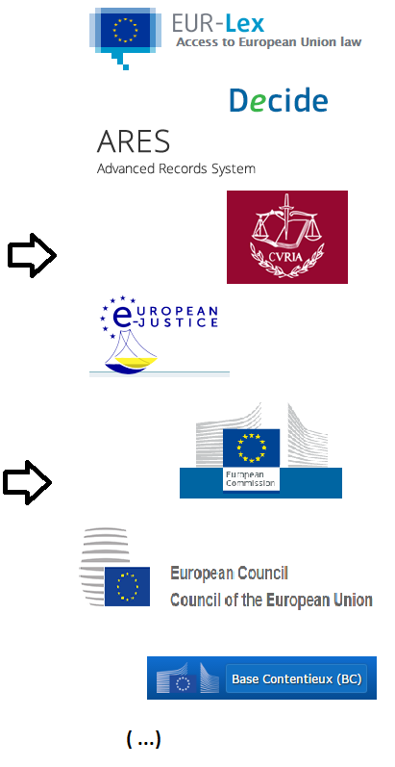
Legal text – Detect - Link
Pourvoi formé contre l’ordonnance du Tribunal de l’Union européenne du 16 février 2016 dans l’affaire T-296/15, recours visant l'annulation partielle du règlement d'exécution (UE) 2015/408 de la Commission, du 11 mars 2013, relatif à l'application de l'article 80, paragraphe 7, du règlement (CE) nº 1107/2009 du Parlement européen et du Conseil concernant la mise sur le marché des produits phytopharmaceutiques (…) elle ne peut pas servir de fondement à une interprétation contra legem du droit national (voir arrêts Impact, C-268/06, EU:C:2008:223, point 100; Dominguez, C-282/10, EU:C:2012:33, point 25, et Association de médiation sociale, C-176/12, EU:C:2014:2, point 39).
Notes:
(Animated slide)
Do you notice something special in these extracts of EU legal texts?
They are full of references and citation
These can in turn be transformed into WEB links
These WEB links are themselves gateways to EU database when you can collect more information about each reference.
In many situations, these assets are underused

Slide 6
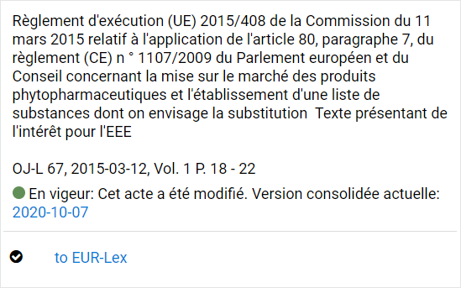
Legal text – Detect – Link - Pull
Pourvoi formé contre l’ordonnance du Tribunal de l’Union européenne du 16 février 2016 dans l’affaire T-296/15, recours visant l'annulation partielle du règlement d'exécution (UE) 2015/408 de la Commission, du 11 mars 2013, relatif à l'application de l'article 80, paragraphe 7, du règlement (CE) nº 1107/2009 du Parlement européen et du Conseil concernant la mise sur le marché des produits phytopharmaceutiques (…) elle ne peut pas servir de fondement à une interprétation contra legem du droit national (voir arrêts Impact, C-268/06, EU:C:2008:223, point 100; Dominguez, C-282/10, EU:C:2012:33, point 25, et Association de médiation sociale, C-176/12, EU:C:2014:2, point 39).*
CELLAR The semantic repository of the Publication Office
Notes:
(Animated slide)
Do you notice something special in these extracts of EU legal texts?
They are full of references and citation
These can in turn be transformed into WEB links
These WEB links are themselves gateways to EU database when you can collect more information about each reference.
In many situations, these assets are underused

Slide 7
Ref2Link
A technology for legal references detection and extraction.
Developed by the EC Legal Service.
Supported by the Digital Europe Programme.
Used in :
the Commission (SJ, DIGIT, SecGEN, OP, …),
other EU Institutions (Council, European Parliament, Court of Justice),
National Administrations.
Notes:
(Animated slide)
Do you ntice something special in these extracts of EU legal texts?
They are full of references and citation
These can in turn be transformed into WEB links
These WEB links are themselves gateways to EU database when you can collect more information about each reference.
In many situations, these assets are underused

Slide 8
Features
Rule-based: use text patterns for detection, versatile and adaptable to any domain.
Out-of-the box detection for EU Law, Case Law and EC Administrative references.
European law standards: ELI and ECLI - including for Member states, CELEX.
Multilingual (EU 24 languages).
Flexible outputs (multi-target web links, footnotes, endnotes, tables, data).
Linked data: pulled from semantic repositories (CELLAR, FinLex) to improve UX and accuracy.
Aliases/Nicknames, Subdivisions, and semantic clusters.
Notes:
(Animated slide)
Do you ntice something special in these extracts of EU legal texts?
They are full of references and citation
These can in turn be transformed into WEB links
These WEB links are themselves gateways to EU database when you can collect more information about each reference.
In many situations, these assets are underused

Slide 9
Use cases
Web business apps/portals filled with legal references.
Legislative authoring systems: automation of references handling e.g. links, footnotes.
Text analytics: through references extraction.
Populate database, search engine systems.
Format validation and quality control.
User self-service: Linkpad.
Notes:
(Animated slide)
Do you ntice something special in these extracts of EU legal texts?
They are full of references and citation
These can in turn be transformed into WEB links
These WEB links are themselves gateways to EU database when you can collect more information about each reference.
In many situations, these assets are underused

Slide 10
Benefits
Productivity:
Business users: time-saving access to legal resources.
Web contributors: spares tedious process of creating links.
On-the-fly generation: continuous adaptation / no broken links.
Improved user experience.
Sustainability & interoperability:
by using available standards.
Quality:
Fosters proper encoding of references & citations by contributors.
Incentivises system owners to align with standards.
Notes:
(Animated slide)
Do you ntice something special in these extracts of EU legal texts?
They are full of references and citation
These can in turn be transformed into WEB links
These WEB links are themselves gateways to EU database when you can collect more information about each reference.
In many situations, these assets are underused

Slide 11
Access and Integrations
Linkpad – Interactive application for end-users – https://webgate.ec.testa.eu/ref2link.
For any user in the EU institutions, EU Login enabled.
Integration through a REST API, JavaScript and Web Content Management Systems snippets.
For apps developers / webmasters.
Integration into MS Word via Ref2Link Add-in.
For Legal Service users (pilot possible for other DGs/Institutions).
Open-source distribution on Joinup (core technology).
Notes:
(Animated slide)
Do you ntice something special in these extracts of EU legal texts?
They are full of references and citation
These can in turn be transformed into WEB links
These WEB links are themselves gateways to EU database when you can collect more information about each reference.
In many situations, these assets are underused

Slide 12
Demonstration
Notes:
(Animated slide)
Do you ntice something special in these extracts of EU legal texts?
They are full of references and citation
These can in turn be transformed into WEB links
These WEB links are themselves gateways to EU database when you can collect more information about each reference.
In many situations, these assets are underused

Slide 13
Thank you to contact us : SJ-REF2LINK-SUPPORT@EC.EUROPA.EU
Notes:
(Animated slide)
Do you ntice something special in these extracts of EU legal texts?
They are full of references and citation
These can in turn be transformed into WEB links
These WEB links are themselves gateways to EU database when you can collect more information about each reference.
In many situations, these assets are underused

