Slide 1
FOSSA – Work Package 4
Open Source Software Inventory

Slide 2
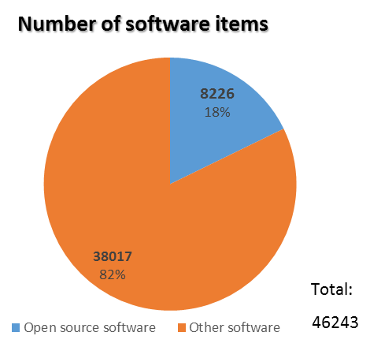
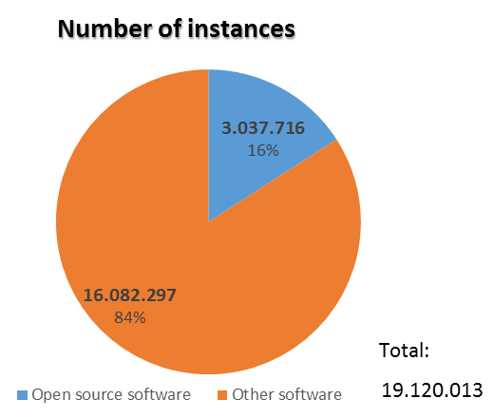
SW counting & screening OSS at the European Commission
Open Source Software items in use at the European Commission and managed by DIGIT amount to a significant part of the total software items (8.226 out of 46.243)
The number of instances of OSS amounts up to 3.037.716 on a total of 19.120.013
A minority, although significant (16%) of all software items installed and inventoried is Open Source

Slide 3


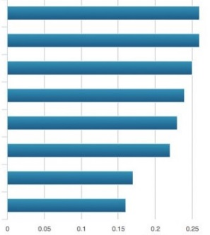
Business criticality analysis
Relation with security
Number of instances
Exposure to end user
Criticality Index (CI)
OSS list
OSS list
ranked by criticality
ANALYSIS AND RANKING

Slide 4
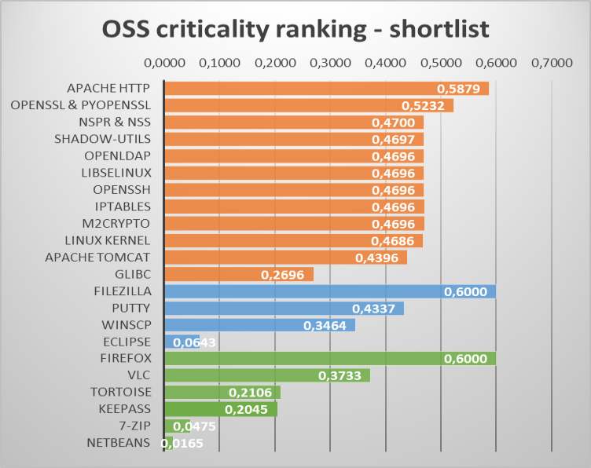
The critical software shortlist
For each analysed environment:
the top business critical items are sorted into a
shortlist
The vulnerabilities of the highest ranked items would impact the most due to their spread and use in the EU institutions.
Datacenter - servers
AppV - Workstations
LANDesk - Workstations

Slide 5
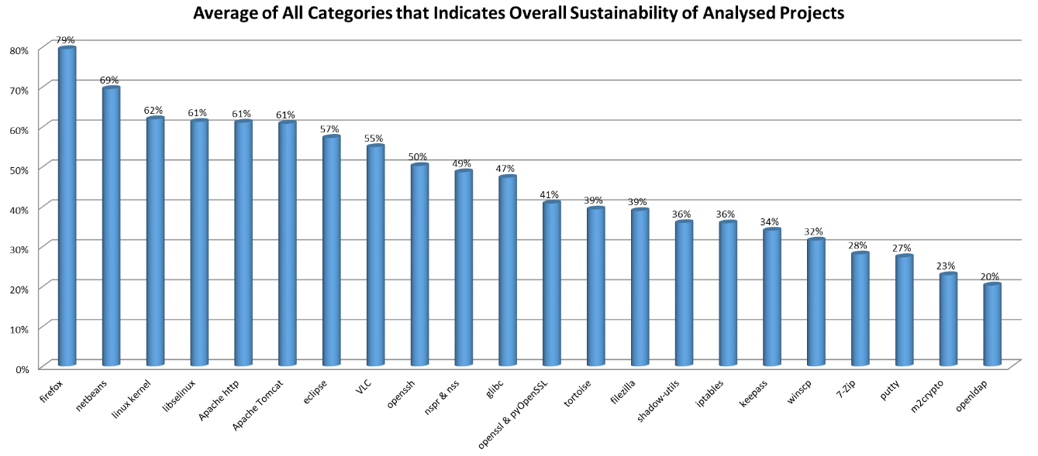
The sustainability analysis
The critical OSS shortlist was assessed on
34 sustainability metrics (Community Activity, Performance, Quality and Security, Demographics and Diversity, Governance, FOSS support).
The sustainability of the critical software ranges
from 20% (very low) to almost 80% (high).

Slide 6









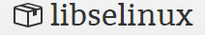
The dependency analysis
The inventory also analysed the dependencies within the Critical OSS shortlist. Interdependencies may significantly amplify the risks occurring in one of the inventoried OSS components.
The following components have more than 1 dependency upon the shortlisted items:
This analysis shows a relative fragmentation of the dependencies, apart from glibc and Bash, which relate to the software shown below:
glibc
shadow
m2crypto

Slide 7
Project documents
For more details on the OSS inventory, please refer to the project documents published at:
https://joinup.ec.europa.eu/community/eu-fossa/og_page/project-deliveries

