Slide 1
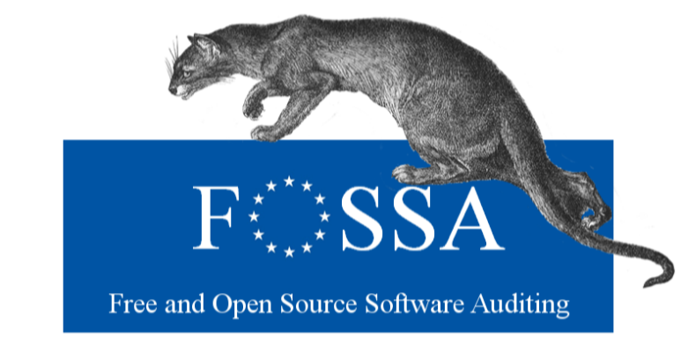
XX-00-00-000-EN-C
Dependencies analysis
The inventory analysis also covered one area that may amplify significantly the risks occurring in one of the inventoried OSS components: the dependencies Analysis performed on the Critical OSS shortlist.
For ongoing updates on FOSSA project status please visit:
https://joinup.ec.europa.eu/community/eu-fossa/home
Components | Number of dependencies
Glibc | 10
Bash | 8
zlib, coreutils | 4
shadow-utils, libselinux, openssl-libs, system | 3
chkconfig, audit-libs, nss-util, krb5-libs, pcre, nspr, nss-softokn-frebl, libcom_err | 2
Work Package 4:
Open Source Software Inventory
This analysis showed a relative fragmentation of the dependencies, apart from Glibc and Bash, on which depend respectively 10 and 8 software items of the shortlist.
DIGIT – B1
doi:00.0000/00000
DIGIT
Leaflet_A4_100x210.indd 1

Slide 2
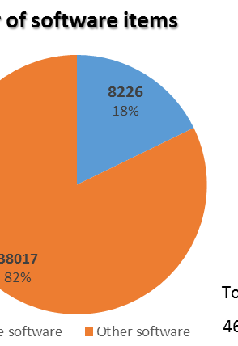
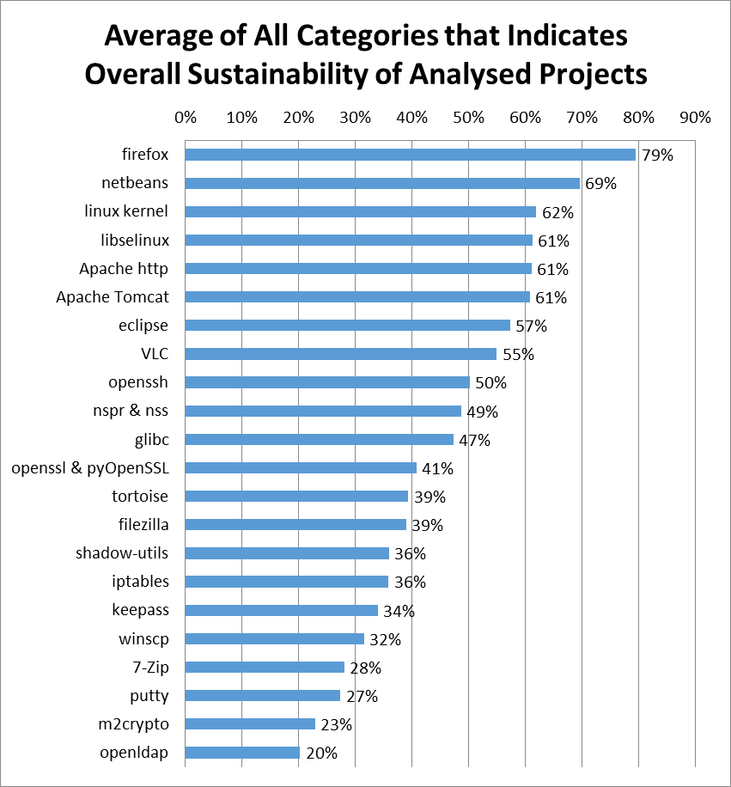
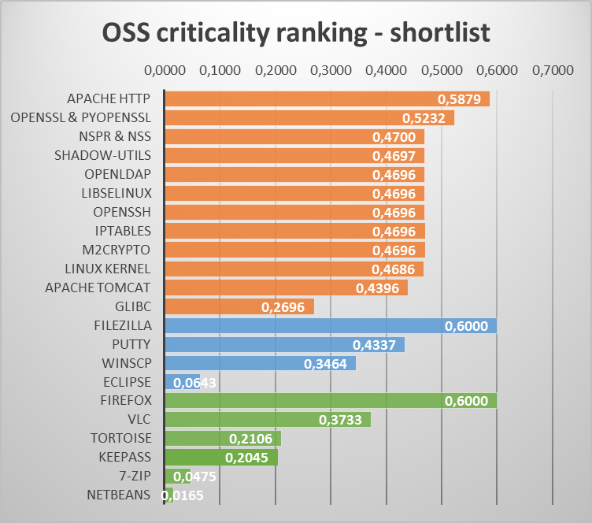
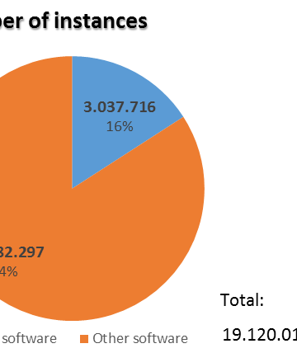
OSS counting
Business Criticality analysis
Sustainability analysis
Inventory Scope:
Infrastructure managed by DIGIT, including Datacenter applications and Desktop applications.
EU-FOSSA defined a Business Criticality Index, based on three parameters:
Number of instances of the software;
Relation with security;
Exposure to end-user.
The inventoried OSS was assessed based on this index. A shortlist of the top 22 critical OSS items was defined, on which to perform the subsequent detailed analysis.
The critical OSS shortlist was assessed on 34 sustainability metrics grouped in 6 categories (Community Activity, Performance, Quality and Security, Demographics and Diversity, Governance, FOSS support). The overall software sustainability is calculated as an average of those categories.
About 16% of the total software installed and inventoried is Open Source.
Datacenter
Workstations - AppV
Workstations -
LANDesk
Leaflet_A4_100x210.indd 5

