Slide 1
ISA Action 1.3: Catalogue of Services
CPSV Application Profile WG Virtual Meeting 2014-11-19

Slide 2
Outline
Welcome and overview
Introduction of the new Working Group Members & collaboration in the WG
Final validation of common working terminology on key concepts
List of business events and public services on the PSCs
Next Steps and Q & A
Analysis of data models used on the PSCs
Current version of CPSV-AP

Slide 3
Welcome and overview

Slide 4
Where are we now?
More information on process and tools to support the Working Group:
https://joinup.ec.europa.eu/asset/cpsv-ap/description

Slide 5
Process & methodology
CPSV
Current model
Proposed new classes & properties
Analysing the models for describing public services & business events PSCs
Commonalities & differences
Comparison with CPSV
Webinar meeting
Comments
New draft with proposed solutions
CPSV-AP

Slide 6
Introduction of new Working Group Members & collaboration in the Working Group

Slide 7
Collaboration in the Working Group
Introduction to the new Working Group Members
Conference call system
Public mailing list archive
Issue tracker
Contributor licence agreement; currently signed by:
Spain
Estonia
Greece
The Netherlands
More information on process and tools to support the Working Group:
https://joinup.ec.europa.eu/asset/cpsv-ap/description

Slide 8
Final validation of common terminology on key concepts

Slide 9
Common terminology
key concepts
Term | Definition
Administrative formality | Based on our analysis we conclude that the term “administrative formality” is a synonym of “public service”. We therefore refer to the definition of “public service”.
Public Service | A set of deeds and acts performed by or on behalf of a public administration for the benefit of a citizen, a business or another public administration.
Business Event | A certain stage in the business lifecycle with which a bundle of public services is associated in the context of a particular Member State.
Key Business Event | A Key Business Event comprises the generic stages of the business lifecycle, regardless from a specific Member State’s context, through which any business carries out its business activities and interaction with Government. We identify 12 Key Business Events: Starting a business Employing Staff Funding Business Operations & Trade Taxation and Finance Legal & Regulatory Innovation Premises & Environment Returns and Other Obligations Expanding your Business Selling to Government Closing or Selling a business
Public Service Portfolio | The complete set of public services that is managed by a governmental service provider. The service portfolio is used to manage the entire lifecycle of all public services, and includes three categories: service pipeline (proposed or in development), service catalogue (live or available for deployment), and retired services.
Catalogue of Public Services | A catalogue of public services is a collection of descriptions of active public services that are provided by a public administration at any administrative level (i.e. local, regional, national or pan-European). These descriptions are created following a common data model for representing public services.

Slide 10
List of business events and public services on the PSCs

Slide 11
Analysis of data models used on the PSCs

Slide 12
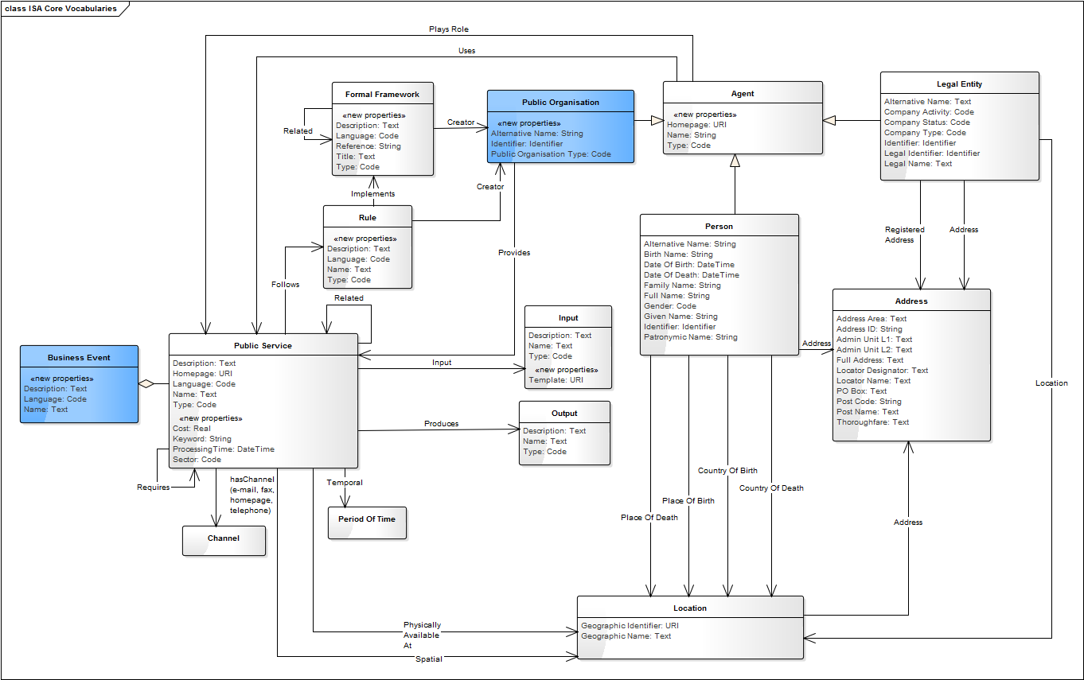
Current version:
UML Model
Issues raised:
https://joinup.ec.europa.eu/asset/cpsv-ap/issue/all

Slide 13
Next steps

Slide 14
Next steps
Information about the next webinar: https://joinup.ec.europa.eu/node/107382

Slide 15
Goal of the next webinar
Discussion on feedback received by the Working Group;
Discussion on proposed changes to the CPSV-AP;
Discussion on mandatory/optional classes and properties;

Slide 16
What is expected
from you?
Review the current version of the CPSV-AP (will be made available in the coming days)
What are mandatory/optional classes and properties for you?
Submit comments:
E-mail the project team;
Send an e-mail to the mailing list cpsv-ap@Joinup.ec.europa.eu
Submit a comment on the CPSV-AP specification document on Joinup
Comment on existing issues https://joinup.ec.europa.eu/asset/cpsv-ap/issue/all
We will contact you for planning an interview (approx. 1 hour)

Slide 17
Questions?
?

Slide 18
Contact us
Project Officer Miguel.Alvarez-Rodriguez@ec.europa.eu
Peter.Burian@ec.europa.eu
Contractors Nikolaos.Loutas@be.pwc.com
Michiel.de.Keyzer@be.pwc.com
Visit our initiatives

