Slide 1
Semantic Interoperability
Courses
Course Module 3
Reference Data Management

Slide 2

Disclaimer
This training material was prepared for the ISA programme of the European Commission by PwC EU Services.
The views expressed in this report are purely those of the authors and may not, in any circumstances, be interpreted as stating an official position of the European Commission.
The European Commission does not guarantee the accuracy of the information included in this study, nor does it accept any responsibility for any use thereof.
Reference herein to any specific products, specifications, process, or service by trade name, trademark, manufacturer, or otherwise, does not necessarily constitute or imply its endorsement, recommendation, or favouring by the European Commission.
All care has been taken by the author to ensure that s/he has obtained, where necessary, permission to use any parts of manuscripts including illustrations, maps, and graphs, on which intellectual property rights already exist from the titular holder(s) of such rights or from her/his or their legal representative.

Slide 3
Learning Objectives
By the end of this training you should have an understanding of:
What reference data is, its context and purpose and how it creates value for organisations.
Why it is important to manage and govern the reference data lifecycle.
How to work with reference data using open-source tools.

Slide 4
Outline
1. Introduction: what is reference data?
Definitions
Importance & relevance
2. Why must reference data be properly managed?
Design
Change management
Documentation
Harmonisation
Reference data
Reference data has many names: code list, taxonomy, thesaurus, mapping, name authority list
What is reference data management
Why is managing reference data important?

Slide 5
Definitions
What is reference data?
Reference data is small, discrete sets of values that are not updated as part of business transactions but are usually used to impose consistent classiﬁcation. Reference data normally has a low update frequency. Reference data is relevant across more than one business system belonging to different organisations and sectors.
European Commission – ISA Programme, 2014 (1)

Slide 6
Example: Country Code
Named Authority Lists
The table below displays an extract of the “Countries” code list as published on the Metadata Registry (MDR) of the EU:
Authority Code | Short Name | Long Name
AND | Andorra | Principality of Andorra
ALB | Albania | Republic of Albania
AUT | Austria | Republic of Austria
BIG | Bosnia and Herzegovina | Bosnia and Herzegovina
… | … | …
http://publications.europa.eu/mdr/resource/authority/country/html/countries-eng.html#description

Slide 7
Reference data has many names
What is considered reference data?
Code list: Complete set of data element values of a coded simple data element [ISO 9735-1:2002, 4.14]
Taxonomy: scheme of categories and subcategories that can be used to sort and otherwise organize items of knowledge or information [ISO/DIS 25964-2].
Thesaurus: controlled and structured vocabulary in which concepts are represented by terms, organized so that relationships between concepts are made explicit, and preferred terms are accompanied by lead-in entries for synonyms or quasi-synonyms [ISO 25964-1:2011]
Mapping: relationship between a concept in one vocabulary and one or more concepts in another [ISO/DIS 25964-2].
Name authority list: controlled vocabulary for use in naming particular entities consistently [ISO/DIS 25964-2]
Source: https://joinup.ec.europa.eu/svn/adms/ADMS_v1.00/ADMS_SKOS_v1.00.html

Slide 8
Importance
Where is reference data used?
Within information systems
For categorising and identifying data
Between Information Systems
For information sharing
Reference data… is just data!
E.g. assigning personnel to a department from a list of predefined values
E.g. using a code list to describing the context of data which is exchanged between systems over different member states. This ensures that member states are ‘talking’ about the same data.

Slide 9
Relevance of common reference data
Why is common reference data important?
To avoid semantic interoperability conflicts
By using a common set of values for describing data which is exchanged between different systems, interoperability conflicts can be avoided.
To avoid the need for mappings
Mappings between different value sets of reference data are often inaccurate. By using common value sets of reference data across domains and IT systems, the need for creating mappings can be avoided.
Please refer to training module 1 for more information on interoperability concepts and more specifically semantic interoperability

Slide 10
Outline
1. Introduction: what is reference data?
Definitions
Importance & relevance
2. Why must reference data be properly managed?
Design
Change management
Documentation
Harmonisation
Reference data
Reference data has many names: code list, taxonomy, thesaurus, mapping, name authority list
What is reference data management
Why is managing reference data important?

Slide 11

Definitions
What is reference data management?
Reference data management comprises planning, implementation & control activities to ensure consistency with “golden version” of contextual data values.
Reference Data Management is control over defined domain values (also known as vocabularies), including control over standardized terms, code values and other unique identifiers, business definitions for each value, business relationships within and across domain value lists, and the consistent, shared used of accurate, timely and relevant reference data values to classify and categorize data
DAMA International, 2009, http://www.dama.org/i4a/pages/index.cfm?pageid=1

Slide 12
Relevance
Why is metadata management important?
To ensure the use of a common setting
To ensure continuity and quality of service
To take decisions and manage changes in a controlled fashion
To prevents conflicts between versions (version control)
To improve data quality

Slide 13
Reference data management
Lifecycle
1. Data Design
2. Change Management
3. Documentation
4. Harmonisation
5. Implementation

Slide 14
1. Data Design
What
Select and reuse existing reference data sets
Why
Impose consistent classification of data
How
Develop thesauri, value sets, code lists, etc.
VocBench
PoolParty
ListPoint
Improve data quality
Reduce interoperability issues
Tools

Slide 15
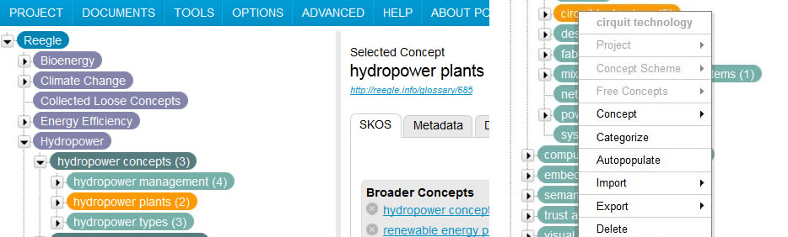
1. Reference Data Design | Tools
PoolParty
PoolParty is a tool for creating thesauri, taxonomies and knowledge graphs based on W3C standards such as SKOS, RDF and SPARQL.
(Semantic Web Company, 2014)

Slide 16
1. Reference Data Design | Tools
VocBench
VocBench is a web-based, multilingual, vocabulary editing and workflow tool (W3C, 2001). It manages thesauri , authority lists and glossaries using SKOS-XL. (FAO, 2014)
Listpoint
Listpoint is an open reference data platform combined with online tools to find and combine data standards and code lists. Moreover, it helps users to make datasets interoperable and kept up-to-date with updates. (Listpoint, 2014).

Slide 17
2. Change Management
What
Why
Maintaining control over the value sets and the change process
How
A combination of management processes for incorporating changes to value sets.
Defining each step in the change process and assigning roles which are described in a governance structure
Taking into account the needs of stakeholders when adapting reference data
Incorporating quality control measures

Slide 18
2. Change Management
In a managed master data environment, specific individuals have the role of a business data steward. They have the authority to create, update, and retire reference data values, and to a lesser extent, in some circumstances, master data values,. Business data stewards work with data professionals to ensure the highest quality reference and master data. Many organizations define more specific roles and responsibilities, with individuals often performing more than one role.
Steps in change management are:
1. Create and receive change requests
2. Identify the related stakeholders and understand their interest
3. Identify and evaluate the impacts of the proposed changes
4. Decide to accept or reject the change, or recommend a decision to management or governance
5. Review and approve or deny the recommendation, if needed
6. Communicate the decision to stakeholders prior to making the change
7. Update the data
8. Inform stakeholders the change has been made

Slide 19
3. Documentation
What
Why
To avoid misinterpretation of the value set
How
Representing the reference data value sets following international standards
Representation
To ensure machine-readability
SKOS
GeneriCode
XSD
HTML
Description: to facilitate searching and retrieving reference data from a repository
Describing the value sets in a uniform way
Publication
Metadata Registry
Description
ADMS

Slide 20
3. Documentation | XML representation
XML Extensible Markup Language (XML) is a simple, very flexible text format derived from SGML (ISO 8879). It permits to represent reference data in many different ways.
XML extract for representing Andalusia in the Countries NAL
<record adm.status="current" date.creation="2010-01-01" IMMC.approval.date="2012-06-27" IMMC.proposal.date="2011-10-06" pub="false" celex="false" deprecated="false" id="COU0001">
<code-3166-1-alpha-2>AD</code-3166-1-alpha-2>
<code-3166-1-alpha-3>AND</code-3166-1-alpha-3>
<code-3166-1-num>020</code-3166-1-num>
<authority-code>AND</authority-code>
<code-iana>.ad</code-iana>
<code-tir>AND</code-tir>
<name><original.name>
<lg.version lg="cat">Andorra</lg.version>
</original.name></name>
<label>
<lg.version lg="bel" script="Cyrillic">Андора</lg.version>
<lg.version lg="bos">Andora</lg.version>
…
</label>
</record>

Slide 21
3. Documentation | SKOS representation
SKOS is an area of work developing specifications and standards to support the use of knowledge organization systems (KOS).
SKOS extract for representing Andalusia in the Countries NAL
<skos:Concept rdf:about="http://publications.europa.eu/resource/authority/country/AND" at:deprecated="false">
<skos:inScheme rdf:resource="http://publications.europa.eu/resource/authority/country"/>
<at:authority-code>AND</at:authority-code>
<at:op-code>AND</at:op-code>
<atold:op-code>AND</atold:op-code>
<dc:identifier>AND</dc:identifier>
<at:start.use>1950-05-09</at:start.use>
<skos:prefLabel xml:lang="be">Андора</skos:prefLabel>
<skos:prefLabel xml:lang="bs">Andora</skos:prefLabel>
<skos:prefLabel xml:lang="bg">Андора</skos:prefLabel>
…
</skos:Concept>

Slide 22
3. Documentation | XSD representation
XSD: XML Schemas express shared vocabularies and allow machines to carry out rules made by people.
XSD extract for representing a country in the Countries NAL
<!--RECORD DEFINITION-->
<xs:element name="record">
<xs:complexType>
<xs:sequence>
<xs:element ref="code-3166-1-alpha-2"/>
<xs:element ref="code-3166-1-alpha-3"/>
<xs:element ref="code-3166-1-num"/>
<xs:element maxOccurs="unbounded" ref="code-3166-3" minOccurs="0"/>
<xs:element ref="authority-code"/>
<xs:element ref="op-styleguide" minOccurs="0"/>
<xs:element maxOccurs="unbounded" ref="code-iana" minOccurs="0"/>
<xs:element ref="code-tir" minOccurs="0"/>
<xs:element ref="name"/>
<xs:element ref="label"/>
…
</xs:sequence>
</xs:complexType>
</xs:element >

Slide 23
3. Documentation | Genericode representation
GeneriCode
Genericode defines a standard format for defining code lists (also known as enumerations or controlled vocabularies). It contains:
a standard model and XML representation for the contents of a code list;
a standard model and XML representation for data associated with items in a code list;
a standard model and XML representation for how new code lists are derived from existing code lists.
“Genericode not only provides a representation of the items in a code list, it also provides an audit trail for how that code list is related to previous versions of the code list, or to other code lists. This simplifies the effort of understanding how a new code list version differs from the previous version, and simplifies the effort in calculating the impact of the change on existing systems and processes.” (Genericode, 2014)

Slide 24
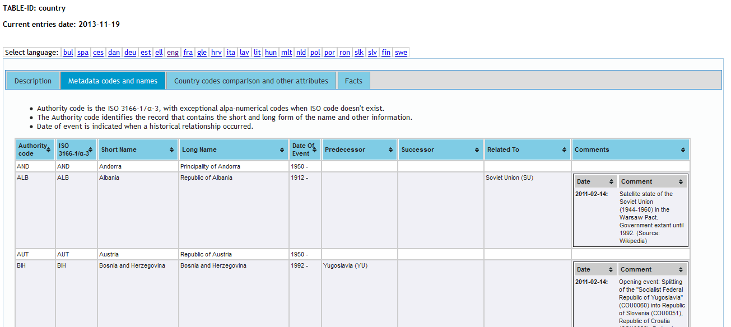
3. Documentation | HTML representation
HTML (Hyper Text Markup Language) is used to describe documents

Slide 25
3. Documentation | ADMS description
ADMS
The Asset Description Metadata Schema (ADMS) is a common way to describe semantic interoperability assets making it possible for everyone to search and discover them.
ADMS allows public administrations, businesses, standardisation bodies and academia to (European Commission – ISA Programme, 2011):
“describe semantic assets in a common way so that they can be seamlessly cross-queried and discovered by ICT developers from a single access point, such as Joinup;
search, identify, retrieve, compare semantic assets to be reused avoiding duplication and expensive design work through a single point of access;
keep their own system for documenting and storing semantic assets;
improve indexing and visibility of their own assets;
link semantic assets to one another in cross-border and cross-sector settings.”
https://joinup.ec.europa.eu/asset/adms/description

Slide 26
3. Documentation | Publication
Metadata Registry
A best practice in reference data management is to publish value sets on an authoritative source. An example of such a source is the Metadata Registry (MDR) of the EU, which is maintained by the Publications Office. The MDR registers and maintains metadata used by European Institutions involved in the legal decision making process.
http://www.iso.org/iso/home/store/catalogue_tc/catalogue_detail.htm?csnumber=35343

Slide 27
4. Harmonisation
What
Why
To foster interoperability with reference data value sets which are represented using a different standard
How
Reference Data Mappings
Tool: Silk Workbench
  The alignment of structural metadata used for information exchange either through the creation of mappings between terms of two or more specifications for structural metadata or by forging a wide consensus on the use of a common specification.

Slide 28
4. Harmonisation | Example
The table below shows a mapping of the Publications Office Named Authority List for countries with the ISO 3166 standard.
Authority Code | ISO 3166 | Short Name | Long Name
AND | AND | Andorra | Principality of Andorra
ALB | ALB | Albania | Republic of Albania
AUT | AUT | Austria | Republic of Austria
BIH | BIH | Bosnia and Herzegovina | Bosnia and Herzegovina
… | … | … | …
http://publications.europa.eu/mdr/resource/authority/country/html/countries-eng.html#description

Slide 29
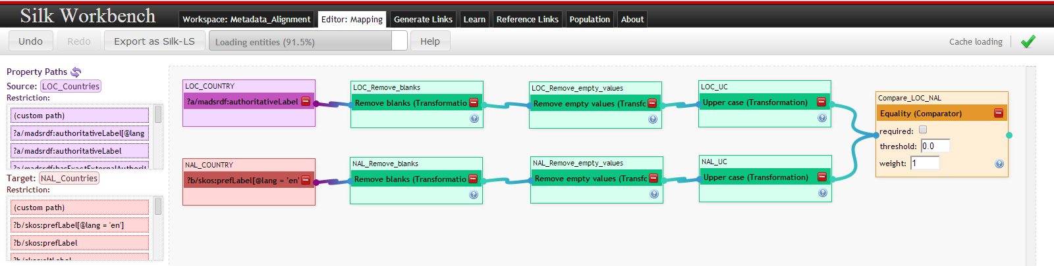
4. Harmonisation | Silk Workbench
Tool: Silk Workbench
The Silk framework is a tool for discovering relationships between data items within different Linked Data sources.
European Commission – ISA Programme, 2014 (2)

Slide 30
5. Implementation
What
Why
Reference data has a lifecycle and needs to be updated
How
In case of automatic propagation, changes to reference data into operational systems should be controlled by governance processes
Improving reusability
Coordinated use of reference data
Manual or automatic propagation
Propagating reference data changes into the software development lifecycle
Manage and support the exchange of information between systems

Slide 31
Implementation of reference data in information systems
To manage and support the exchange of information between systems, the propagation of changes to reference data is needed
Can be done automatically or manual
Propagation of reference data changes needs to be part of the software development lifecycle in order to ensure coordinated and timely updates of reference data in all information systems involved.

Slide 32
References
European Commission – ISA Programme. (2011). Asset Description Metadata Schema (ADMS). Brussels.
European Commission - ISA Programme. (2012). D7.1.3 - Study on persistent URIs, with identification of best practices and recommendations on the topic for the MSs and the EC. Brussels.
European Commission - ISA Programme. (2012). Asset Description Metadata Schema for Software. Brussels.
European Commission – ISA Programme. (2014). D4.1. Metadata management requirements and existing solutions in EU Institutions and Member States. Brussels.
European Commission – ISA Programme. (2014). D4.5. Metadata alignment pilot in the EU institutions and MSs. Brussels.

Slide 33
References
W3C. (2001). VocBench. Available at http://www.w3.org/2001/sw/wiki/VocBench.
DAMA International. (2009). DAMA International. Available at http://www.dama.org/
FAO. (2014). VocBench. Available at http://aims.fao.org/tools/vocbench-2.
Genericode. (2014). What is ‘genericode’? Available at http://www.genericode.org/.
Listpoint. (2014). Welcome to Listpoint. Available at https://www.listpoint.co.uk/.
Mosley, M., Brackett, M., Earley, S., & Henderson, D. (2009). The DAMA Guide to The Data Management Body of Knowledge (DAMA-DMBOK Guide). New Jersey: Technics Publications, LLC.

Slide 34
References
European Commission - ISA Programme. (2012). ADMS Controlled Vocabularies. Available at https://joinup.ec.europa.eu/svn/adms/ADMS_v1.00/ADMS_SKOS_v1.00.html
European Commission - ISA Programme. (2012). SEMIC – 10 Rules for Persistent URIs. Available at https://joinup.ec.europa.eu/community/semic/document/10-rules-persistent-uris
Publications Office of the EU. (2014). Metadata Registry. Available at http://publications.europa.eu/mdr/resource/authority/country/html/countries-eng.html#description.
ISO. (2014). ISO/IEC 11179-1:2004 - Information technology - Metadata registries (MDR) - Part 1: Framework. Available at http://www.iso.org/iso/home/store/catalogue_tc/catalogue_detail.htm?csnumber=35343

Slide 35

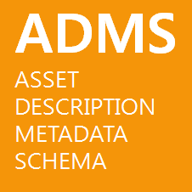






Project Officers Vassilios.Peristeras@ec.europa.eu
Suzanne.Wigard@ec.europa.eu
Athanasios.Karalopoulos@ec.europa.eu
Visit our initiatives
Get involved
Follow @SEMICeu on Twitter
Join the SEMIC group on LinkedIn
Join the SEMIC community on Joinup

