Slide 1
Training Module 1.2 Introduction to Linked Data
PwC firms help organisations and individuals create the value they’re looking for. We’re a network of firms in 158 countries with close to 180,000 people who are committed to delivering quality in assurance, tax and advisory services. Tell us what matters to you and find out more by visiting us at www.pwc.com.
PwC refers to the PwC network and/or one or more of its member firms, each of which is a separate legal entity. Please see www.pwc.com/structure for further details.

Slide 2
This presentation has been created by PwC Authors: Michiel De Keyzer, Nikolaos Loutas, Christophe Colas and Stijn Goedertier
Presentation metadata
Disclaimers
The views expressed in this presentation are purely those of the authors and may not, in any circumstances, be interpreted as stating an official position of the European Commission.
The European Commission does not guarantee the accuracy of the information included in this presentation, nor does it accept any responsibility for any use thereof.
Reference herein to any specific products, specifications, process, or service by trade name, trademark, manufacturer, or otherwise, does not necessarily constitute or imply its endorsement, recommendation, or favouring by the European Commission.
All care has been taken by the author to ensure that s/he has obtained, where necessary, permission to use any parts of manuscripts including illustrations, maps, and graphs, on which intellectual property rights already exist from the titular holder(s) of such rights or from her/his or their legal representative.
This presentation has been carefully compiled by PwC, but no representation is made or warranty given (either express or implied) as to the completeness or accuracy of the information it contains. PwC is not liable for the information in this presentation or any decision or consequence based on the use of it.. PwC will not be liable for any damages arising from the use of the information contained in this presentation. The information contained in this presentation is of a general nature and is solely for guidance on matters of general interest. This presentation is not a substitute for professional advice on any particular matter. No reader should act on the basis of any matter contained in this publication without considering appropriate professional advice.
Open Data Support is funded by the European Commission under SMART 2012/0107 ‘Lot 2: Provision of services for the Publication, Access and Reuse of Open Public Data across the European Union, through existing open data portals’(Contract No. 30-CE-0530965/00-17).
© 2014 European Commission

Slide 3
Learning objectives
By the end of this training module you should have an understanding of:
What is linked data;
What is the difference between linked and open data;
How to publish linked data (5-star schema);
The economic and social aspects of linked data.

Slide 4
Content
This module contains ...
An introduction to the linked data principles;
An introduction to linked data technologies;
An outline of the 5-star scheme for publishing linked data;
An example of how tabular data can be published as linked data using Open Refine;
The expected benefits of linked data for governments;
An overview of linked data initiatives in Europe.
Find more on: training.opendatasupport.eu

Slide 5
What is linked data? Evolution from a document-based Web to a Web of interlinked data.

Slide 6
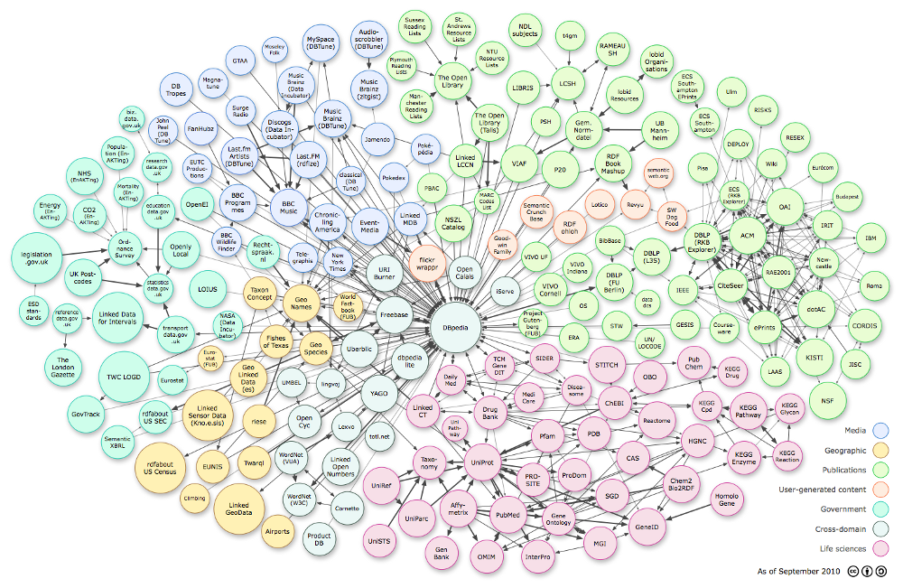
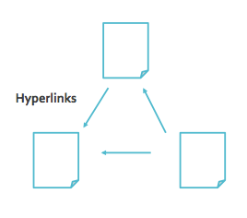
The Web is evolving from a “Web of linked documents” into a “Web of linked data”... (1/2)
Web of documents...
Web of linked data...

Slide 7
The Web is evolving from a “Web of linked documents” into a “Web of linked data”... (2/2)
The Web started as a collection of documents published online – accessible at Web location identified by a URL.
These documents often contain data about real-world resources which is mainly human-readable and cannot be understood by machines.
The Web of Data is about enabling the access to this data, by making it available in machine-readable formats and connecting it using Uniform Resource Identifiers (URIs), thus enabling people and machines to collect the data, and put it together to do all kinds of things with it (permitted by the licence).
Machine-readable data (or metadata) is data in a format that can be interpreted by a computer.
2 types of machine-readable data:
human-readable data that is marked up so that it can also be understood by computers, e.g. microformats, RDFa;
data formats intended principally for computers, e.g. RDF, XML and JSON.
See also:
http://www.ted.com/talks/tim_berners_lee_on_the_next_web.html
http://linkeddatabook.com/editions/1.0/

Slide 8
Defining linked data...
“Linked data is a set of design principles for sharing machine-readable data on the Web for use by public administrations, business and citizens.”
EC ISA Case Study: How Linked Data is transforming eGovernment
The four design principles of Linked Data (by Tim Berners Lee):
Use Uniform Resource Identifiers (URIs) as names for things.
Use HTTP URIs so that people can look up those names.
When someone looks up a URI, provide useful information, using the standards (RDF*, SPARQL).
Include links to other URIs so that they can discover more things.
See also:
http://www.youtube.com/watch?v=4x_xzT5eF5Q
http://www.w3.org/DesignIssues/LinkedData.html http://www.youtube.com/watch?v=uju4wT9uBIA

Slide 9


Uniform Resource Identifier (URI)
“A Uniform Resource Identifier (URI) is a compact sequence of characters that identifies an abstract or physical resource.”
A country, e.g. Belgium
http://publications.europa.eu/resource/authority/country/BEL
An organisation, e.g. the Publications Office
http://publications.europa.eu/resource/authority/corporate-body/PUBL
A dataset, e.g. Countries Named Authority List
http://publications.europa.eu/resource/authority/country/
BE
See also:
https://joinup.ec.europa.eu/community/ods/document/tm23-design-manage-persistent-uris-en

Slide 10

Linked data vs. open data
“Open data is data that can be freely used, reused and redistributed by anyone – subject only, at most, to the requirement to attribute and sharealike.”
- OpenDefinition.org
Open data
Data can be published and be publicly available under an open licence without linking to other data sources.
Linked data
Data can be linked to URIs from other data sources, using open standards such as RDF without being publicly available under an open licence.
See also:
Cobden et al., A research agenda for Linked Closed Data http://ceur-ws.org/Vol-782/CobdenEtAl_COLD2011.pdf

Slide 11
Benefits of using linked data
Allows for flexible integration of data from different sources, without requiring the data to be moved.
Fosters the reuse of data from reference/authoritative sources.
Caters for assigning common identifiers in the form of HTTP URIs to things (e.g. people, products, business, locations...).
Provides context to data – richer and more expressive data.
The use of standard Web interfaces (such as HTTP and SPARQL) can simplify the use of data for machines.
See also:
https://joinup.ec.europa.eu/community/semic/document/study-business-models-linked-open-government-data-bm4logd

Slide 12
Considerations for publishing Linked Data
Linked Data is high-quality data. Considerable data cleansing and curation is required.
Managing the data lifecycle is a challenging task. Mechanisms for handling updates and deletions in the data should be devised.
The tools and software supporting linked data solutions are still not at production level/quality.
A central authority should take the responsibility of publishing and maintaining persistent HTTP URIs for data resources. Existing identifiers should be reused to the extent possible, especially the ones coming from reference data sources, such as company registers.
Data is currently available under different licences and in most cases no licence actually exists. This hampers data reuse and integration.
Alternative business model for publishing linked data should be further explored. The costs and benefits of the different alternatives need to identified, before governments can decide on the adoption of the linked data technological paradigm.

Slide 13
How to publish linked data? Paving the way towards 5-star linked data

Slide 14
5 star-schema of Linked Open Data
★ | Make your stuff available on the Web (whatever format) under an open license.
★★ | Make it available as structured data (e.g., Excel instead of image scan of a table)
★★★ | Use non-proprietary formats (e.g., CSV instead of Excel)
★★★★ | Use URIs to denote things, so that people can point at your stuff
★★★★★ | Link your data to other data to provide context

Slide 15
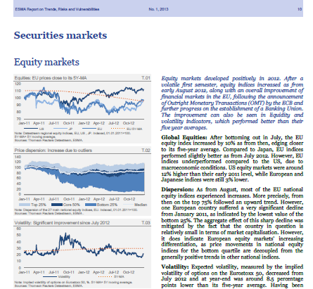


★ Make your stuff available on the Web under an open licence
Trends, risks and vulnerabilities in securities markets

Slide 16
Pros & cons of ★ open data
As a consumer... | As a publisher...
You can look at it. | It is simple to publish.
You can store it locally. | You do not have explain repeatedly to others that they can use your data.
You can enter the data into any other system.
You can change the data.
You can share the data with anyone.

Slide 17
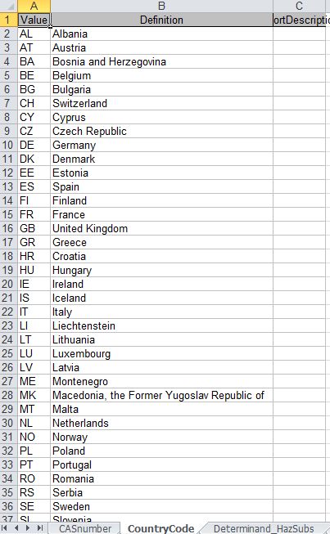
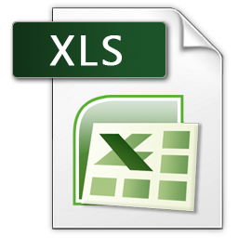
★ ★ Make it available as structured data
Waterbase - Emissions to water:
CountryCode

Slide 18
Pros & cons of ★ ★ open data
All the benefits of ★ open data; plus
As a consumer... | As a publisher...
You can directly process it with proprietary software to aggregate it, perform calculations, visualise it, etc. | It is still simple to publish.
You can export it into another (structured) format.

Slide 19
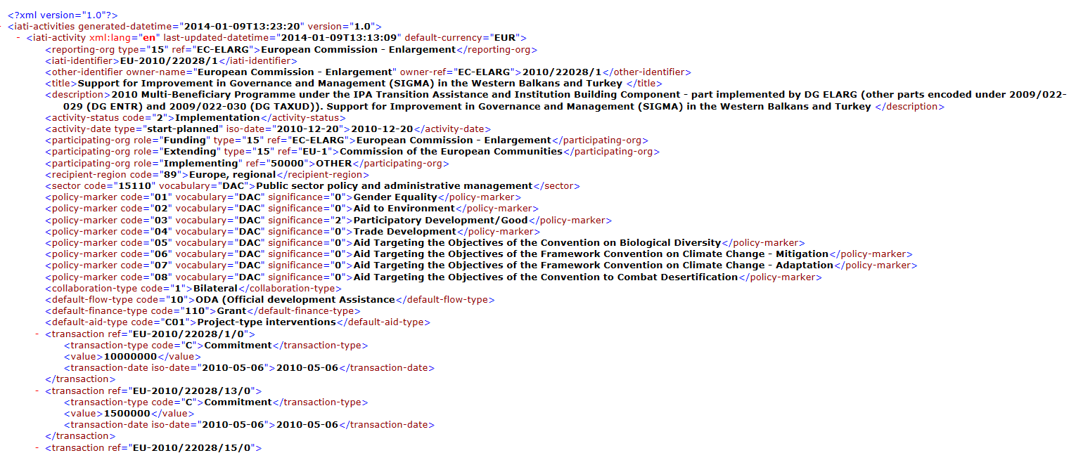
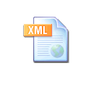
★ ★ ★ Use non-proprietary formats
Proprietary: Excel, Word, PDF...
Non-proprietary: XML, CSV, RDF, JSON, ODF...
DG Enlargement - Regional programmes:

Slide 20
Pros & cons of ★ ★ ★ open data
All the benefits of ★ ★ open data; plus
As a consumer... | As a publisher...
You can manipulate the data in any way you like, without being confined by the capabilities of any particular software. | It is still simple to publish.
 | - But, you do need converters or plug-ins to export the data from the proprietary format.

Slide 21
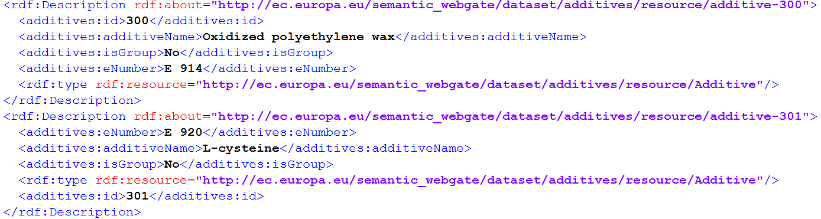
★ ★ ★ ★ Use URIs to denote things
Food Additives - http://open-data.europa.eu/en/data/dataset/0VSJ36wxUk9o0IbZVgVhEg
See also:
http://www.slideshare.net/OpenDataSupport/design-and-manage-persitent-uris

Slide 22
Pros & cons of ★ ★ ★ ★ linked open data
All the benefits of ★ ★ ★ open data; plus
As a consumer... | As a publisher...
You can link to it from any other place. | You have fine-granular control over the data items and can optimise their access.
You can bookmark it. | Other data publishers can now link into your data, promoting it to 5 star.
You can reuse parts of the data. | You will be able to reuse vocabularies, data and metadata, and URI design patterns instead of creating them from scratch.
You may be able to reuse existing tools and libraries.
You can combine the data safely with other data. | - But you typically need to invest some time in slicing and dicing your data.
- But understanding the technology requires effort and can have a steep learning curve.

Slide 23
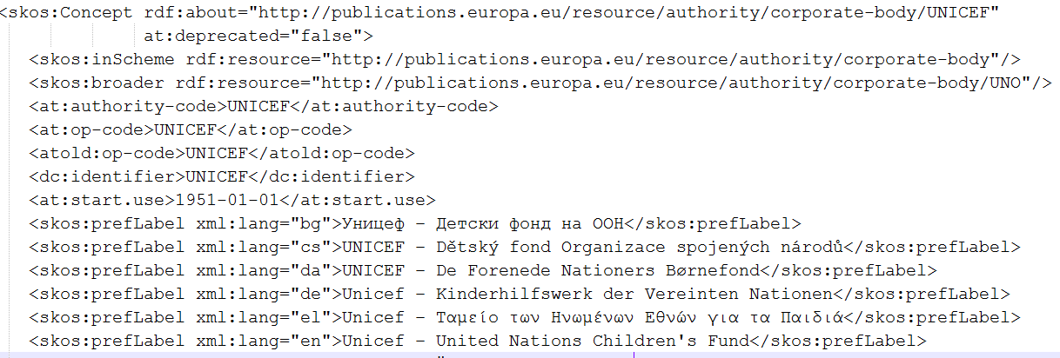
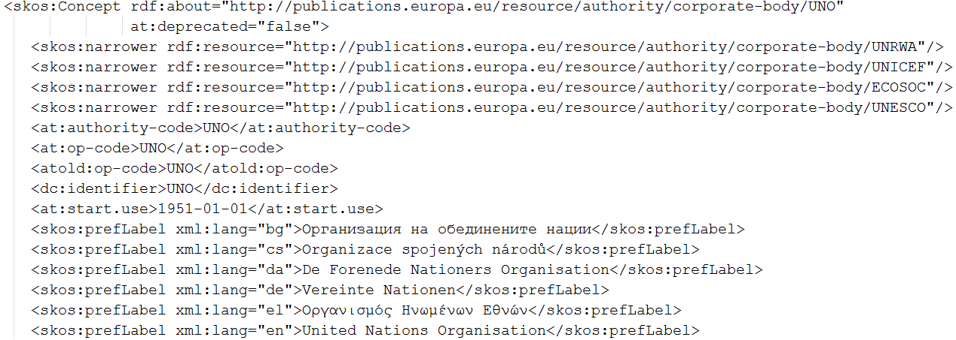
★ ★ ★ ★ ★ Link your data to other data to provide context
Corporate bodies NAL - http://open-data.europa.eu/en/data/dataset/SZGmLR0FFqWyJZN4ReBeNg

Slide 24
Pros & cons of ★ ★ ★ ★ ★ linked open data
All the benefits of ★ ★ ★ ★ open data; plus
As a consumer... | As a publisher...
You can discover more (related) data while consuming the data. | You make your data discoverable.
You can directly learn about the data schema. | You increase the context, expressivity, quality and value of your data (and consequently you give visibility to your organisation).
You can combine data from different source, be innovative, gain new knowledge, be an entrepreneur... | - This requires an investment in time, money, technology and competencies/ skills.
- But, you now have to deal with broken data links. Not all publishers/data sources will be reliable.

Slide 25
Example Using Open Refine for RDF to publish tabular data as Linked Data.

Slide 26

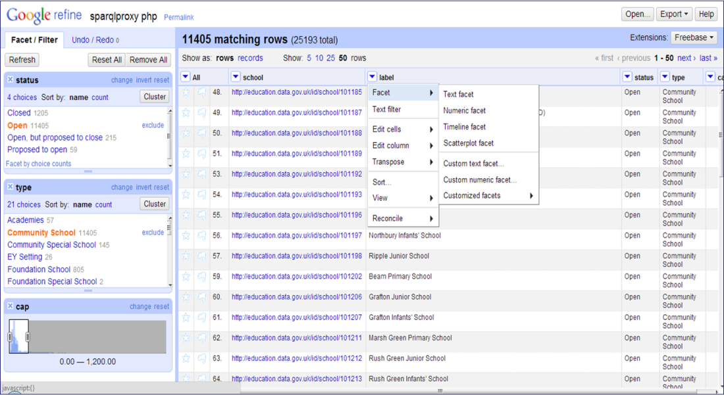
What is Open Refine
“OpenRefine (ex-Google Refine) is a powerful tool for working with messy data, cleaning it, transforming it from one format into another, ...”
- openRefine.org
See also:
Open Refine website
http://openrefine.org/

Slide 27
What is Open Refine RDF extension
Open Refine RDF extension, allows you to easily import data in different formats such as :
CSV;
Excel(.xls and .xlsx);
JSON;
XML; and
RDF/XML.
And then determine the intended structure of an RDF dataset, by drawing a template graph.
See also:
LOD 2 Webinar – Open Refine http://www.youtube.com/watch?v=4Ve93C238gI

Slide 28
Using Open Refine to model and publish open data Getting started
Install Open Refine from: https://github.com/OpenRefine
Install the RDF extension : http://refine.deri.ie/
And then...
Describe your data in a spreadsheet.
Create a project and upload it in Open Refine.
Map your data to appropriate RDF classes & properties.
Export the data in RDF.
1
2
3
4

Slide 29
Describe your data in a spreadsheet
1
Company_name | Registration date | Country | E-mail
Nikè | 1991-04-28 | BE | niké@sport.org
BARCO | 1986-09-05 | BE | Barco@email.be
Coca-Cola | 1964-03-26 | US | coca@cola.com

Slide 30
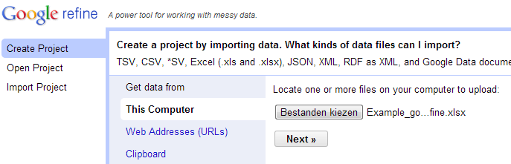
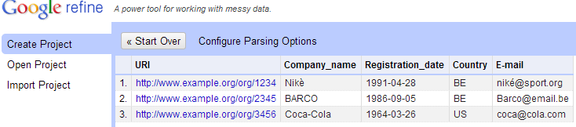
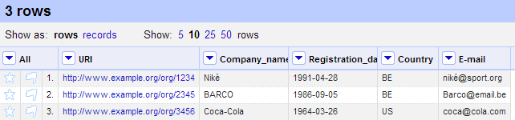
Create a project and upload it in Google Refine
2
Upload the spreadsheet
Select relevant tabs
Create the project

Slide 31
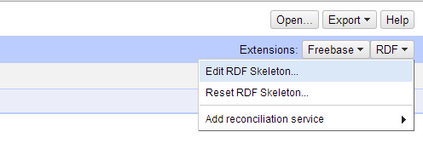
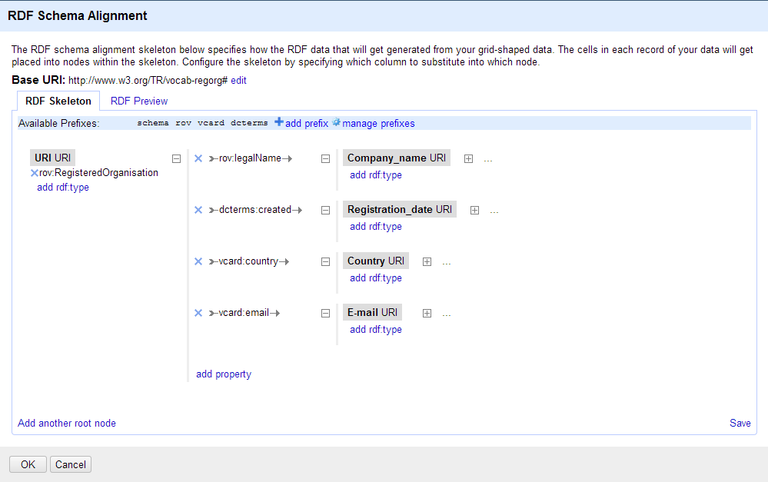
Map your data to appropriate RDF classes & properties (model your data)
3
Define a skeleton to transform your spreadsheet data to RDF

Slide 32
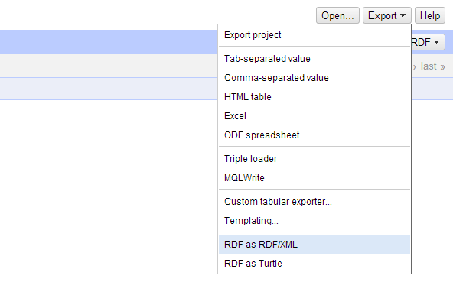
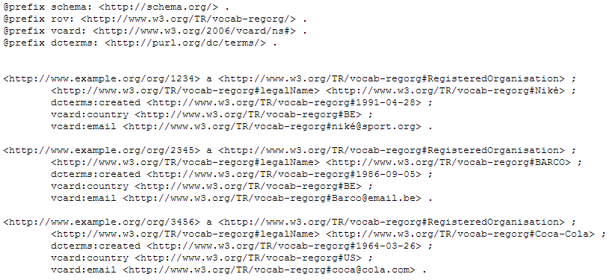
Export your data to RDF/XML or Turtle
4

Slide 33
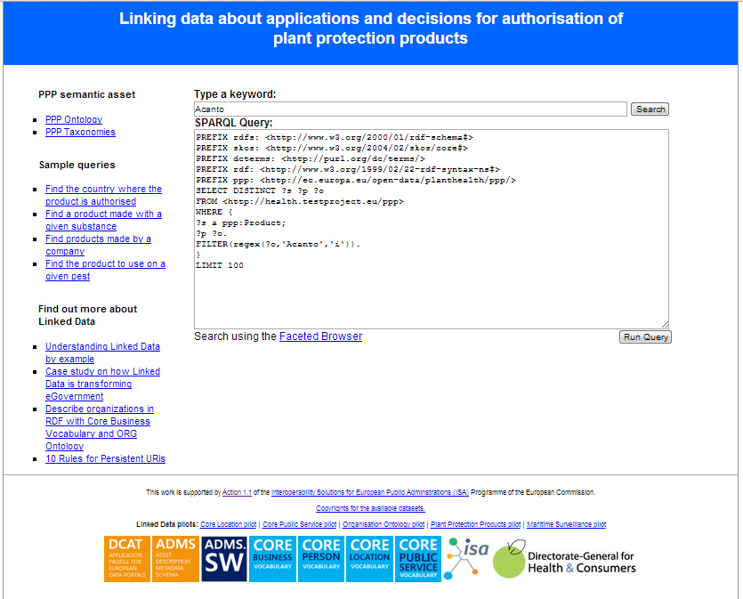
Case study: Linking data about plant protection products
We will show how a dataset of the Greek Ministry of Rural Development and Food was described using an ontology developed by DG Health and Consumers and was then published as Linked Data.
The dataset was in CSV format.
http://health.testproject.eu/PPP/
See also:
http://joinup.ec.europa.eu/asset/core_business/document/linking-data-about-applications-and-decisions-authorisation-ppp

Slide 34
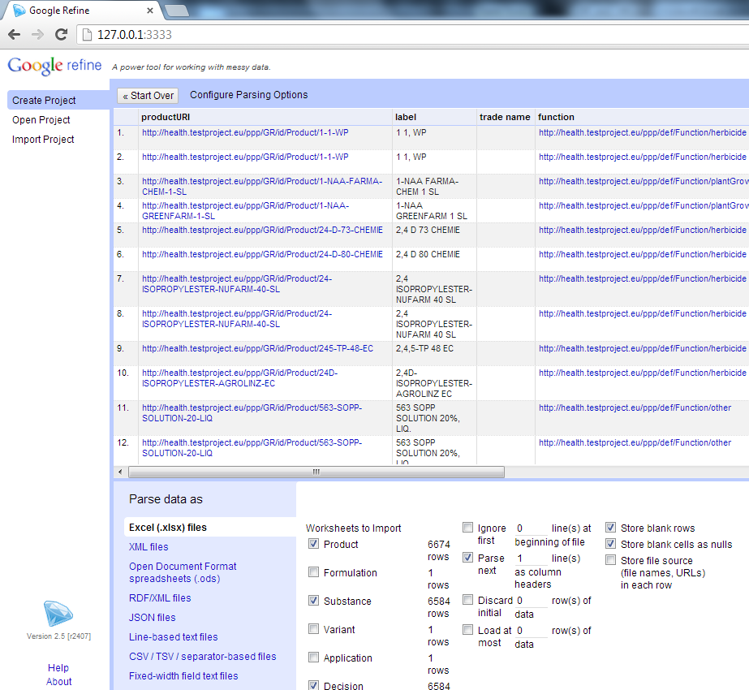
Creating the project in Open Refine
Make sure that Open Refine and the RDF extension are installed on your machine.
Launch Open Refine.
Upload the spreadsheet and selected the sheets that you want.
Confirm the creation of the project.

Slide 35
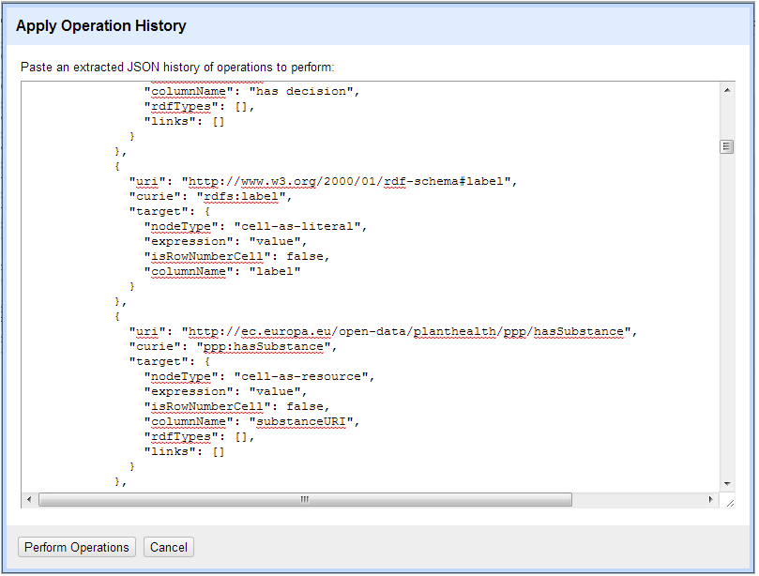
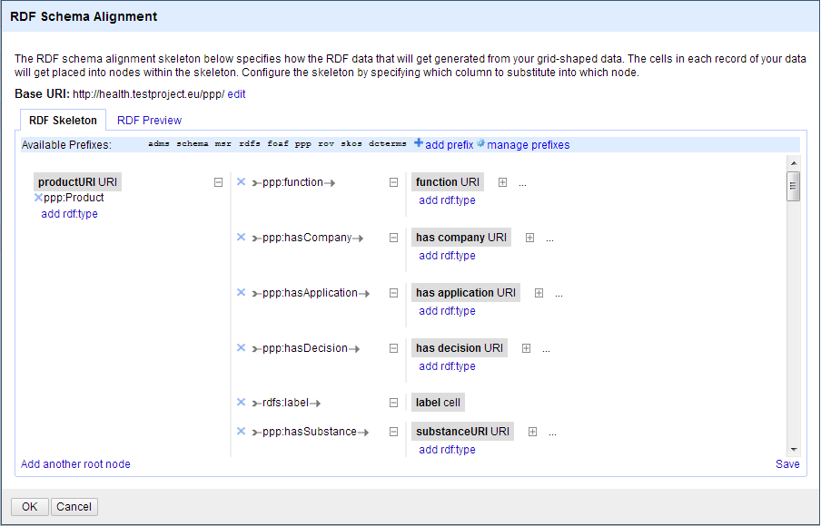
Mapping the raw data to the ontology
You can map the data to the ontology using a simple graphical interface to create or edit an existing RDF skeleton.
You can set the base URI for the data.
Graphical interface to edit an RDF skeleton
Graphical interface to copy/paste an existing RDF skeleton

Slide 36
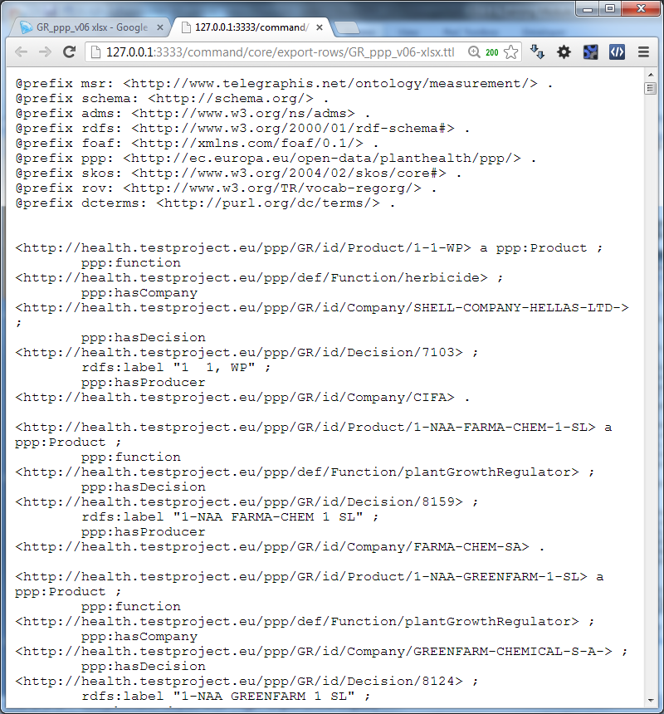
Exporting the data in RDF – Linked Data
You can now export your data in:
RDF/XML; or
Turtle
Export of the data in Turtle

Slide 37
Linked data initiatives in the EUIs

Slide 38










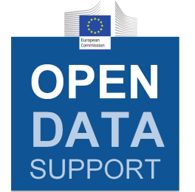





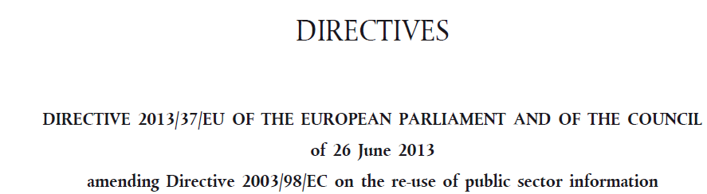
Linked Government Data & Metadata initiatives funded by the European Commission

Slide 39
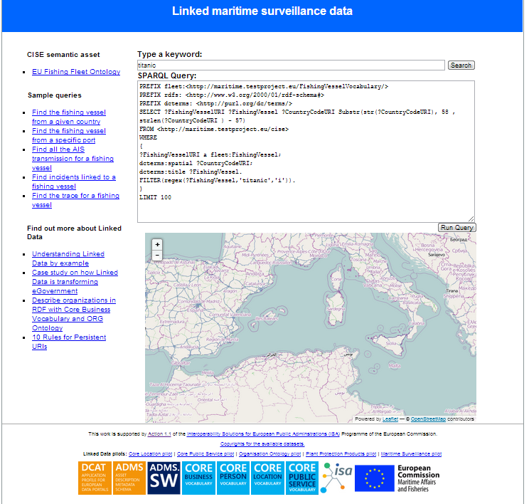
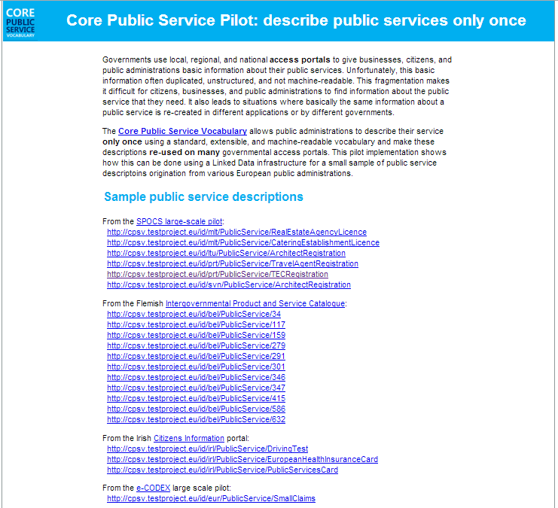
The Linked Government Data Pilots of ISA
http://health.testproject.eu/PPP/
http://maritime.testproject.eu/CISE/
http://cpsv.testproject.eu/CPSV/

Slide 40
Conclusions
Linked data is a set of design principles for sharing machine-readable data on the Web in a Data as a Service fashion;
URIs, RDF and SPARQL form the foundational layer for Linked data;
Linked data offers a number of advantages for:
Data integration with small impact on legacy systems;
Enabler to semantic interoperability;
Sparks new business models for data reuse.

Slide 41

Group questions
How would you encourage the supply and the demand for (Linked) Open Government Data from the EU Institutions?
What are, in your opinion, the expected benefits and pitfalls of Linked Data?
http://www.visualpharm.com
http://www.visualpharm.com

Slide 42
Thank you! ...and now YOUR questions?

Slide 43
References
EUCLID. Course 1: Introduction and Application Scenarios. http://www.euclid-project.eu/modules/course1
Linking Open Data cloud diagram, by Richard Cyganiak and Anja Jentzsch. http://lod-cloud.net/
ISA Programme. Case study on how Linked Data is transforming eGovernment. https://joinup.ec.europa.eu/community/semic/document/case-study-how-linked-data-transforming-egovernment
Tim Berners-Lee. Linked Data. http://www.w3.org/DesignIssues/LinkedData.html
The Open Knowledge Foundation. Open Data – An Introduction. http://okfn.org/opendata/
ISA Programme. D7.1.3 - Study on persistent URIs, with identification of best practices and recommendations on the topic for the MSs and the EC. https://joinup.ec.europa.eu/sites/default/files/D7.1.3%20-%20Study%20on%20persistent%20URIs.pdf
5 ★ Open Data. http://5stardata.info/
Open Refine: https://github.com/OpenRefine
RDF Extension: http://refine.deri.ie/

Slide 44


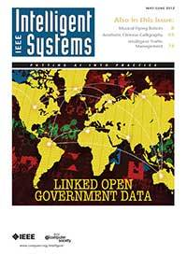
Further reading
Linked Open Data: The Essentials. Florian Bauer, Martin Kaltenböck.
http://www.semantic-web.at/LOD-TheEssentials.pdf
Linked Data: Evolving the Web into a Global Data Space. Tom Heath and Christian Bizer.
http://linkeddatabook.com/editions/1.0/
Linked Open Government Data. Li Ding Qualcomm, Vassilios Peristeras and Michael Hausenblas.
http://ieeexplore.ieee.org/stamp/stamp.jsp?tp=&arnumber=6237454
EUCLID - Course 1: Introduction and Application Scenarios
http://www.euclid-project.eu/modules/course1

Slide 45






Related projects and initiatives
LOD2 FP7 project, http://lod2.eu/
The Open Knowledge Foundation, http://okfn.org/
W3C Semantic Web, http://www.w3.org/standards/semanticweb/
EUCLID, http://projecteuclid.org/
ISA Programme, http://ec.europa.eu/isa/
W3C LOGD WG, http://www.w3.org/2011/gld/wiki/Main_Page
LOD Around The Clock FP7 project, http://latc-project.eu/
Data.gov.uk, http://data.gov.uk/linked-data

Slide 46





Be part of our team...
Find us on
Join us on
Open Data Support
http://www.slideshare.net/OpenDataSupport
Open Data Support
http://goo.gl/y9ZZI
http://www.opendatasupport.eu
Follow us
Contact us
@OpenDataSupport
contact@opendatasupport.eu

