Slide 1
Open Data Support Contributing to the development of the European data economy Nikolaos Loutas, Michiel De Keyzer, Leda Bargiotti PwC EU Services
PwC firms help organisations and individuals create the value they’re looking for. We’re a network of firms in 158 countries with close to 180,000 people who are committed to delivering quality in assurance, tax and advisory services. Tell us what matters to you and find out more by visiting us at www.pwc.com.
PwC refers to the PwC network and/or one or more of its member firms, each of which is a separate legal entity. Please see www.pwc.com/structure for further details.

Slide 2
This presentation has been created by PwC Authors: Nikolaos Loutas, Michiel De Keyzer and Stijn Goedertier
Presentation metadata
Disclaimer
The views expressed in this presentation are purely those of the authors and may not, in any circumstances, be interpreted as stating an official position of the European Commission.
The European Commission does not guarantee the accuracy of the information included in this presentation, nor does it accept any responsibility for any use thereof.
Reference herein to any specific products, specifications, process, or service by trade name, trademark, manufacturer, or otherwise, does not necessarily constitute or imply its endorsement, recommendation, or favouring by the European Commission.
All care has been taken by the author to ensure that s/he has obtained, where necessary, permission to use any parts of manuscripts including illustrations, maps, and graphs, on which intellectual property rights already exist from the titular holder(s) of such rights or from her/his or their legal representative.
Open Data Support is funded by the European Commission under SMART 2012/0107 ‘Lot 2: Provision of services for the Publication, Access and Reuse of Open Public Data across the European Union, through existing open data portals’(Contract No. 30-CE-0530965/00-17).
© 2014 European Commission

Slide 3
Context of Open Data Support

Slide 4
Open Data has a great potential to create social and economic value
Publishing data
Public administrations share data online
Developers / Companies integrate data into apps (services)
Developers / Companies search for data
Citizens/businesses benefit from the apps (services)
Reusing data

Slide 5
There are more than 150 portals in Europe hosting Open Government Data
Existing OGD Portal
150+

Slide 6
Limited accessibility and lack of (cross-border/sector) awareness of open datasets
Different metadata vocabularies
Limited accessibility and lack of awareness
Limited reuse of open datasets

Slide 7
No reuse = No social and economic value
Public administrations share data online
Developers / Companies integrate data into apps (services)
Developers / Companies search for data
Citizens/businesses benefit from the apps (services)

Slide 8
Open Data Support Description of the project

Slide 9
Introduction
Open Data Support is
A 36-month project that started on 1 January 2013
Funded by Unit D3 of DG CONNECT
Led by PwC Enterprise Advisory
Delivered by a great team comprising also Tenforce and Makx Dekkers.
Makx Dekkers

Slide 10
Our mission...
To improve the and facilitate the to datasets published on local and national Open Data portals in order to increase their within and across borders.

Slide 11
How?
... by providing
to description metadata of open datasets via a
Pan-European Data portal
ODIPP

Slide 12
We provide services in the area of Open Government Data
Publishing services
Training
services
Consulting services
We help (potential) Open Government Data publishers to prepare, transform and publish reusable metadata descriptions of their datasets.
We train public administrations across Europe on the value of (Linked) Open Government Data and help them build capacity in effectively and efficiently publishing data.
We provide consultancy services tailored to the needs of public administrations covering a wide spectrum of topics from IT to licensing of (Linked) Open Government Data.

Slide 13
We provide training services
Training
services
We train public administrations across Europe on the value of (Linked) Open Government Data and help them build capacity in effectively and efficiently publishing data.
Target audience
Policy makers and government officials
Government IT strategists
Government software engineers
What will you learn?
Comprehend and formulate the added value of Linked Open Government Data for your domain.
Understand the life cycle and the publishing requirements of Linked Open Government Data.
Acquire hands-on experience on Linked Government Open Data technologies.

Slide 14
Our training services
All trainings will be freely available online through Joinup.
We provide onsite trainings adapted to your needs.
Online training
Onsite
training
Find more on: training.opendatasupport.eu

Slide 15
Our main achievements
Metadata publishing services
We have put the Open Data Interoperability Platform (ODIP) into operations. ODIP supports metadata harvesting, harmonisation and publishing.
We have harvested so far 8 open data catalogs. More than 55000 descriptions of datasets – harmonised according to the DCAT-AP – are currently accessible via ODIP.
More national data portals in the pipeline.
Training services
We have deployed a popular online training service on Joinup and slideshare – the number of visitors is steadily increasing.
We have delivered 6 onsite trainings – more than 15 foreseen in 2014.

Slide 16
High-value datasets Prioritising the opening-up of public sector information

Slide 17
What is a dataset?
Example:
European Banking Authority - Credit Institutions Register
(URI: https://eportal.eba.europa.eu/cir/)
% of persons employed with ICT user skills
(URI: http://ec.europa.eu/eurostat/product?code=isoc_ic_biski)
“A collection of data, published or curated by a single agent, and available for access or download in one or more formats.”
- Data Catalogue Vocabulary (DCAT) - W3C
See also:
Data Catalog Vocabulary (DCAT) http://www.w3.org/TR/2014/REC-vocab-dcat-20140116/#class-dataset

Slide 18
Definition of high-value datasets
Publisher’s viewpoint. A public sector publisher may publish a dataset because of:
It contributes to transparency (G8 Open Data Charter)
Its publication is subject to a legal obligation
It directly or indirectly relates to their public task
It realises a cost reduction
The type and size of its target audience
Reuser’s viewpoint. The value in a dataset lies in its reuse and its potential for creating new applications, services and business models.

Slide 19
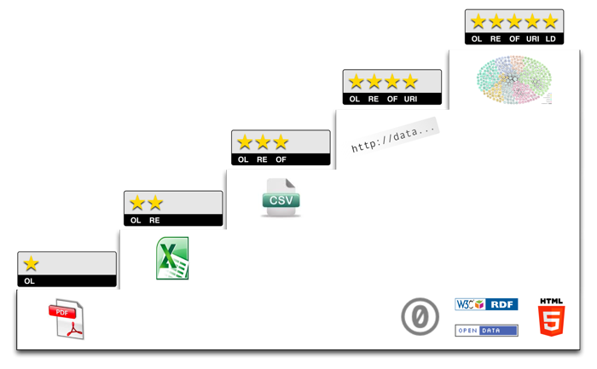
Maturity of a high-value dataset the journey from open to linked open data
http://5stardata.info/

Slide 20
Identification of high-value datasets
Type | #of datasets
Identified EU Institutions datasets not on the EU ODP (high-value) | 95
“EU implementation of the G8 Open Data Charter”-datasets | 8
Identified 2-star (or lower) high-value data on the EU ODP | 35
Work in progress!

Slide 21
High-value datasets - examples
Tendering information (TED)
Election & Parliament data
Financial Transparency System (FTS)
Commission staff directory
Statistics (Eurostat)
Legislation (EUR-Lex)
...
Your feedback!

Slide 22
Be part of our team...
Find us on
Join us on
Open Data Support
http://www.slideshare.net/OpenDataSupport
Open Data Support
http://goo.gl/y9ZZI
http://www.opendatasupport.eu
Follow us
Contact us
@OpenDataSupport
contact@opendatasupport.eu
Project Officer: Daniele.RIZZI@ec.europa.eu

Slide 23
Have you heard about the SEMIC project?
Visit semic.eu and know more about ISA Action 1.1 on semantic interoperability.
Project Officer: Vassilios.PERISTERAS@ec.europa.eu
Visit our initiatives
Get involved
Follow @SEMICeu on Twitter
Join SEMIC group on LinkedIn
Join SEMIC community on Joinup

Slide 24
Meet us also at SEMIC 2014
View the agenda here: https://joinup.ec.europa.eu/community/semic/event/semic-2014-semantic-interoperability-conference

