Slide 1
SOA and Open Source Technologies to leverage e-government potential: the case of LGAF Project @ KEDKE
Petros KAVASSALIS ATLANTIS Group@RACTI
Badajoz, Dec. 2010

Slide 2
new developments in the horizon
The diffusion of the Internet within an increasingly large part of the population and the effective exploitation of the available to enterprise Information Technologies is the cause of new modes to conduct e-government.
Harnessing the potential of enterprise integration technologies, public organizations can integrate the processes they deploy to provide services to citizens and businesses
across organizational and geographical frontiers and
by electronic communications, end-to-end

Slide 3
the challenge and the vision
A large number of e-government services requires from government agencies to exchange information and documents during the service delivery process.
Such transactions can be organized in a fully automated way
… similar to how e-business networks have established the electronic exchange of messages and the combination of processes between companies.
The result should
Improve the speed and efficiency of government services
Support interactivity
Multi-channel provision
Cross-border transport of “rich information” and documents

Slide 4
bend it like…
Governments should redefine strategies and investments in the area of e-government to leverage the potential of enterprise computing technologies
Service Oriented Architectures (SOA) have been emerging as the key integration approach in contemporary, complex, heterogeneous computing environments.
SOA in e-government appears now as the right framework for developing a new generation of e-services (e-government 2.0). Essentially the issue is
how to re-engineer legacy applications, and
develop new ones “from the existing”, by using SOA, EAI (Enterprise Architecture Integration) and BPMS (Business Process Management Systems).

Slide 5
primary strategy
Develop a batch of new, flexible, “composite” and user-friendly e-government applications
much like banks currently do with loan origination, claims management, case management etc.

Slide 6
the European Commission is backing
Through ISA Programme
http://ec.europa.eu/isa/
Supports electronic cooperation among public administrations in the EU Member States. The actions will help administrations to exchange information more easily and to deliver better services to citizens and businesses. ISA stands for 'interoperability solutions for European public administrations'
Use intelligently the ISA Interoperability Architecture Framework to your domain!

Slide 7
isa interoperability architecture framework

Slide 8
tip: open source technologies can help your administration…
… to manage a gradual / scalable transition
from the existing to
isa-like interoperability architectures
Open source enterprise technologies are thriving
content management systems
business process management systems
rules management systems
document management systems

Slide 9
open source enterprise technologies in the service of e-government: our experience: the LGAF project at KEDKE
LGAF = Local Government Access Framework (Project for “Coordination of Local Government Authorities” / ΚΕΔΚΕ)
LGAF is a platform
Supports Online Services to:
Local Citizens (e.g. Family Record Certificates, Municipal Tax Payments, Recycling of Electrical Appliances etc)
Business (e.g. Municipal Tax Payments)
Establishes online task management of the activities related to online services delivery
Public Employees
LGAF mission
Defines a framework for digitizing e-gov services provided by Local Government Authorities through the automation of business processes
Business Process Modeling and Execution
Data components Modeling and Document Modeling
Entrerpise Technologies-based Content Management

Slide 10
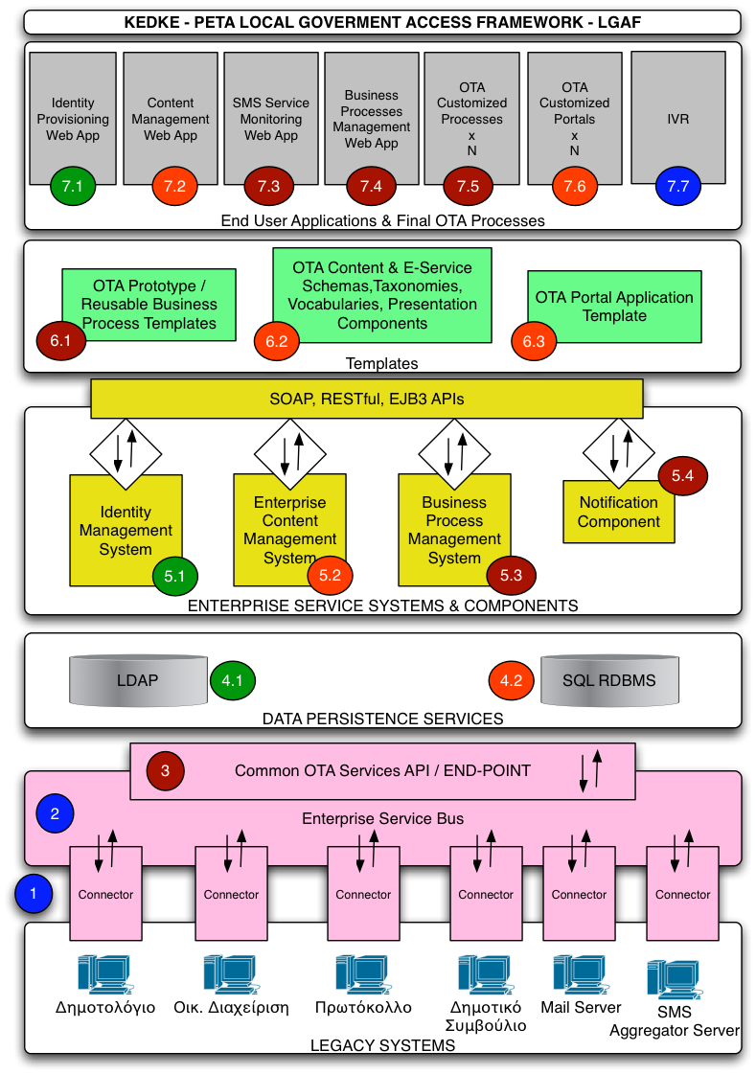
LGAF architecture in detail: a two parts system
+

Slide 11
LGAF architecture: core principles and core components
Core Principles
Design Impetus: Operate as an Open Platform (SOA)
Working Model: Software-as-a-Service (SaaS)
Core Components
Enterprise Service Systems and Components
Business Process Management System (BPMS)
Enterprise Content Management System (E-CMS)
Identity Management System (IMS)
LGAF Interface
LGAF portal + ServicesPortal
Enterprise Service Bus (ESB)
Gateway to Legacy Applications
Municipal ERP
Document Registration
Municipal Family Registry

Slide 12
LGAF architecture: core layers
BetaCMS|LGAFportal + LGAFServicesPortal (GWT)
Human Workflow Engine + LGAF ServicePortal
BetaCMS-based webapps (portal, wiki)
OTA Executable Process Models
OTA Content Management Standards and Models + Executable Templates
Business Process Management System (Intalio|BPMS)
Enterprise Content Management System (BetaCMS)
ESB (Mule)
core operations
OTA API (open to everybody)
core documents
WSDLs
Local ESB
OTA Legacy Systems

Slide 13
LGAF: open standards and open source software
Technology stack from a process management standpoint
Business Process Management (at the center)
Intalio|BPMS
GWT-based Interface for Process Participants (all interactions through a single UI)
Enterprise Service Bus (at the frontier)
Mule ESB
Enterprise Service Bus (at the Municipality level)
Mule ESB (could be anything else)
Data Transferring (inside and outside)
Web Services (SOAP Services)
Data Modeling
XML Schemas

Slide 14
LGAF follows EC standards for e-government services
European Interoperability Framework
Defines SOA as the proposed architecture
Use XML for Data Modeling And Transferring
Three layers of Interoperability
Organizational
Semantic
Technical
Greek e-GIF (e-Government Interoperability Framework)
Process Modeling, Reusable Business Services
Code Lists, Core Data Components, Data Types

Slide 15
LGAF and SOA
LGAF applies SOA principles
Everything is a service (ESB, processes, IAMS, E-CMS, BPMS), described through WSDL
Data exchange format in XML. SOAP is used for supporting data exchange. Data modeling is performed with XML Schemas
Loose coupled services (e.g. Municipal Portion Service) using the ESB
The BPMS Layer performs the orchestration of third systems (legacy apps etc.) and humans (participants) to create Composite Services and Applications

Slide 16
Business Process Model
Orchestration

Slide 17
does LGAF have orchestration limits? only the sky! [see next page]
LGAF is a core of OS technologies “at the center
Open to integrate, at the “periphery”, with vendor or OS
Third-party Systems
Applications
Example: document management system
Example: fines collection system (PDA-enabled)
Example: e-payment systems
Credit and Debit Cards: Re-direction
E-banking
(Transaction Validation)
Example: micro-payments system
Re-direction to IPX payment page

Slide 18
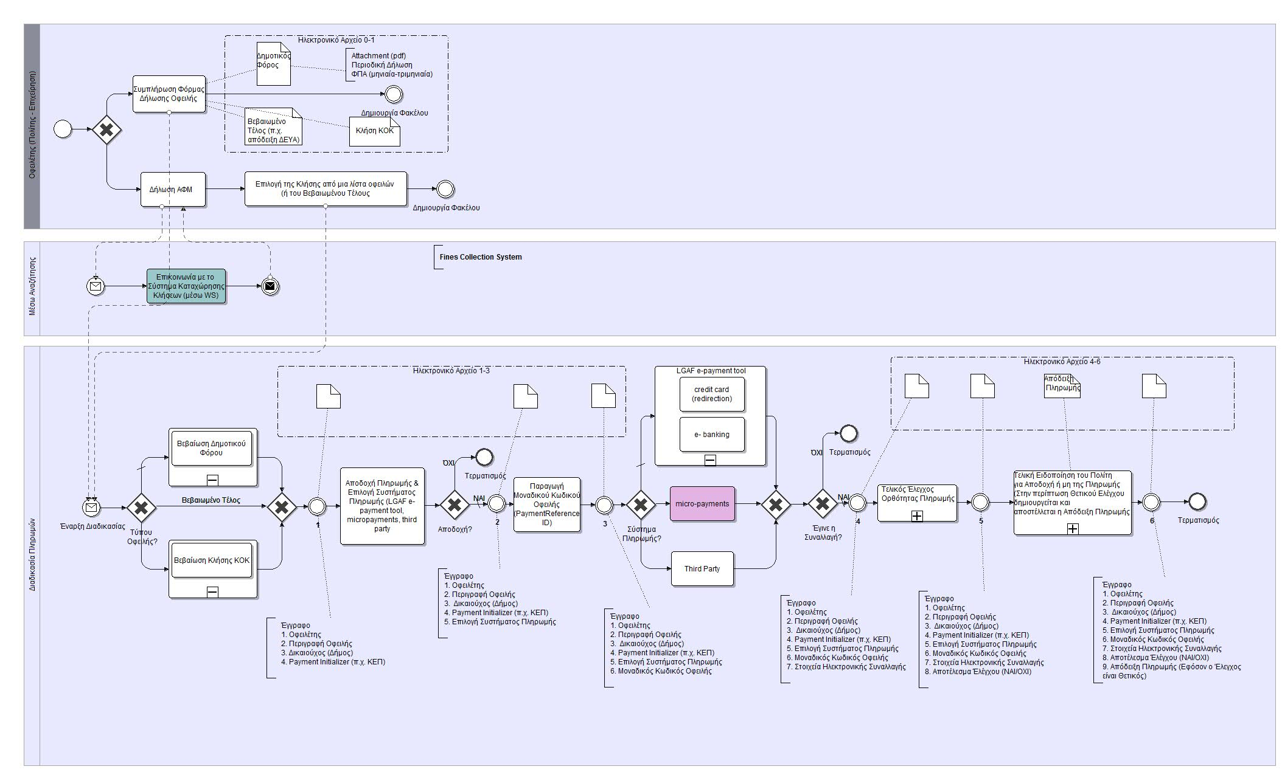
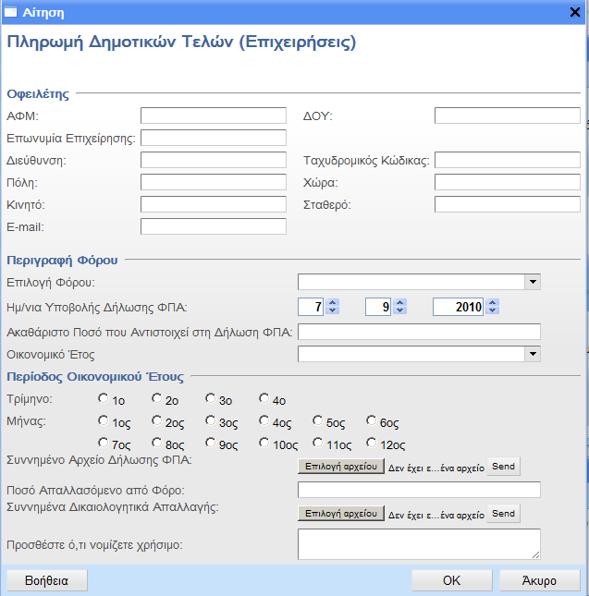
tax and fines payment: a case of an open-designed process
Process “hides” behind an evolving document evolution. In each step document is enhanced with information related to the process. Basic components
Initializer
Payer
Payee
Tax Description
Payment System Vendor
Transaction Details
Validation Details and Receipt
Citizen Fills the Tax Description
to the Appropriate Form (mini Portal).
Route to the payment way. Citizen can pay:
Credit Card (LGAF e-payment tool)
E- banking (LGAF e-payment tool)
Micro payment (Ericsson)
Something Else….
Sub process: Citizen is notified about the payment status and if the validation is positive receives the receipt
Sub process: Employee check the validity of payment transaction. If the validation is positive, Back office produces the receipt number of the payment
Citizen is informed About the Final Amount.
Accepts or not the Payment
A unique key that describes the payment values is produced
Check if the Tax is Affiliated or non. The Tax is Registered in Municipal BackOffice
18

Slide 19
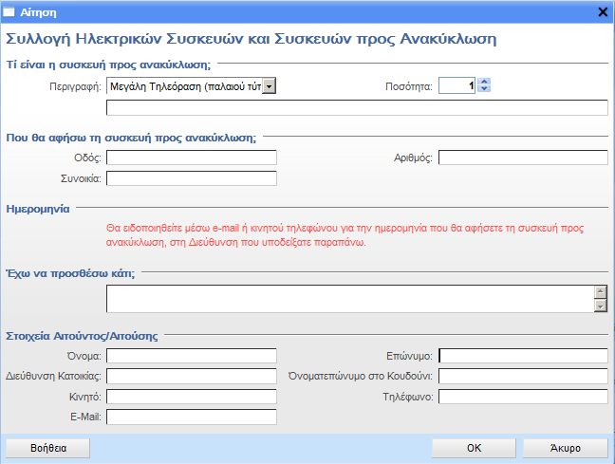
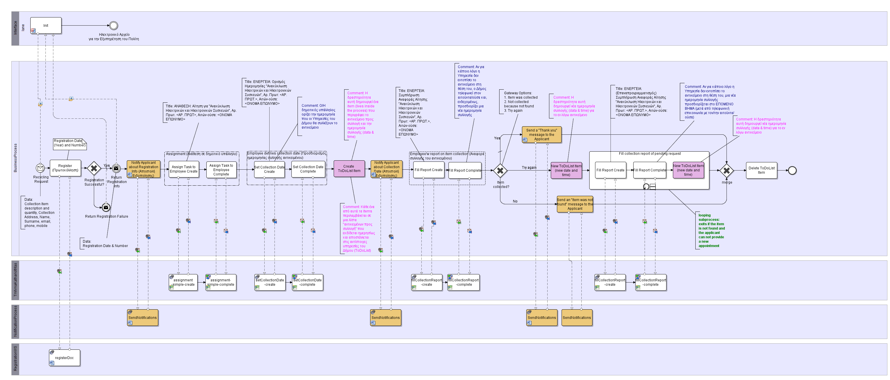
case: recycling of electrical appliances
Request Form
To do list Creation
If Item not collected the procedure is repeated
Task Assignment to an employee or department. Set Collection Date, or do collect or fill a report
Notify Citizen about the status of the request
Registration
19

